Slide 1
EUV Imagers & Space Weather Forecasting
Matthew J West
Notes:
Good afternoon I'm going to be continuing the discussion on EUV imagers, but this time focusing more on some of the physical restrictions on such an instrument, and if I have time introducing some interesting potential forecasting tools that might be used with L5 and L1 EUV imagers.

Slide 2
Current EUV Instrumentation

Slide 3
Cadence
SOHO-EIT (720s)
TRACE (10s)
STEREO-EUVI (120s)
PROBA2-SWAP (100s)
SDO-AIA (5s)
HI-C (5s)
GOES R-SUVI (10s)
Solar Orbiter - FSI (<600s)
Notes:
What are the advantages of the different cadences?

Slide 4
Resolution - arcsec / px
SOHO-EIT (2.6)
TRACE (0.5)
STEREO-EUVI (1.6)
PROBA2-SWAP (3.1)
SDO-AIA (0.6)
HI-C (0.1)
GOES R-SUVI (2.5)
Solar Orbiter - FSI (9)*Perihelion
Notes:
These imagers have had a range of resolutions, going all the way down to High resolution 0.6 arc-seconds per pixel AIA observations

Slide 5
Field of view
Solar Orbiter – FSI (Potential at perihelion)
SDO-AIA
SOHO-EIT
GOES-SUVI
PROBA2 - SWAP
STEREO - EUVI
Notes:
Similarly we have had a range in Fields of view, ranging from around 54 arc minute observations of PROBA2 SWAP and EUVI observations, down to AIA with a FOV around 40 arc minutes.
PROBA2 – SWAP - 54
GOES-SUVI
SOHO-EIT
SDO-AIA - 40
STEREO-EUVI

Slide 6
considerations when choosing an euv imager
Notes:
With an L1 or an L5 mission, you may not have the chance to fly multiple passbands, so which do you choose? At L1 can you rely on SUVI? At L5, you probably won’t be able to carry such a large payload, and will you want filter wheels on an operational mission.

Slide 7
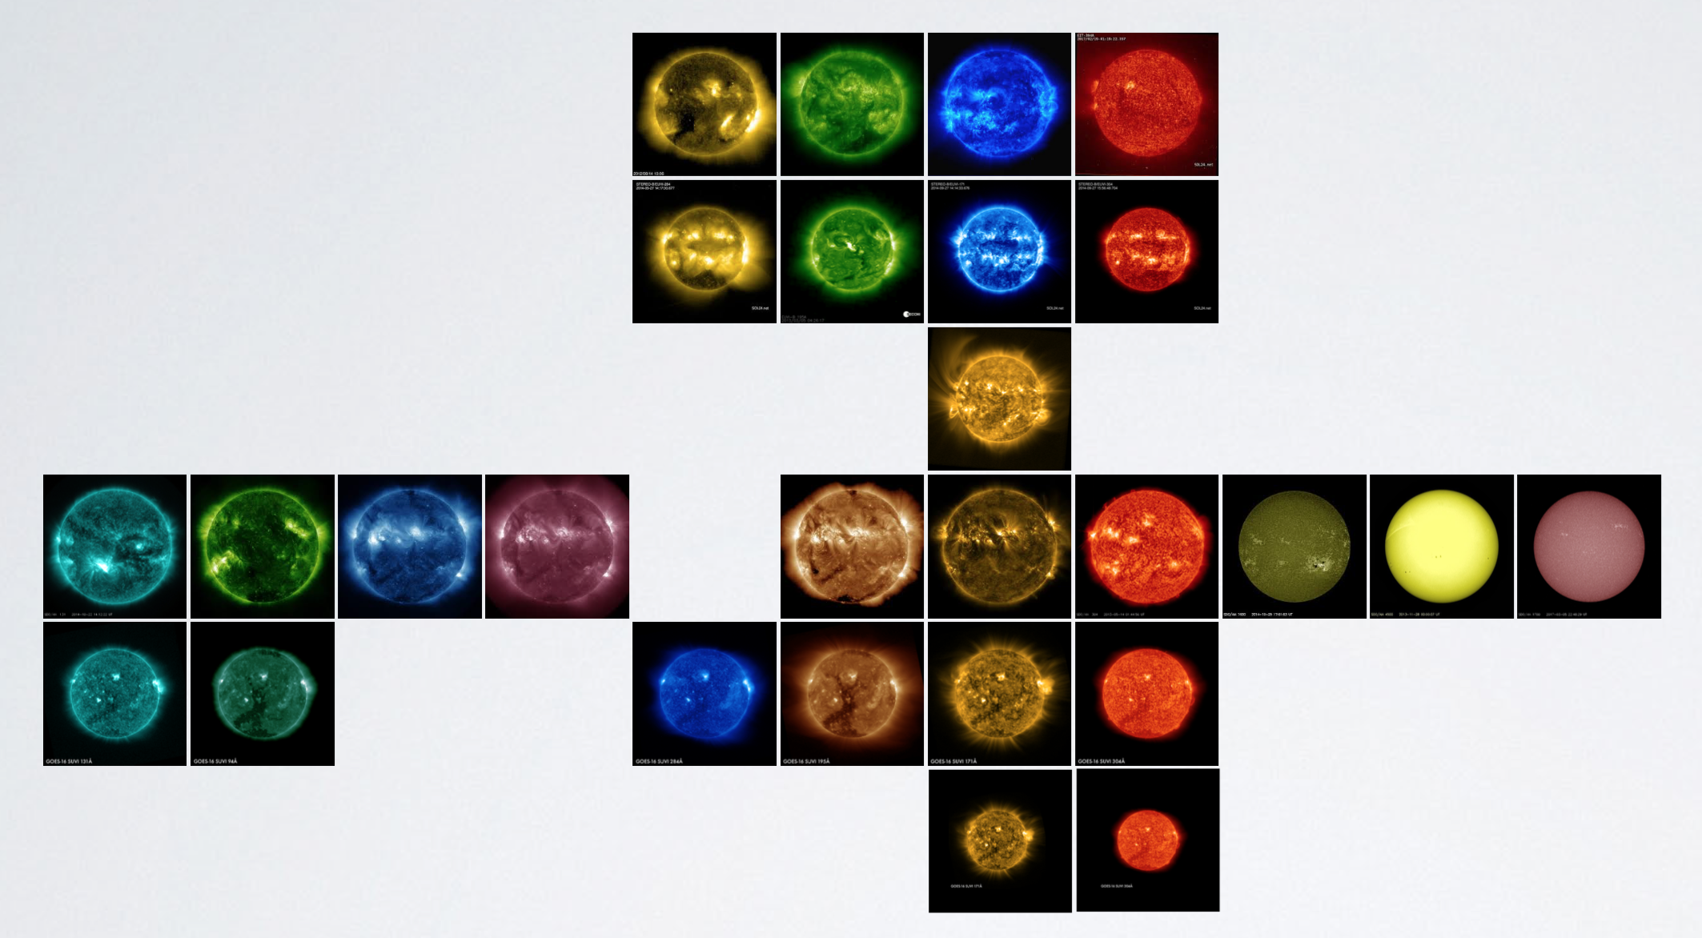
Wavelengths
SOHO-EIT
STEREO-EUVI
PROBA2-SWAP
SDO-AIA
GOES R-SUVI
SO-FSI
13.1
9.4
33.5
21.1
28.4
30.4
160
450
170
Wavelength /Å
19.3-19.5
17.1-17.4
Notes:
Through this range of imagers, we have had the privilege of viewing the sun through a wide range of passbands

Slide 8
Wavelengths
SOHO-EIT
STEREO-EUVI
PROBA2-SWAP
SDO-AIA
GOES R-SUVI
SO-FSI
Wavelength /Å
13.1
9.4
33.5
21.1
28.4
19.5
17.4
30.4
160
450
170
6,000
4,500
Temperature /K
50,000
10,000
6 million
2 million
600,000
2 million
10 million
2.5 million
1 million
Notes:
Ranging from the photospheric temperatures to around 10 million degrees

Slide 9
Wavelengths
SOHO-EIT
STEREO-EUVI
PROBA2-SWAP
SDO-AIA
GOES R-SUVI
SO-FSI
Regions of interest
Active regions
Corona &
hot flare plasma
Photosphere
Active regions
Flaring regions
Active regions
Flaring regions
Chromosphere &
transition region
Temperature min,
photosphere
Quiet corona, upper
transition region
Transition region &
upper photosphere
Notes:
Although several of these passbands can see multiple solar phenomena most were designed to focus on particular solar features, with the cooler passbands designed to look at the photosphere and transition region, then trusty 304 looking at the chromosphere, filaments and prominences. We then see the 17 and 19 nm lines which are useful for looking at dynamic phenomena, coronal holes and the quiet sun, before moving into the hotter passbands which are used for looking at active regions and flaring regions.

Slide 10
Wavelengths
Solar phenomena
filaments
Coronal holes
Active regions
CMEs / dimming / EUV waves
Flaring dynamics
Quiet regions
Wavelength /Å
13.1
9.4
33.5
21.1
28.4
30.4
19.3-19.5
17.1-17.4
Notes:
Courtesy of: http://www.goes-r.gov

Slide 11
Wavelengths
Solar phenomena
filaments
Coronal holes
Active regions
CMEs / dimming / EUV waves
Flaring dynamics
Quiet regions
Wavelength /Å
13.1
9.4
33.5
21.1
28.4
30.4
19.3-19.5
17.1-17.4
Notes:
From the perspective of an operational space weather mission - Courtesy of: http://www.goes-r.gov

Slide 12
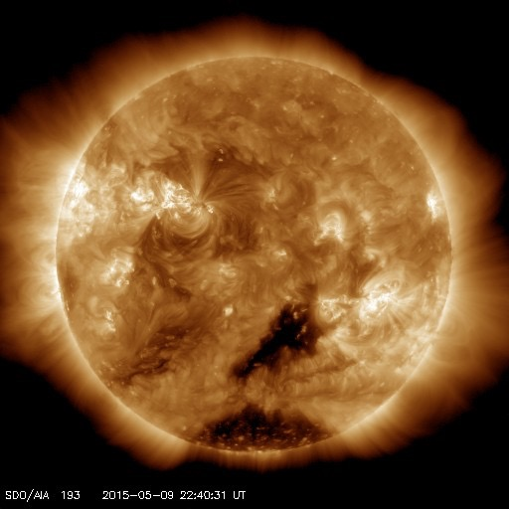
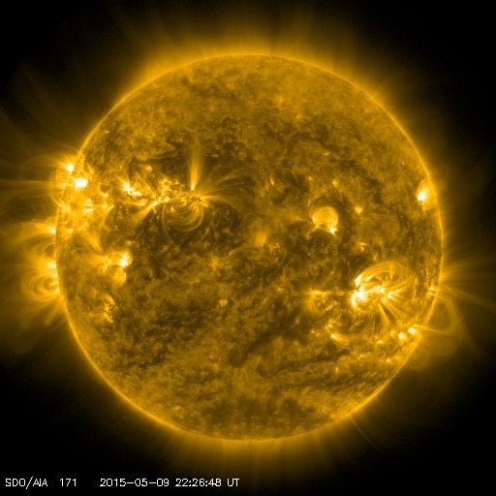
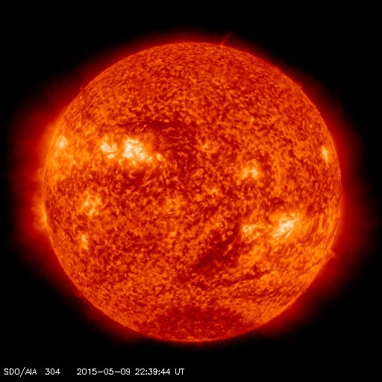
optimal euv imager bandpasses
Must show the million degree corona.
19.5 (28.4, 21.1?), 17.4 or 30.4 nm bandpasses
Physical restrictions
aperture, focal length, mirror size
Notes:
So as Bob discussed before, we’re interested seeing activity in the million degree corona, and the three pasbands listed here are sufficient for all our space weather monitoring needs but we will also have to consider physical restrictions such as aperture, focal length and mirror size.

Slide 13
optimal euv imager bandpasses
30.4 nm bandpass
Filaments & prominences
Lower coronal hole & active region contrast.
Notes:
So to begin with, if you have room, it would be nice to include a chromospheric imager for monitoring prominences and filaments. But the passband doesn’t have the contrast for tracking coronal holes or eruptive associated activity
imagers

Slide 14
optimal euv imager bandpasses
17 nm bandpass
Contains Fe IX, X and XI
Strong flux
Homogenous temperature response peaking at 1 MK.
Coronal holes, dimmings, waves, eruptions* *lower contrast
Notes:
Next we have the 17nm passband, with which you can see coronal holes, waves and eruptions with a reasonable contrast, and this line has the added advantage of a strong flux, allowing us to have a smaller aperture and physical instrument.

Slide 15
optimal euv imager bandpasses
19.5 nm bandpass
Centered on Fe XII
Weaker flux (compared to 17 nm)
Dimmings, waves and coronal holes have better contrast
Solar flares brighter (presence of the Fe XXIV emission line formed only within flaring plasma at
T > 10 MK.)
Notes:
Then we have the 195 passband, which offers the most contrast for viewing coronal holes, waves and eruptive phenomena, but may require a slightly bigger unit to actually achieve a good signal. This is probably the optimal passband to be included for a space weather operational mission, offering observations of several dynamic phenomena with good contrast, allowing the ability to apply automated tracking routines. But given size restrictions, the 17 nm passbands would be sufficient

Slide 16
FOV
Notes:
Next we need to consider the Field of View.

Slide 17
Notes:
Here we can see a movie of SWAP EUV observations, which offers the largest FOV from an Earth orientated imager. And in recent years there has been increased interest in the structures in the middle corona, this region about a solar radii around the Sun. Where I want to draw your attention to these large fan and loop structures. These structures provide the medium through which eruptions are accelerated and decelerated.

Slide 18
Other considerations
Notes:
And I just wanted to follow up with a couple of other considerations

Slide 19
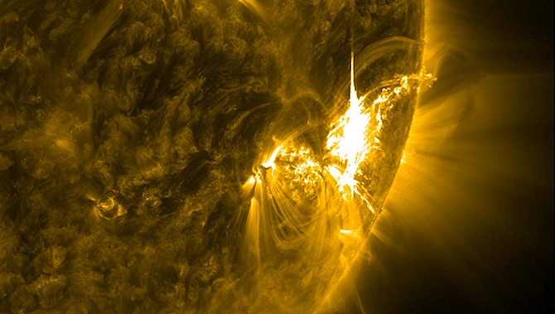
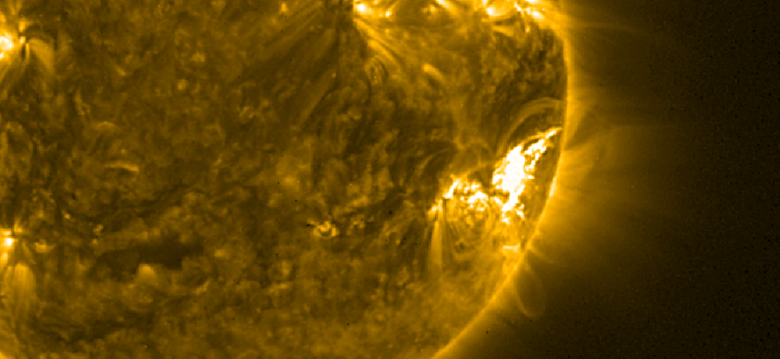
Type of detector - blooming
CCD
CMOS
Notes:
Firstly the type of detector, at L5, we’ll probably be looking to run some onboard detection algorithms, and we would need to be careful with ccd blooming affects. Therefore I’d advocate a CMOS the detector, similar to that being deployed on Solar orbiter.

Slide 20
Imager characteristics
 | L5 | L1
Resolution | 3.2 arcsec / px | ≥3.2
Pixels | 1024 | ≥1024
FOV | 54 arcmin (SWAP) | 41 arcmin (SDO)
Power | 2.6 W
Length | 565 mm
Weight | 11 kg
Type | CMOS
Size restrictions can dictate passband
Do we want filter wheels on an operational mission
Notes:
Just to conclude, I’d be interested in seeing a large FOV imager at L5 so we can not only track on disk structures, but also monitor out to 1 solar radii. I’d consider about 54 arcmin, as beyond this the signal is probably too weak without enhanced observation times. a 1k detector is sufficient for operational needs. Here I highlight some of SWAP power and size characteristics, just to show it is possible to deploy a light weight low power EUV imager. However you need to consider the size may dictate which passbands you can use.

