Slide 1
SW3 Software development
M.J West ☀︎ 08 Nov 2016 ☀︎ PDR

Slide 2
M.J West ☀︎ 08 Nov 2016 ☀︎ PDR ☀︎ observation scenarios
mission environment
The mission environment will strongly dictate the amount of processing that needs to be performed onboard.
Image processing requirements can be split between those that will be performed onboard and those that will be performed on-ground.
If onboard CME detection is to be performed, the onboard processors will have to perform more sophisticated routines such as image processing e.g.
Image processing. E.g. generate difference-images, filtering, brightness correction, etc
Mathematical routines. E.g. hough transform, array manipulation, etc.
The OBS will also need access to satellite information, such as pointing, timing and position, either to be used onboard with image manipulation, or to be added as meta-data to the final images.
Notes:
The mission environment will strongly dictate the amount of processing that needs to be performed onboard and consequently the burden on the DHU. Earth orbits are subject to both Lunar and Earth occultations and geo-orientated radiation, but generally have the advantage of higher telemetry rates, whereas solar orbits (L1 and L5) don't suffer from occultations but generally have lower telemetry available and are subject to Solar Energetic Particles (SEPs).
Image processing requirements can be split between those that will be performed onboard and those that will be performed on-ground. If onboard CME detection is to be performed, the onboard processors will have to perform more sophisticated routines such as image processing (e.g. to generate difference-images, filtering, brightness correction, etc), mathematical routines (e.g. hough transform, array manipulation, etc), and provide sufficient image storage.
The OBS will also need access to satellite information, such as pointing, timing and position, either to be used onboard with image manipulation, or to be added as meta-data to the final images. For example several automated detection routines rely on the difference-image technique to help estimate the speeds of CMEs. Generating such difference images requires precise knowledge of the satellite pointing, so that images can be accurately combined and the size of the Sun, which may vary in some orbits. Creating difference images with insufficient pointing knowledge could lead to false brightness features, and subsequently false CME detections.

Slide 3
M.J West ☀︎ 08 Nov 2016 ☀︎ PDR ☀︎ observation scenarios
scenarios
High cadence images are transmitted.
Low cadence images are prioritised are transmitted.
Low cadence images are transmitted to the ground.
CME detection is performed onboard and selected data is transmitted
CME detection is performed onboard and only CME characteristics are transmitted.
Notes:
1. High cadence images are continually transmitted to the ground. In this scenario, images are acquired and transmitted providing a continuous stream of data where ground based automatic / manual detection algorithms are applied. This scenario requires a fixed geo-stationary orbit or multiple ground stations to provide a continual link with a satellite elsewhere.

Slide 4
M.J West ☀︎ 08 Nov 2016 ☀︎ PDR ☀︎ observation scenarios
scenarios
High cadence images are transmitted.
Low cadence images are prioritised are transmitted.
Low cadence images are transmitted to the ground.
CME detection is performed onboard and selected data is transmitted
CME detection is performed onboard and only CME characteristics are transmitted.
Notes:
1. High cadence images are continually transmitted to the ground. In this scenario, images are acquired and transmitted providing a continuous stream of data where ground based automatic / manual detection algorithms are applied. This scenario requires a fixed geo-stationary orbit or multiple ground stations to provide a continual link with a satellite elsewhere.

Slide 5
M.J West ☀︎ 08 Nov 2016 ☀︎ PDR ☀︎ observation scenarios
scenarios
High cadence images are transmitted.
Low cadence images are prioritised are transmitted.
Low cadence images are transmitted to the ground.
CME detection is performed onboard and selected data is transmitted
CME detection is performed onboard and only CME characteristics are transmitted.
Notes:
1. High cadence images are continually transmitted to the ground. In this scenario, images are acquired and transmitted providing a continuous stream of data where ground based automatic / manual detection algorithms are applied. This scenario requires a fixed geo-stationary orbit or multiple ground stations to provide a continual link with a satellite elsewhere.

Slide 6
M.J West ☀︎ 08 Nov 2016 ☀︎ PDR ☀︎ observation scenarios
scenarios
High cadence images are transmitted.
Low cadence images are prioritised are transmitted.
Low cadence images are transmitted to the ground.
CME detection is performed onboard and selected data is transmitted
CME detection is performed onboard and only CME characteristics are transmitted.
Notes:
1. High cadence images are continually transmitted to the ground. In this scenario, images are acquired and transmitted providing a continuous stream of data where ground based automatic / manual detection algorithms are applied. This scenario requires a fixed geo-stationary orbit or multiple ground stations to provide a continual link with a satellite elsewhere.

Slide 7
M.J West ☀︎ 08 Nov 2016 ☀︎ PDR ☀︎ observation scenarios
scenarios
High cadence images are transmitted.
Low cadence images are prioritised are transmitted.
Low cadence images are transmitted to the ground.
CME detection is performed onboard and selected data is transmitted
CME detection is performed onboard and only CME characteristics are transmitted.
Notes:
1. High cadence images are continually transmitted to the ground. In this scenario, images are acquired and transmitted providing a continuous stream of data where ground based automatic / manual detection algorithms are applied. This scenario requires a fixed geo-stationary orbit or multiple ground stations to provide a continual link with a satellite elsewhere.

Slide 8
M.J West ☀︎ 08 Nov 2016 ☀︎ PDR ☀︎ observation scenarios
scenarios
High cadence images are transmitted.
Low cadence images are prioritised are transmitted.
Low cadence images are transmitted to the ground.
CME detection is performed onboard and selected data is transmitted
CME detection is performed onboard and only CME characteristics are transmitted.
Notes:
1. High cadence images are continually transmitted to the ground. In this scenario, images are acquired and transmitted providing a continuous stream of data where ground based automatic / manual detection algorithms are applied. This scenario requires a fixed geo-stationary orbit or multiple ground stations to provide a continual link with a satellite elsewhere.

Slide 9
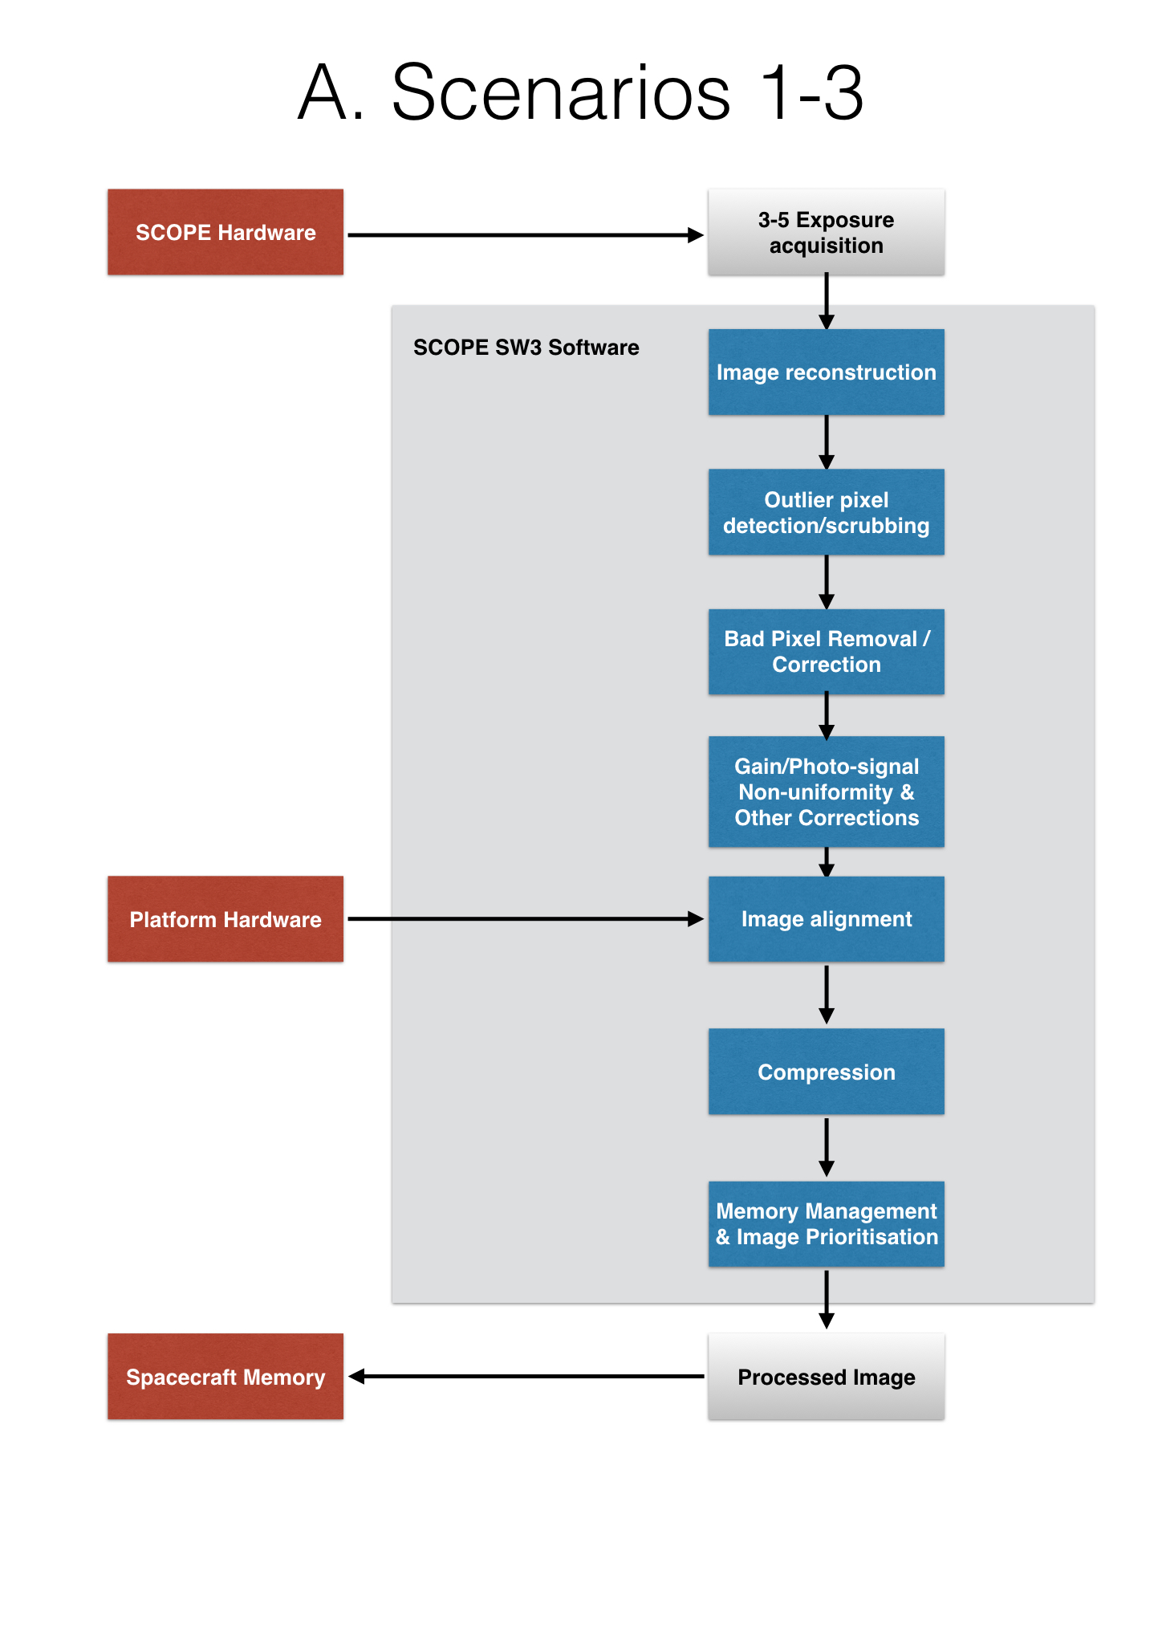
M.J West ☀︎ 08 Nov 2016 ☀︎ PDR ☀︎ observation scenarios
A. Scenarios 1-3

Slide 10
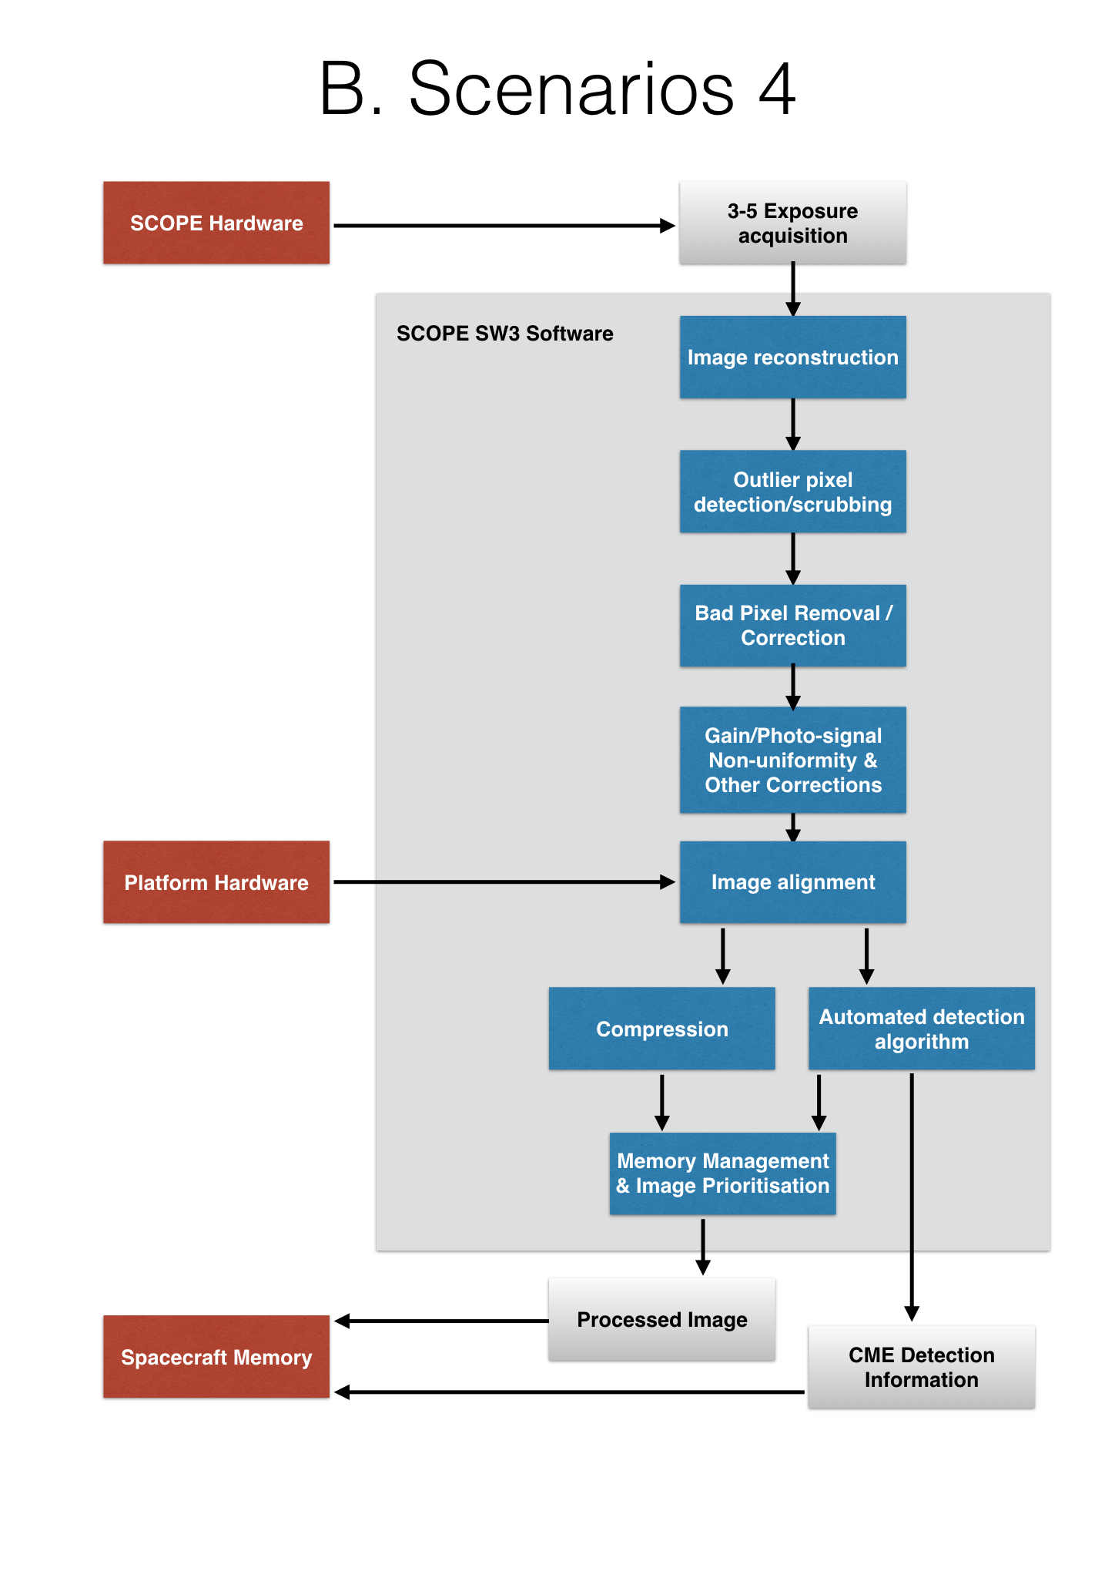
M.J West ☀︎ 08 Nov 2016 ☀︎ PDR ☀︎ observation scenarios
B. Scenarios 4

Slide 11
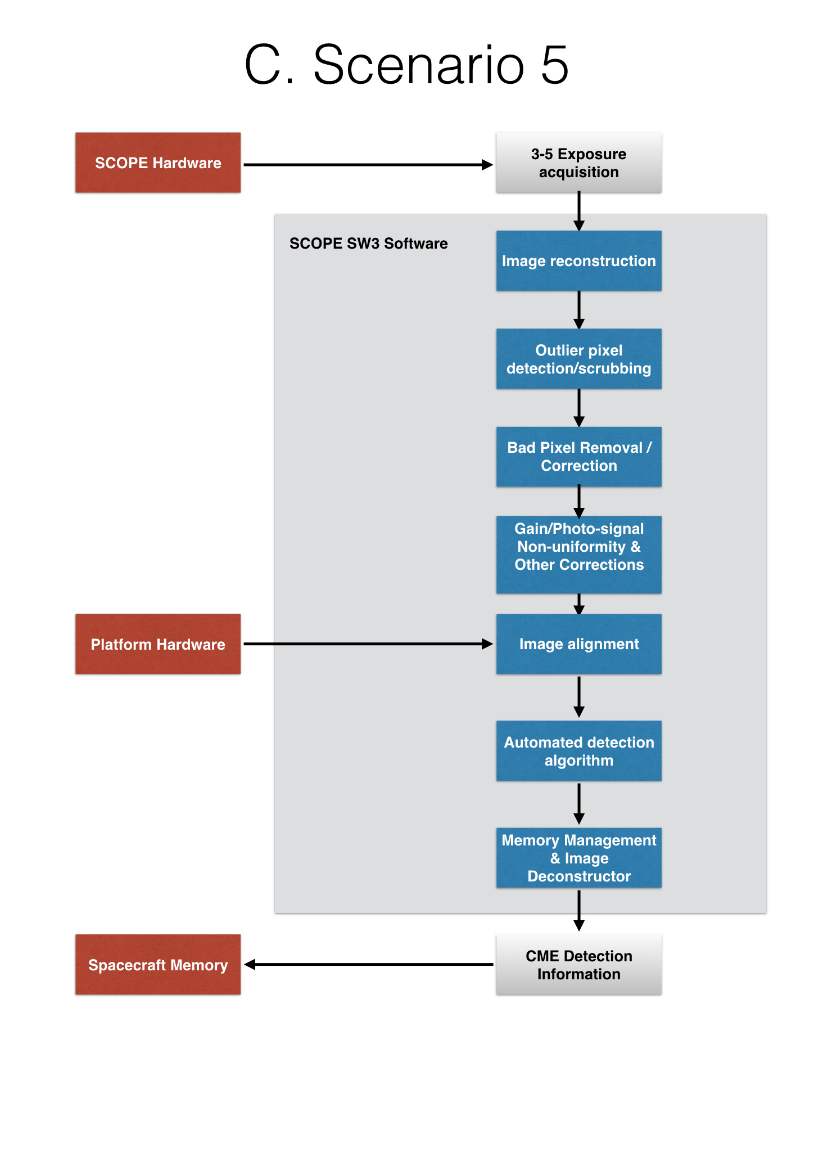
M.J West ☀︎ 08 Nov 2016 ☀︎ PDR ☀︎ observation scenarios
C. Scenarios 5

Slide 12
M.J West ☀︎ 08 November 2016 ☀︎ onboard detection
issues with onboard detection
A feasibility study comparing automated CME detection vs manual detection was presented in RAL-SCOPE-RB-001 SCOPE Requirements.
SEEDs, CORIMP, ARTEMIS and CACTus were compared to CDAW.
Notes:
In the ‘RAL-SCOPE-RB-001 SCOPE Requirements Baseline Issue’ document a feasibility study comparing automated CME detection vs manual detection was presented, where several automated CME detection algorithms were discussed (SEEDs, CORIMP, ARTEMIS and CACTus) and their efficiency presented and compared to the CDAW manual CME catalogue (Yashiro et al., 2008). (See also Gopalswamy et al., 2013; Robbrecht et al. 2009 and Byrne, 2015). A brief review of the findings is presented here.

Slide 13
M.J West ☀︎ 08 November 2016 ☀︎ onboard detection
issues with onboard detection
There was a large disparity between narrow CME detections
Manually recorded velocities nearly always exceeded automated detection velocities. - especially in fast CMEs
Reliability issues concerning multiple CMEs
More CMEs in automatic catalogues
Notes:
In general there was a large disparity between narrow CME detections, where detections from automated algorithms far exceed those from manual detections. It is not clear if these constitute false detections created by image artefacts or are small flows misclassified as CMEs.
The second biggest discrepancy was found when comparing plane-of-sky CME speeds, where manually recorded velocities nearly always exceeded automated detection velocities. This was effect was more pronounce in faster CMEs. This may be due to a failure in detecting the leading edge in automatic detections, or due to faster CMEs being present in less successive images, preventing the automated algorithms from characterising the CME speed.
Byrne (2015) found that there are inherent reliability issues with all automated detection algorithms, which arise particularly in cases of multiple CMEs that overlap in space and time. The problem with such cases is that a subsequent CME can erupt in the same direction as a previous one, close enough in time that the two detections are merged, and the second CME is detected as part of the trailing material of the first. Byrne goes on to discuss that, by raising the detection thresholds, single CMEs are then interpreted as multiple CMEs, especially large CMEs with substantial trailing material. Byrne concluded that such problems are inherent in all automated catalogs, where CORIMP suffers mainly from the former problem, while CACTus and SEEDS mainly suffer from the latter. Therefore, manual intervention is always required.
Interestingly, Byrne (2015) compares a series of test CMEs to see how the CORIMP, CACTus and SEEDs algorithms perform compared to CDAW manual detection. He uses the detection algorithms to measure CME angles, speeds and acceleration measurements for a variety of different CMEs (e.g. Arcade eruption, Gradual CME, Fast CME, etc). The test examples indicate that CACTus offers the highest accuracy measurements when compared to those measured in CDAW. However, all algorithms failed to accurately measure the speed of a fast CME, with a linear speed of 2393 km/s, where all three algorithms significantly underestimated the speed as measured in the CDAW catalog.
The main reasons to use automated CME detections is due to a faster analysis and unbiased results and to provide a back-up forecasting tool. However, imaging and sensitivity issues can lead to false results. In fact, CACTus has detected a substantial number of CMEs, which are not included in manual catalogs. Some of these are due to false alerts (e.g. detections triggered by corrupt images) or undesired splitting of events in time or space, but there are also real events, which have been missed by the manual operators. However, the majority of all extra detections are small events (angular width < 40 degrees).

Slide 14
M.J West ☀︎ 08 November 2016 ☀︎ onboard detection
issues with onboard detection
incorrect CME speed, width and position angle measurements can lead to incorrect forecasts
There is a growing consensus in the space-weather forecasting community to position one satellite on the Sun-Earth line and a second away at the L5 point.
In such a scenario, onboard detection would be pointless as multi-satellite analysis could not be performed onboard.
Notes:
When forecasting the arrival time of a CME there are obvious problems generated through incorrect speed measurements. However, incorrect CME width and position angle measurements can also lead to incorrect forecasts, whereby CMEs that are considered narrow, or pointing away from the Earth, may in fact have a component on the Sun - Earth line. To remedy this, there is a growing consensus in the space-weather forecasting community to position one satellite on the Sun-Earth line and a second away at the L5 point. If such observations are to be made, and observations combined, an onboard characterisation and detection algorithm would be rendered useless.
One of the most used tools in operational forecasting is the StereoCAT tool (http://ccmc.gsfc.nasa.gov/analysis/stereo/), which takes advantage of multiple coronagraph viewpoints from STEREO SECCHI and LASCO. The StereoCAT tool has highlighted that single perspective forecasts can be erroneous as the direction of the bulk of the mass of a CME can be misinterpreted, as well as the degree of deceleration (or even acceleration) that occurs in the solar wind.

Slide 15
M.J West ☀︎ 08 November 2016 ☀︎ onboard detection
issues with onboard detection
Need for contextual images
Notes:
Finally, none of the automated detection algorithms have a contextual solar source imager package, where the source of the CME is determined on the solar disk. Having an automated CME detection algorithm run on board a satellite would not be able to determine the difference between front and backsides events, or distinguish broad CMEs located on the solar limb with front facing part-halo CMEs. Without further (human) analysis, onboard automatic detection will have inherent problems, with a 50% chance that a significant Halo CME is back-sided and will not influence the Earth.
Also, if a CACTus like routine was to be used onboard SCOPE - the thresholds should be changed as it over detects small events, and sometimes breaks up bigger halo CMEs into a series of smaller CMEs, leading to false readings. Also the software needs to be aware of bad image sectors. Reducing the threshold would reduce the number of false and real CME detections.

Slide 16
M.J West ☀︎ 08 November 2016 ☀︎ onboard detection
issues with onboard detection
Without an emulator we cannot estimate performance.
It might make more sense to evaluate compression algorithms
Notes:
It is also not known how well a CACTus type algorithm would operate onboard, as emulation is beyond the scope of this study. A series of tests were performed using single CPU computers on the ground to approximate how well a CACTus like routine would perform on board. At the moment CACTus requires approximately 7 images of a CME to have a reasonable chance of characterising it. LASCO operates with a cadence of 12 minutes, requiring 84 minutes of data in total. On the ground using a Intel(R) Xeon(R) CPU E5-2650 v2 @ 2.60GHz with a cpu of 1200 MHz and 8 cores, it would require approximately 2.8 seconds to process 84 minutes of data. This is the time taken to generate a complete velocity map. But we reiterate that running the full version of CACTus onboard would take considerably longer as we would not have access to such processing power.
The memory requirements for CME characterisation are also dependent on the type of CME. For example, slow CMEs require the most computation time since they need many images to travel through a coronagraph’s FOV (Robbrecht et al., 2009).
CACTus is built on polar-unwrapped running-difference LASCO images and then applying the Hough transform. Any OBS would have to have the ability to perform such mathematical routines. Such software is likely to developed using the C programming language, which should be compatible with most 'off the shelf' OBS packages already developed, such as RTEMS (which is being used in several other scientific satellites currently under development). If we want a more sophisticated version of the CACTus software run onboard, further routines may need to be incorporated, at which point we begin to be restricted by the available OBS and portability is not guaranteed. It is possible to write and translate more advanced functions into C, but this is beyond the scope of the initial SCOPE study.
It is the opinion of the authors that in this study more effort should be put into developing an optimal image compression, while developing basic image processing techniques (alignment etc), so future automated detection algorithms might be implemented. At this time, automated detection algorithms are unable to function independently on the ground and therefore cannot function effectively onboard a satellite. Also, as the automated detection algorithm will not have access to lower coronal imagery it will be unable to determine if any detections are front-sided or back-sided.
A further assessment of how CACTus performs with compressed images should also be performed; to see what is the minimum quality image required to make accurate CME detections. A further test will be developed to see how well CACTus performs with misaligned images.

