Slide 1
Solar
in X-rays
photometer
Energetic particle environment as seen by SphinX
P. Podgorski¹, O. V. Dudnik², S. Gburek¹, M. Kowalinski¹, J. Sylwester¹, M. Siarkowski¹, S. Plocieniak¹ , J. Bakala¹
¹Space Research Centre, Polish Academy of Sciences, 51-622 Wrocław, ul. Kopernika 11, Poland
²V.N. Karazin Kharkiv National University, Svobody Square 4, 61077, Kharkiv, Ukraine
Science & Space Weather Opportunities for PROBA2, May 04, 2012, Royal Observatory of Belgium, Brussels

Slide 2
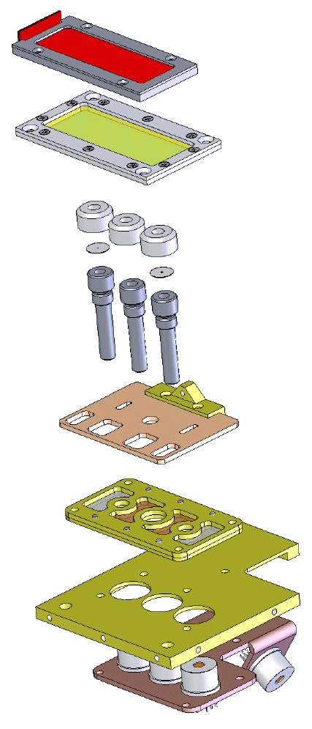
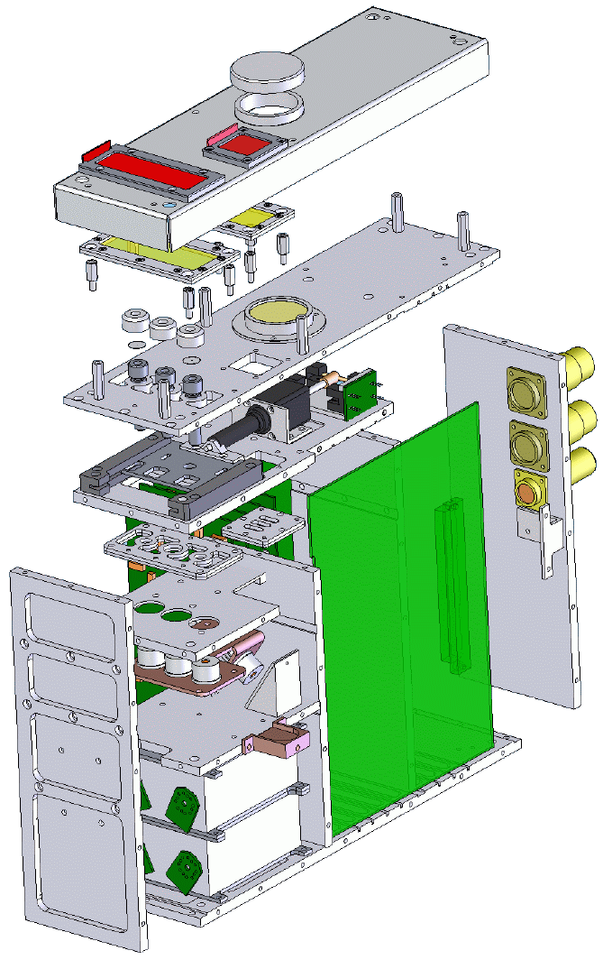
SphinX mechanical construction outline
Safety Covers
EUV Filter
Calibrated Apertures
Moving Shutter
Fluorescence Filter
Detector Support
Copper Plate
Silicon PIN Detectors
Alignment Mirror
Linear Motor
Heat Sink
Preamplifiers
Science & Space Weather Opportunities for PROBA2, May 04, 2012, Royal Observatory of Belgium, Brussels

Slide 3
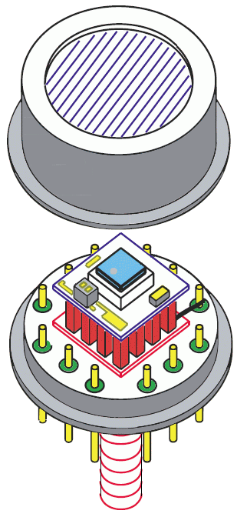
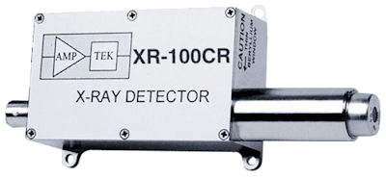
SphinX detector
Be Window
(thickness: 12.5 μm)
Si-PIN Detector
Area:
- D1: 25 mm²
- D2: 13 mm²
Thickness: 500 μm
Temperature Sensor
Thermoelectric Cooler
TO-8 Package
Mounting Stud
FET
Preamplifier:
Charge sensitive
Sensitivity: 1 mV/keV (typical)
Reset type
Negative output
Science & Space Weather Opportunities for PROBA2, May 04, 2012, Royal Observatory of Belgium, Brussels

Slide 4
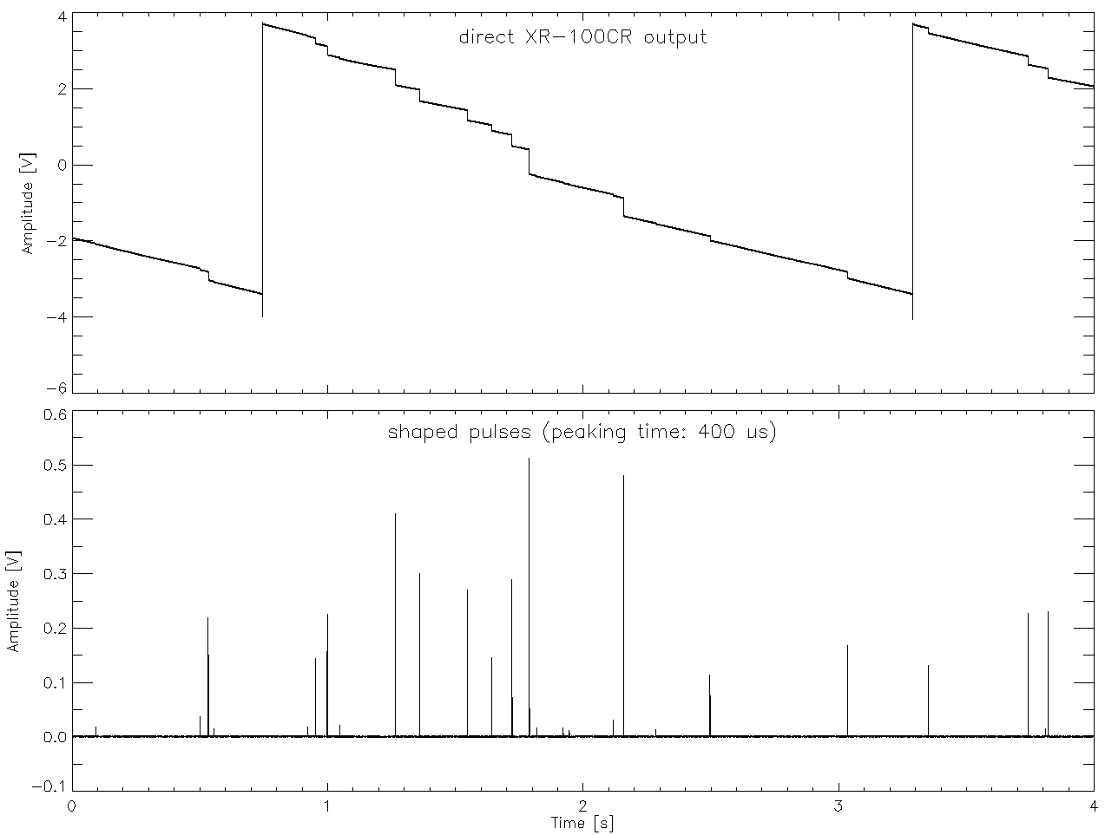
Detector response to particles
High energy detector event
Continuous feedback capacitance charging by the detector leakage current (depends on detector temperature)
Preamp reset
Shaped pulse
Science & Space Weather Opportunities for PROBA2, May 04, 2012, Royal Observatory of Belgium, Brussels

Slide 5
SphinX operation modes
Basic mode:
provides only lightcurves in 4 energy bands,
active all time while SphinX operated.
Spectral mode:
provides spectra (256 channels),
active only for selected time periods.
Sequence mode:
provides full data – sequence of detector events recorded with their amplitudes and arrival times,
active most of the time,
allows for data reduction,
limited size of data buffer.
Photons above 15 keV
Particles
Preamp resets
Counts
 | energy bins
Band | D1 | D2, D3
Noise | 0 - 24 | 0 - 16
Low | 25 - 50 | 17 - 50
High | 51 - 253 | 51 - 253
Background | 254 - 255 | 254 - 255
Energy bin
Noise
Low
High
Background
Science & Space Weather Opportunities for PROBA2, May 04, 2012, Royal Observatory of Belgium, Brussels

Slide 6
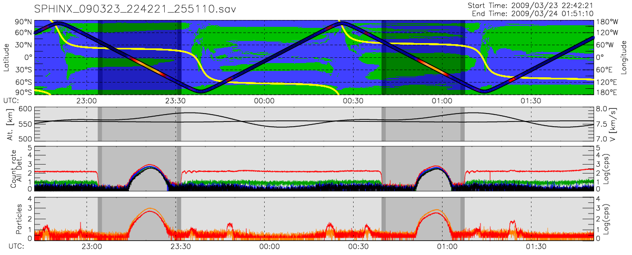
Example of SphinX particle signal (Level 0, basic mode)
Latitude
Particle signal (D1)
Optical & X-ray shadow
Altitude
Detector lightcurves [c/s]
Particle signal (D2+D3+D4)
Particle signal (D1)
Detector D1 is sensitive to particles within SAA nad RB while D2 is sensitive mainly to particles within SAA.
Science & Space Weather Opportunities for PROBA2, May 04, 2012, Royal Observatory of Belgium, Brussels

Slide 7
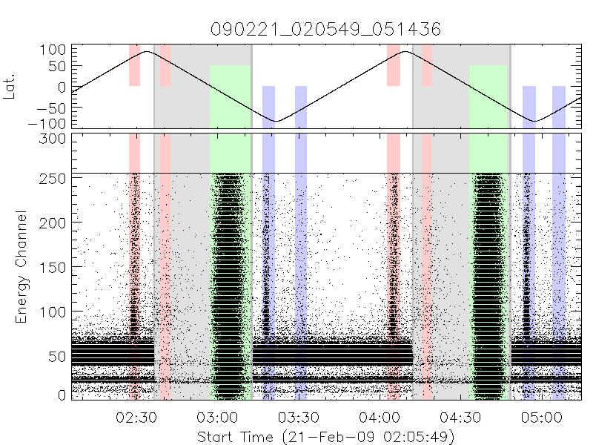
Example of SphinX D1 particle signal (Level 0, sequence mode)
X-ray shadow
SRB
SRB
X-ray shadow
SRB
SRB
SAA
SAA
NRB
NRB
NRB
NRB
Particles and preamp resets
Particle events
Solar X-ray events
Science & Space Weather Opportunities for PROBA2, May 04, 2012, Royal Observatory of Belgium, Brussels

Slide 8
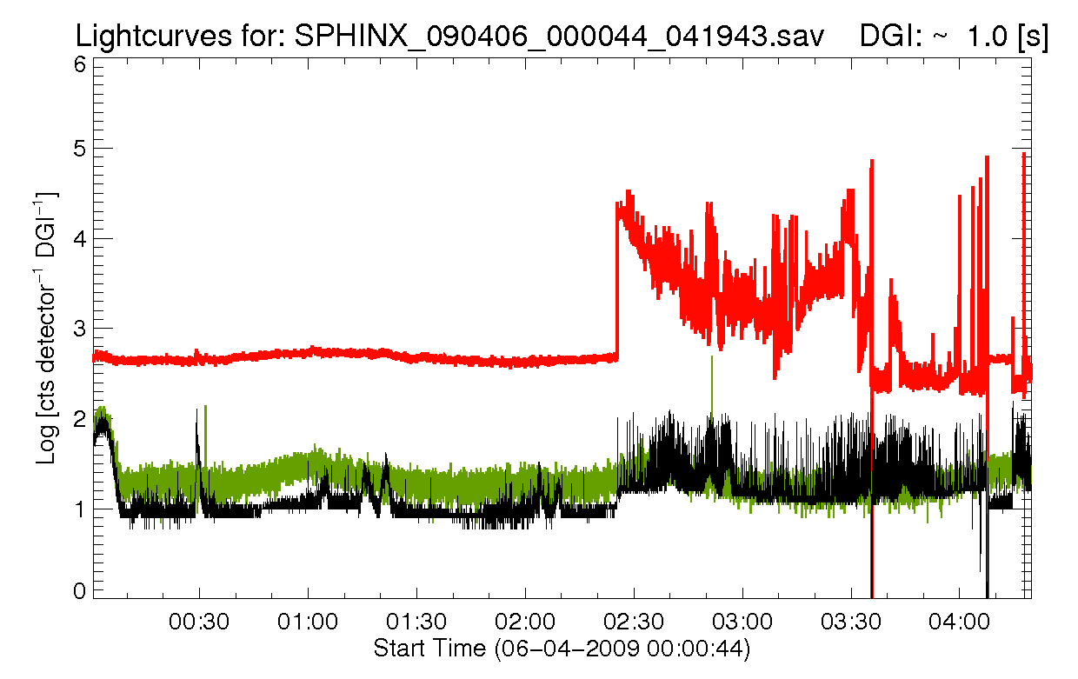
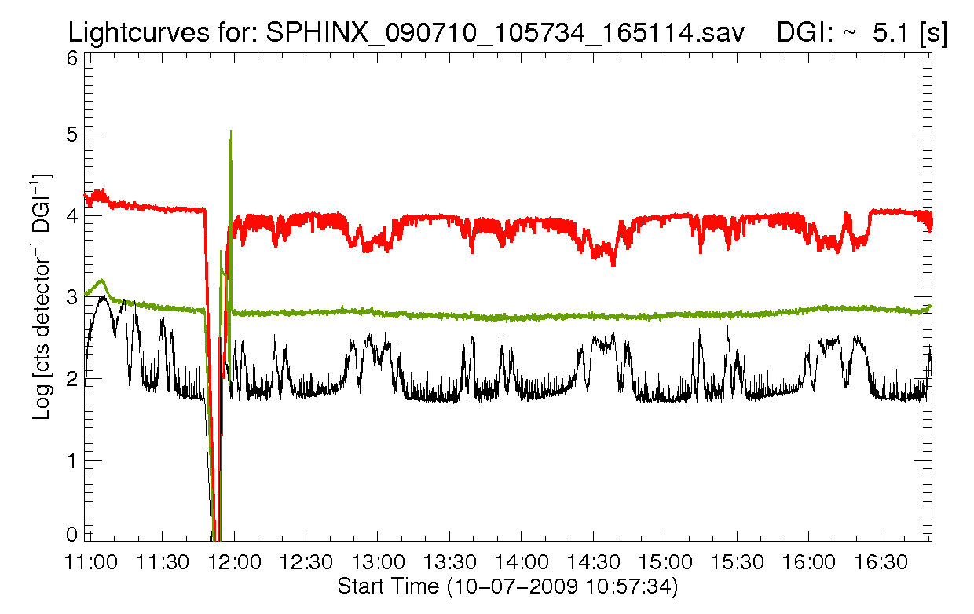
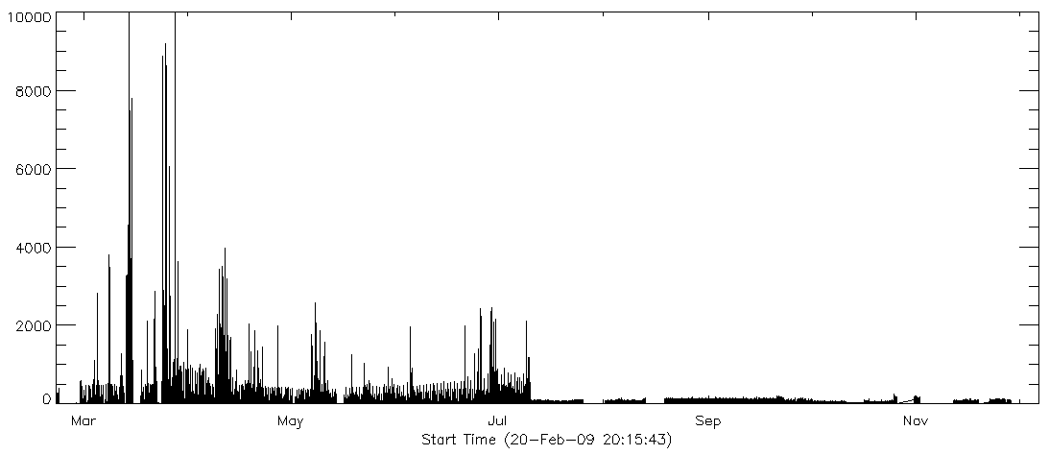
SphinX D1 particle signal
06.04.2009 – permanent D1 preamp malfunction
10.07.2009 – change of flight software:
Improvement of data quality in sequence mode
degradation of data quality in basic mode
22.09.2009 – change of flight software:
Allows for some corrections of data in basic mode
Condition of SphinX D1 particle signal:
20.02.2009 - 06.04.2009 – excellent D1 data quality (sequence mode allows for further improvements)
06.04.2009 - 10.07.2009 – deteriorated D1 data quality. The data may be useful for analysis after some corrections.
10.07.2009 - 22.09.2009 – insufficient D1 data quality for any analysis
22.09.2009 - 29.11.2009 – insufficient D1 data quality for any analysis (may be useful after some corrections).
Science & Space Weather Opportunities for PROBA2, May 04, 2012, Royal Observatory of Belgium, Brussels

Slide 9
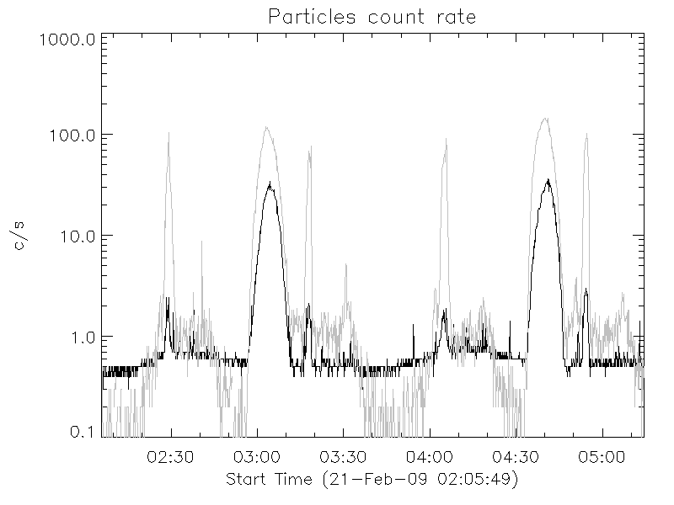
Improvement of D1 particle signal quality
(Possible only for time period from 20.02.2009 to 06.04.2009)
Uncorrected particle count rate
Particle count rate corrected for resets and dead time
Background level due to preamp resets (varies with detector temperature)
Science & Space Weather Opportunities for PROBA2, May 04, 2012, Royal Observatory of Belgium, Brussels

Slide 10
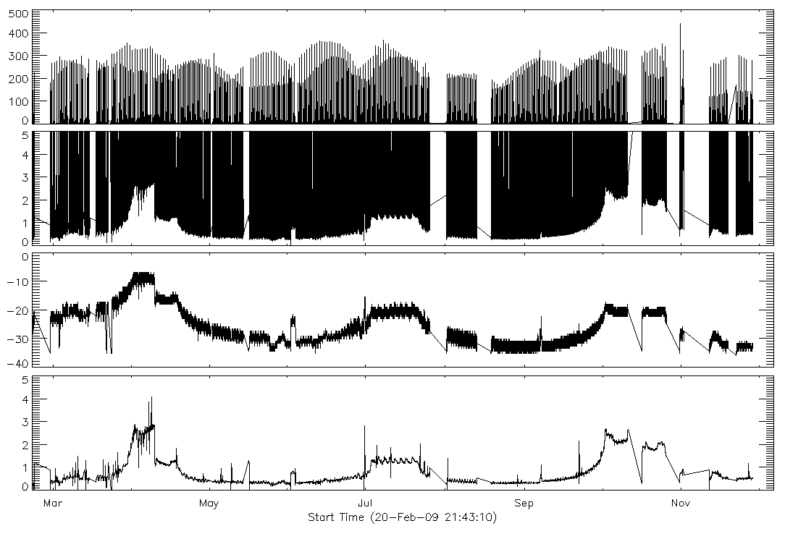
SphinX D2 particle signal
Overall SphinX D2 particle signal:
[c/s]
SphinX D2 particle signal – background level:
[c/s]
SphinX D2 detector temperature:
[^{O}C]
Correction for background level:
[c/s]
Science & Space Weather Opportunities for PROBA2, May 04, 2012, Royal Observatory of Belgium, Brussels

Slide 11
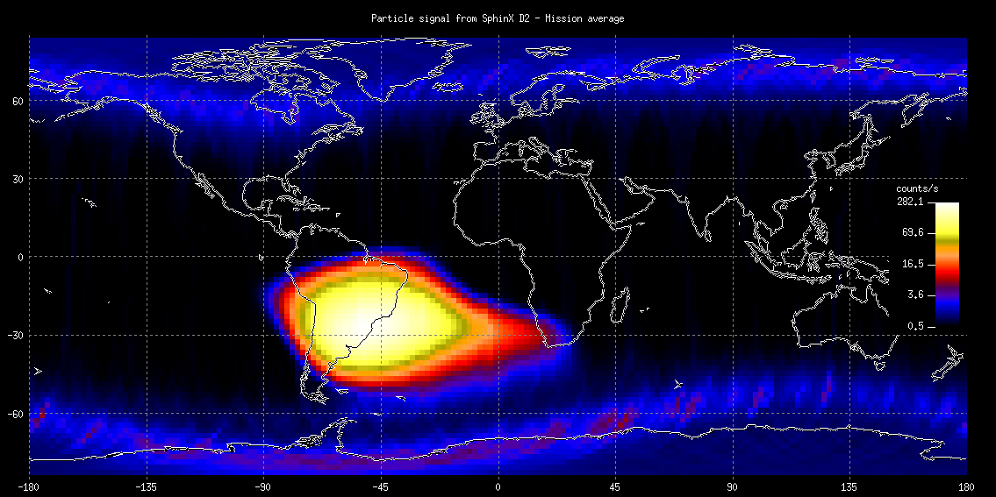
Reconstruction of Earth’s particle environment
Count rate distribution in geographic coordinates obtained from SphinX D2 detector (basic mode) after background level correction. The map is averaged over whole observation period from February 20 to November 29, 2009.
Science & Space Weather Opportunities for PROBA2, May 04, 2012, Royal Observatory of Belgium, Brussels

Slide 12
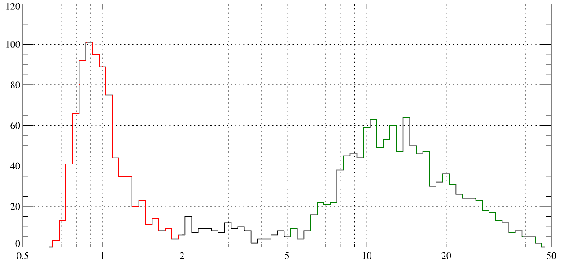
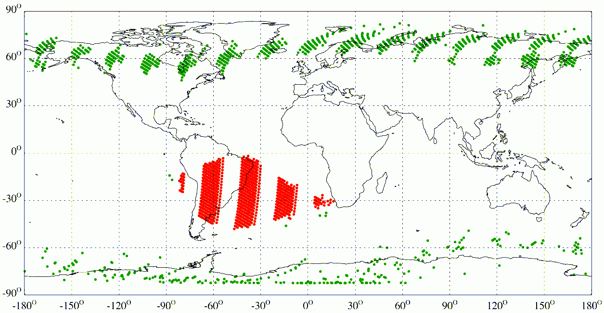
SphinX sensitivity to particles
D1/D2 count rate ratio
(normalized to respective detector areas)
Number of events
SAA
RB
Geographic coordinates of D1/D2 count rate ratio
Latitude
Longitude
[O. V. Dudnik et al.
X-RAY SPECTROPHOTOMETER SPHINX AND PARTICLE SPECTROMETER STEP-F OF THE SATELLITE EXPERIMENT CORONAS-PHOTON – PRELIMINARY RESULTS OF JOINT DATA ANALYSIS,
Solar System Research, 2012, Vol. 46, No. 2, pp. 160–169]
Science & Space Weather Opportunities for PROBA2, May 04, 2012, Royal Observatory of Belgium, Brussels

Slide 13
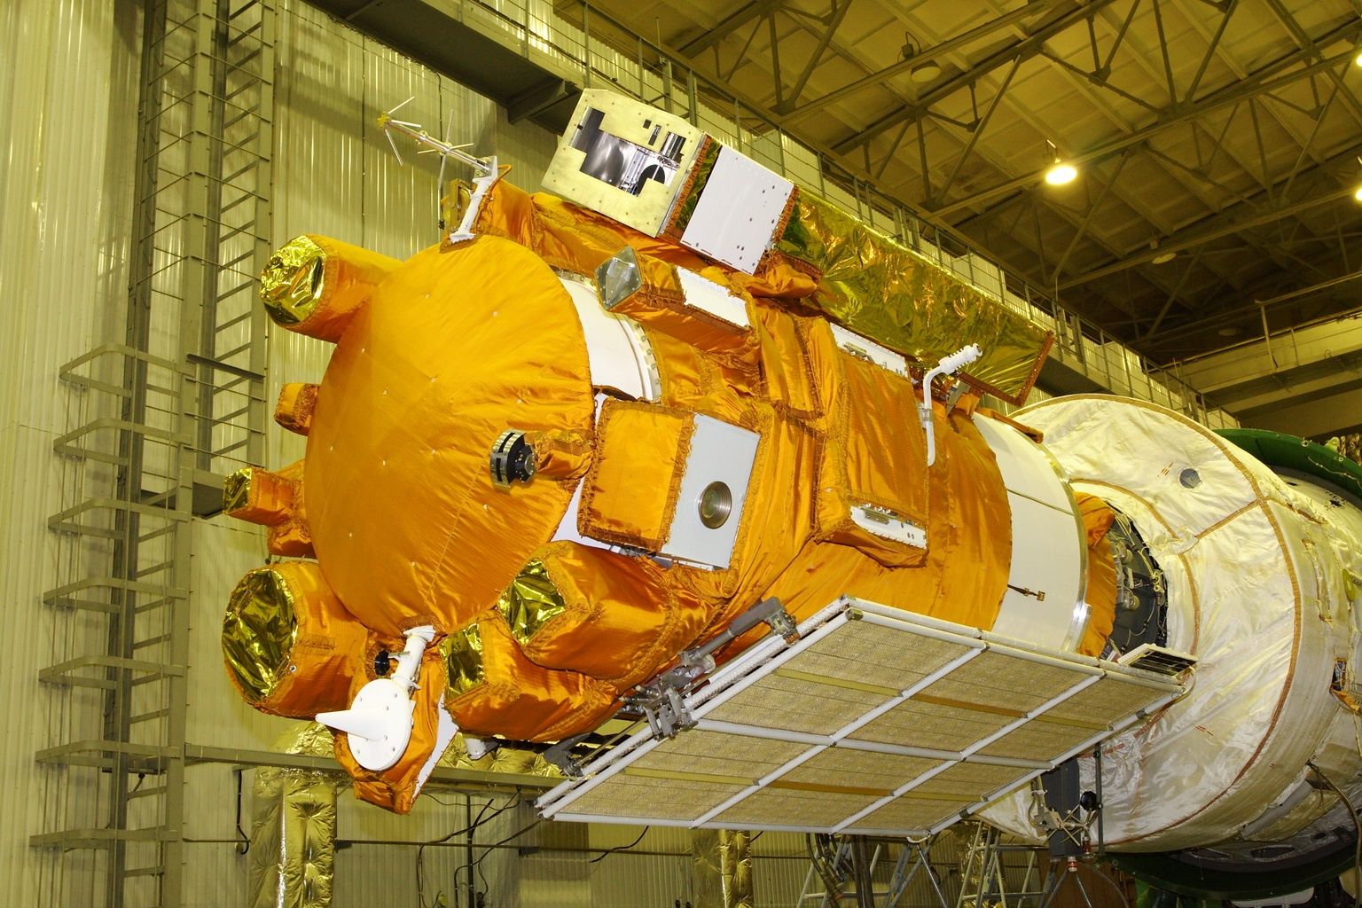
SphinX – STEP-F joint data analysis
CORONAS-Photon satellite
SphinX (incorporated within TESIS complex)
Solar photometer in X-rays
Space Research Centre, Polish Academy of Sciences
STEP-F
Satellite Telescope for measuring electrons and protons
V.N. Karazin Kharkiv National University, Ukraine
Science & Space Weather Opportunities for PROBA2, May 04, 2012, Royal Observatory of Belgium, Brussels

Slide 14
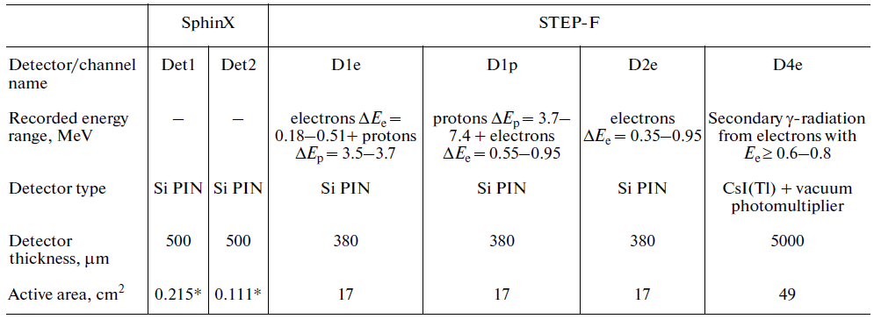
SphinX – STEP-F joint data analysis
STEP-F is a telescope for measuring electron and proton fluxes aboard CORONAS-Photon satellite.
The STEP-F instrument provides registration of:
electron fluxes and energy spectra in the energy range Ee = 0.18 – 2.3 MeV,
electron fluxes in integral range Ee > 2.3 MeV,
proton fluxes and energy spectra in the energy range Ep = 3.5 - 55.2 MeV,
proton fluxes in integral range Ep > 55.2 MeV,
alpha-particle fluxes and energy spectra in the energy range Eа = 15.9 - 160.0 MeV.
Registration channels used for common analysis:
Science & Space Weather Opportunities for PROBA2, May 04, 2012, Royal Observatory of Belgium, Brussels

Slide 15
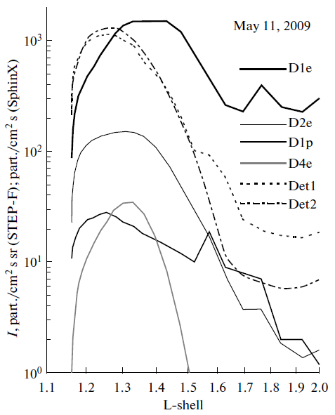
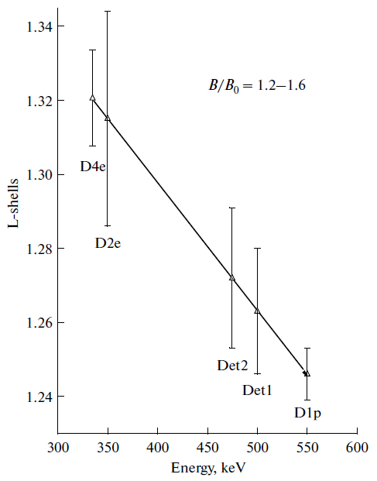
Distribution of particle intensities by L-shells within SAA
Averaged energy thresholds for SphinX detectors in SAA:
E_{thr1} ≈ 500keV (D1)
E_{thr2} ≈ 475keV (D2)
(the values are not
strictly fixed)
An example of SAA particle flux in L-shell domain for four channels of STEP-F instrument and two SphinX channels.
dependence of L-shell positions at which maximum particle fluxes within SAA were observed on energy of electrons bound to the channels D2e and D1p of the STEP-F instrument.
[O. V. Dudnik et al.
X-RAY SPECTROPHOTOMETER SPHINX AND PARTICLE SPECTROMETER STEP-F OF THE SATELLITE EXPERIMENT CORONAS-PHOTON – PRELIMINARY RESULTS OF JOINT DATA ANALYSIS,
Solar System Research, 2012, Vol. 46, No. 2, pp. 160–169]
Science & Space Weather Opportunities for PROBA2, May 04, 2012, Royal Observatory of Belgium, Brussels

Slide 16
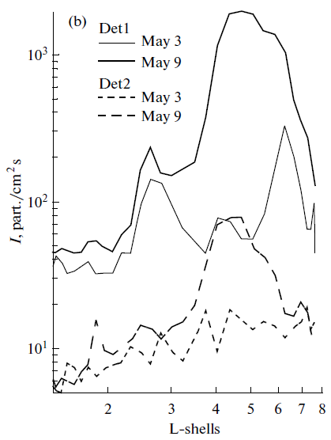
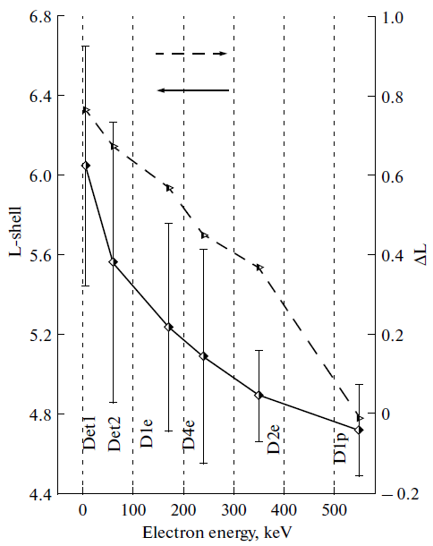
Distribution of particle intensities by L-shells within RB
May 3, 2009 - quiet conditions before geomagnetic storm,
May 9, 2009 - initial recovery phase from the magnetic storm
Averaged energy thresholds for SphinX detectors in RB:
E_{thr1} ≈ 5keV (D1)
E_{thr2} ≈ 60keV (D2)
(the values are not
strictly fixed)
Changes of particle intensity distribution in nothern hemisphere due to geomagnetic storm as seen by SphinX
Initial values of L-shell positions of fluxes maxima in north hemisphere and ΔL displacement due to geomagnetic storm in dependency of electron energy
[O. V. Dudnik et al.
X-RAY SPECTROPHOTOMETER SPHINX AND PARTICLE SPECTROMETER STEP-F OF THE SATELLITE EXPERIMENT CORONAS-PHOTON – PRELIMINARY RESULTS OF JOINT DATA ANALYSIS,
Solar System Research, 2012, Vol. 46, No. 2, pp. 160–169]
Science & Space Weather Opportunities for PROBA2, May 04, 2012, Royal Observatory of Belgium, Brussels

Slide 17
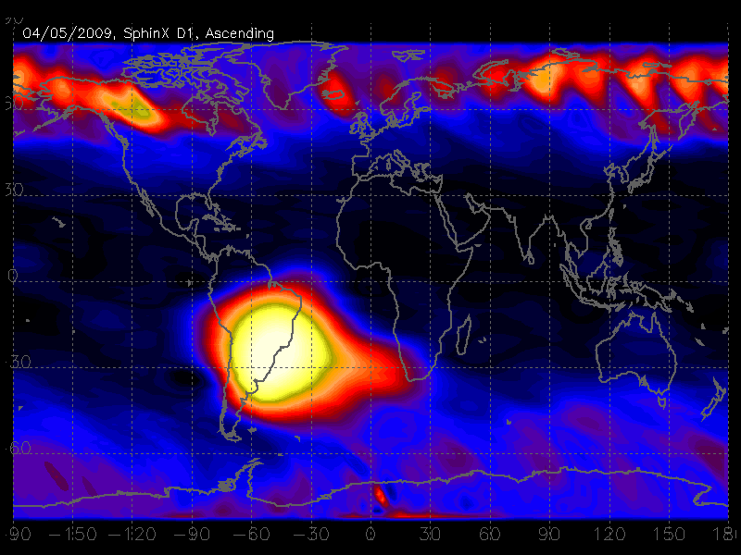
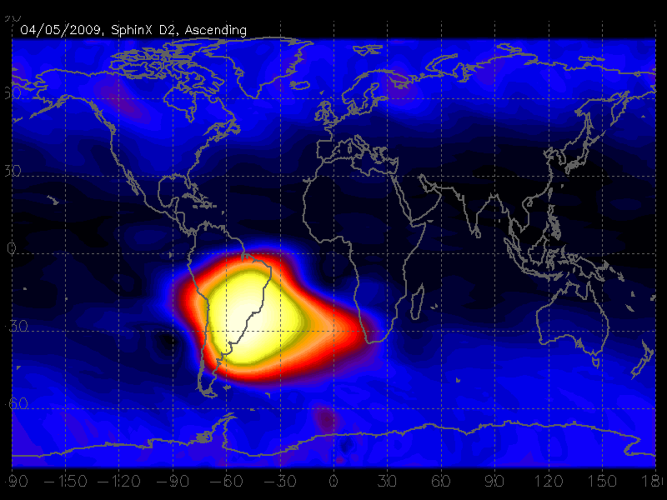
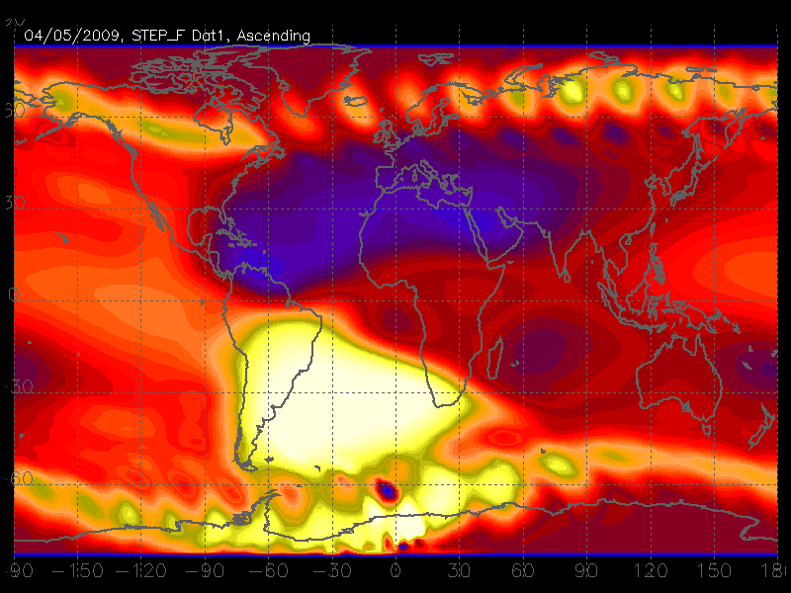
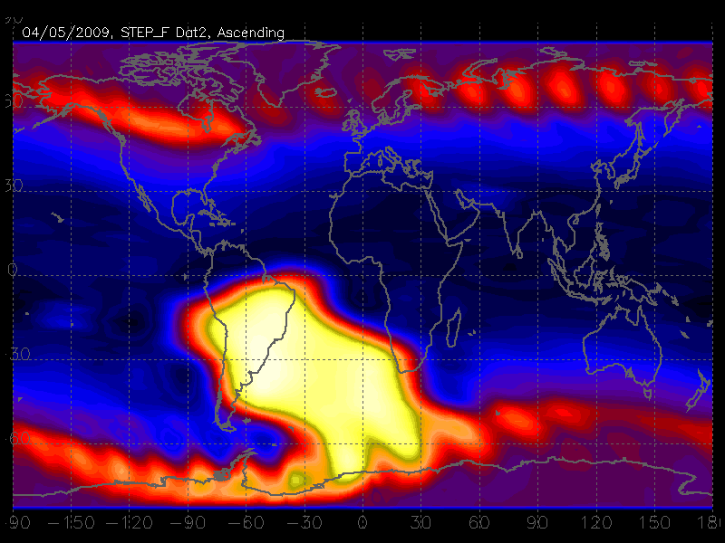
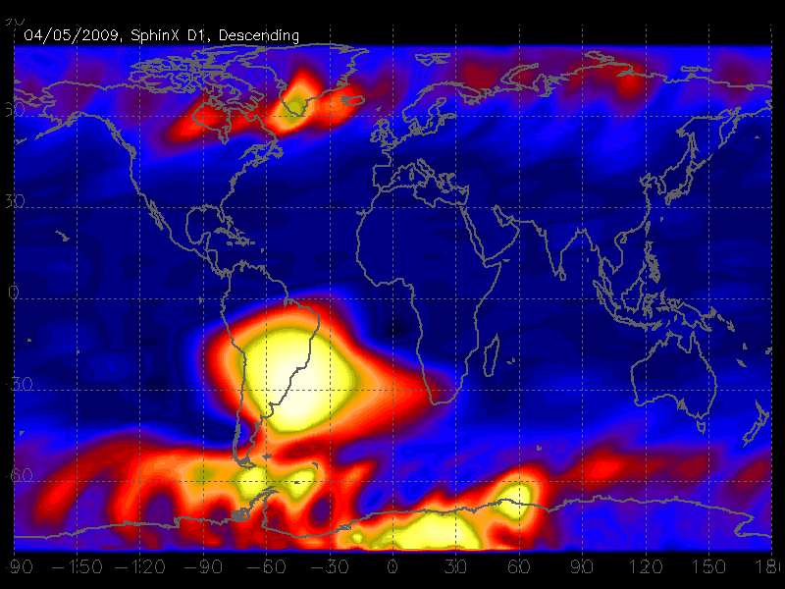
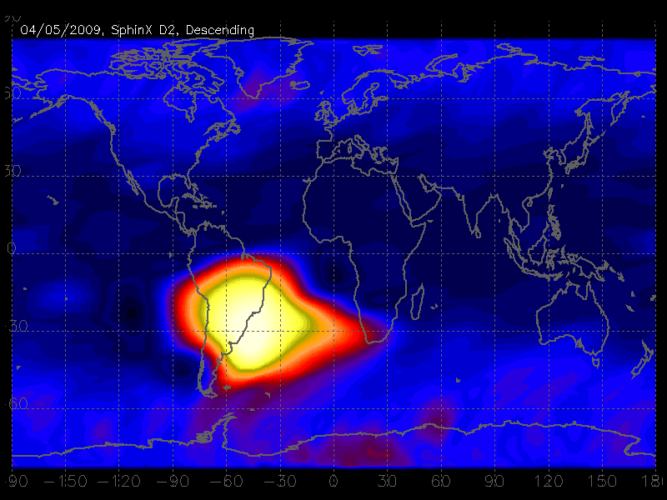
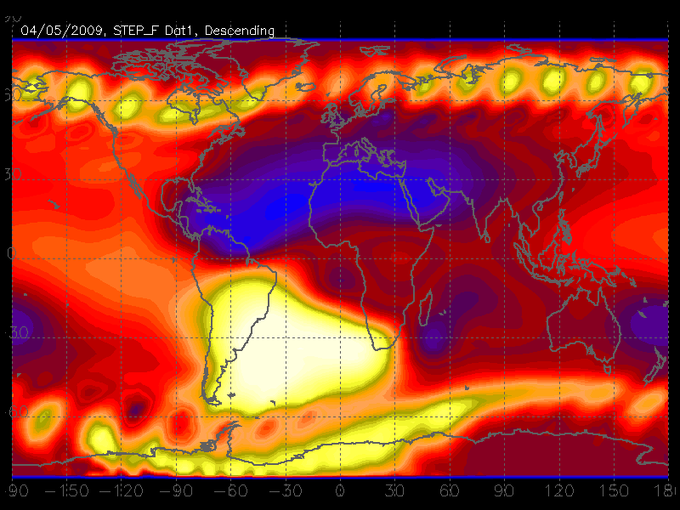
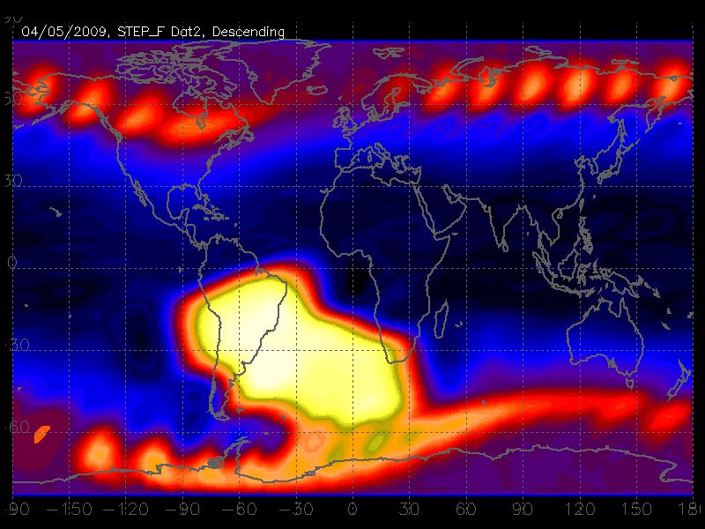
Comparison of SphinX and STEP-F daily particle maps
04.05.2009
SphinX
SPEP-F
D1:
D2:
D1-e:
D1-p:
ascending:
descending:
Science & Space Weather Opportunities for PROBA2, May 04, 2012, Royal Observatory of Belgium, Brussels

Slide 18
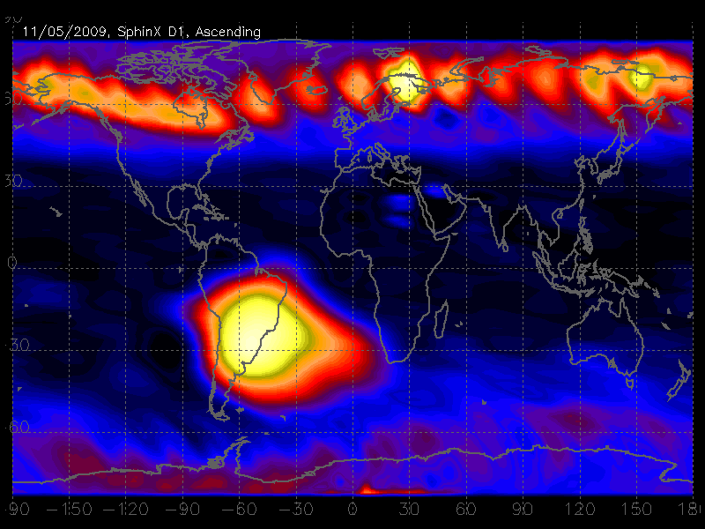
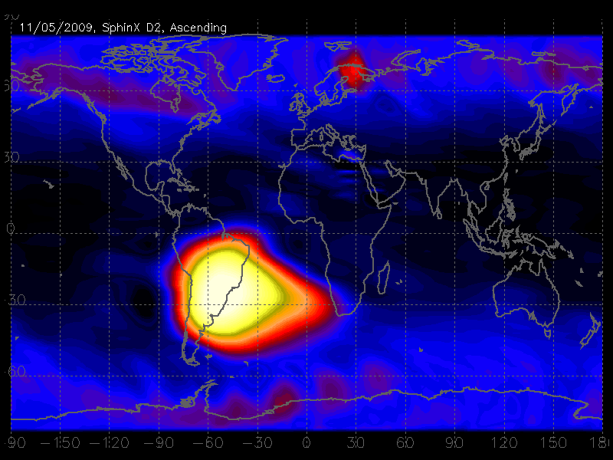
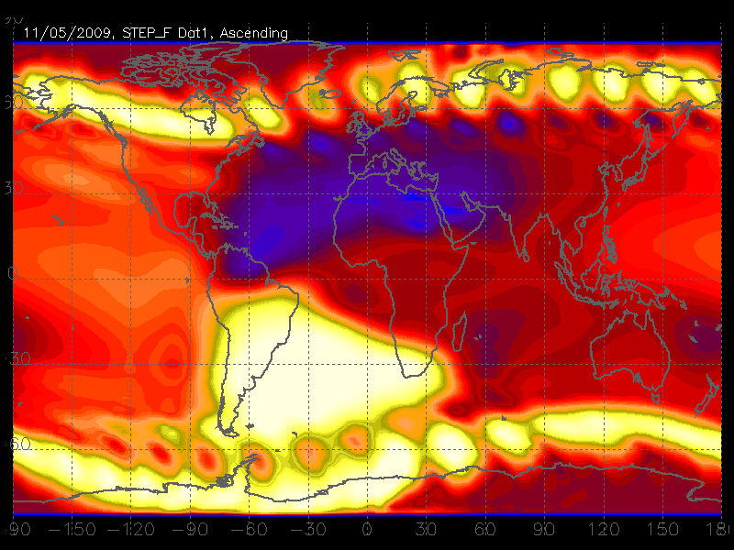
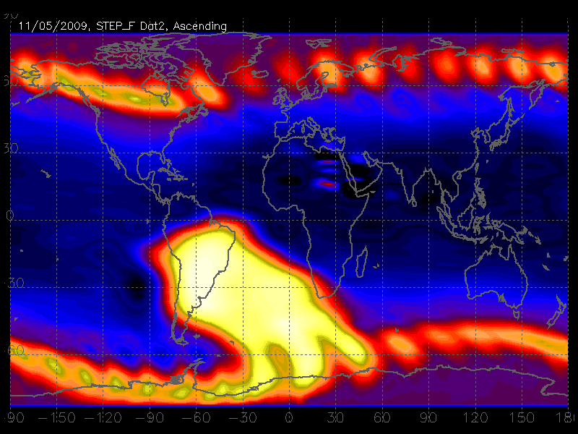
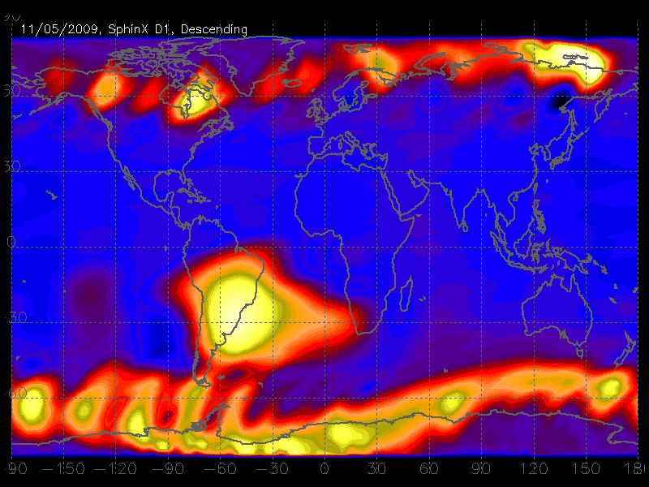
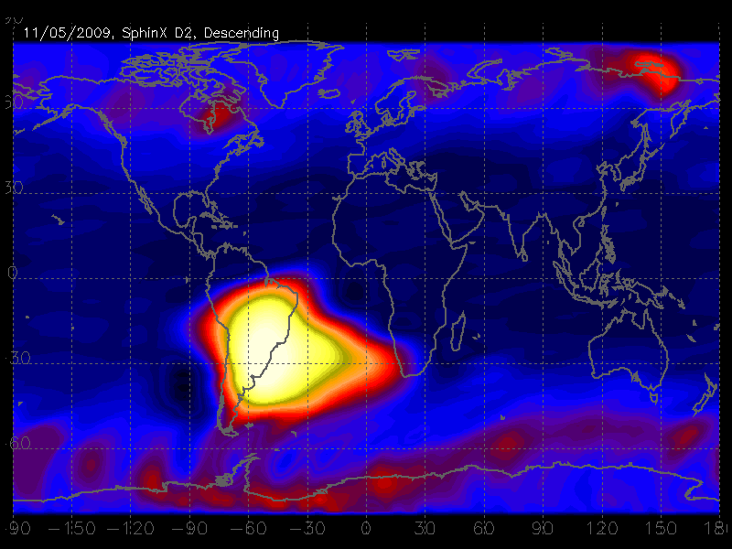
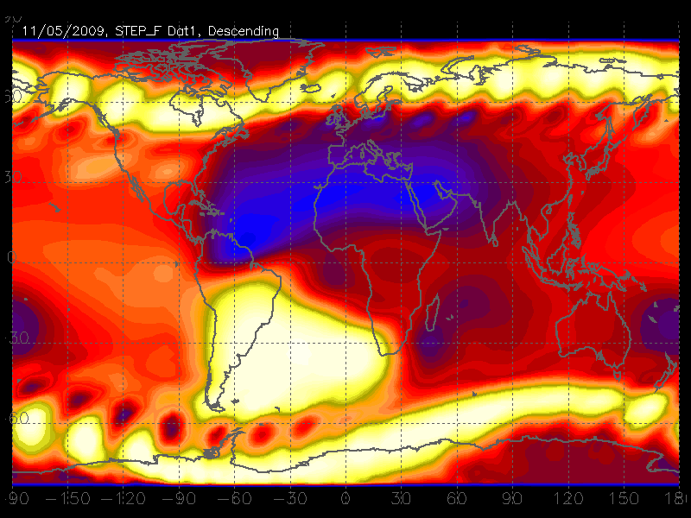
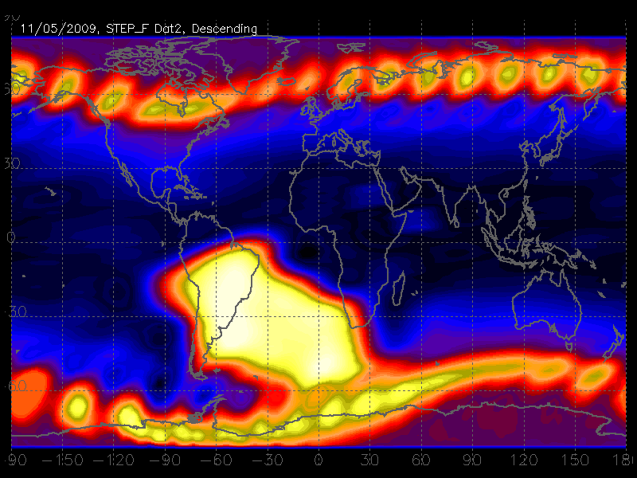
Comparison of SphinX and STEP-F daily particle maps
11.05.2009
SphinX
SPEP-F
D1:
D2:
D1-e:
D1-p:
ascending:
descending:
Science & Space Weather Opportunities for PROBA2, May 04, 2012, Royal Observatory of Belgium, Brussels

Slide 19
Thank you

