Slide 1
Subject: LYRA Occulation Analysis 2010/2011 occultations for the Geminid meteor campaign
History:
20110306: initial design

Slide 2
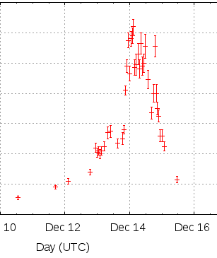
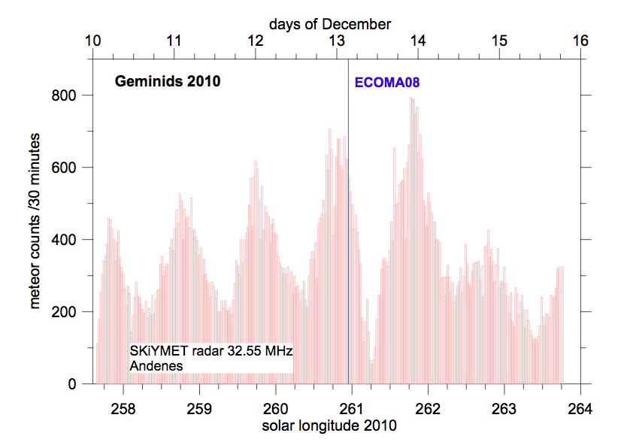

Slide 3
Collect Data from period of interest on local harddisk
Create data set for unit3 and for unit2 containing only relevant, occulatation data
Analyze unit3 and unit2 data for 2010/11 until 2011/02

Slide 4
Collect Data from period of interest on local harddisk
STEP 1
Csh: foreach I (01 02 03 04 .. 31) do
~/.getlyra.sh 2010 11 $i
end
Run this foreach loop for 2010 11, 201012, 2011 01 and 2011 02
[sol073:eng/2011/02] jzender% less ~/.getlyra.sh
#!/bin/sh
#
# Download the lyra data of one day
#
if [ $# -ne 3 ]
then
year=`date -u +%Y`
month=`date -u +%m`
day=`date -u +%d`
else
year=$1
month=$2
day=$3
fi
path='/p2sc/public/lyra/data/eng/'${year}'/'${month}'/'${day}
url='http://proba2.sidc.be/lyra/data/eng/'${year}'/'${month}'/'${day}
echo $path
/opt/local/bin/wget -m -r $url -l1 --no-parent -A.fits -nd -P$path
echo 'getting the SPICE SPK and CK files now'
path='/p2sc/data/PPT/data/'
url='http://proba2.sidc.be/aux/data/spice/kernels/spk/'
/opt/local/bin/wget -m -r $url -l1 --no-parent -A.bsp -nd -P$path
url='http://proba2.sidc.be/aux/data/spice/kernels/ck/'
/opt/local/bin/wget -m -r $url -l1 --no-parent -A.bc -nd -P$path

Slide 5
Collect Data from period of interest on local harddisk
STEP 2
All IOS files were grepped for the acquisition command. This data was directed into an ASCII file named LYRA_IOS_ACQUISITION_COMMANDS.TXT (see example)
LYRA_Planning_00147_2011_02_04_08_42_53.txt 2011.02.08T06:53:00.000 acquisition 50ms unit_2 unit_3 100 off 0
LYRA_Planning_00147_2011_02_04_08_42_53.txt 2011.02.08T06:58:00.000 acquisition 50ms unit_2 unit_3 200000 off 0
LYRA_Planning_00147_2011_02_04_08_42_53.txt 2011.02.08T07:43:00.000 acquisition 50ms unit_2 off 200000 off 0
LYRA_Planning_00147_2011_02_04_08_42_53.txt 2011.02.09T07:42:00.000 acquisition 50ms unit_2 unit_3 100 off 0
LYRA_Planning_00147_2011_02_04_08_42_53.txt 2011.02.09T07:47:00.000 acquisition 50ms unit_2 unit_3 200000 off 0
LYRA_Planning_00147_2011_02_04_08_42_53.txt 2011.02.09T08:31:00.000 acquisition 50ms unit_2 off 200000 off 0
LYRA_Planning_00147_2011_02_04_08_42_53.txt 2011.02.10T06:51:00.000 acquisition 50ms unit_2 unit_3 100 off 0
LYRA_Planning_00147_2011_02_04_08_42_53.txt 2011.02.10T06:56:00.000 acquisition 50ms unit_2 unit_3 200000 off 0
LYRA_Planning_00147_2011_02_04_08_42_53.txt 2011.02.10T07:40:00.000 acquisition 50ms unit_2 off 200000 off 0
LYRA_Planning_00147_2011_02_04_08_42_53.txt 2011.02.11T07:40:00.000 acquisition 50ms unit_2 unit_3 100 off 0
LYRA_Planning_00147_2011_02_04_08_42_53.txt 2011.02.11T07:45:00.000 acquisition 50ms unit_2 unit_3 200000 off 0
LYRA_Plannin
The IDL routine ‘readIOS’ reads the content of this file and filters out all the calibration campaign. The start and end times of the campaigns are stored in JulianDate in a simple array structure that is saved as ‘eventInfo.sav’

Slide 6
Create data set for unit3 and for unit2 containing only relevant data
PRO COMPUTE_INTERMEDIATE_ALTITUDE
LOAD EVENTINFO.SAV
INTER_ALT= DOUBLEARRAY(174*101 , 3) ;; 174 as we have 174 events, 101 as we have 101 altitude baskets
I=0
FOREACH day in month in (201011, 201012, 201101, 201102) do
BEGIN
FIND OCCULTATIONS IN THE EVENTINFO
FOREACH occultation DO
OPEN LYRA FITS FILE OF THE DAY
TEMP = DBLARR( 60*60*20, 2) ;; occultation max 1hrs, 20 hz, we save time and value
LOCATE INDEX FOR START AND END OF EVENT
ALTINDEX=49
J=0
FOR T=START,END DO
ALT=COMPUTE_ALTITUDE
IF ALT GT 500 THEN CONTINUE
TEMP[*,*] = 0.0
INDEX = ALT/10
IF( ALTINDEX != INDEX )THEN
IF( ALTINDEX GT INDEX) THEN DOWNUP=1.0 ELSE DOWNUP=-1.0
INTER_ALT[I]=[ DOWNUP, (ENDTIME-STARTTIME/2) , TEMP[0:N,1]/N, VARIANZ(TEMP[0:N,1]) ]
J=0
END ELSE
TEMP[J++,*]= [TIME[JD], LYRADATAVALUE]
ENDELSE
ENDFOR
CLOSE FITS FILE
ENDFOR
ENDFOR
SAVE, ‘FINDATA.SAV’

Slide 7
Final Data Structure for analysis
Final data structure is a double array containing the following elements
{1.0, -1.0}: 1.0 first part of occultation, -1.0 second part, means down and up.
Altitude in km by 10km from 500 to 0 to 500, as follows
1.0 500-490km
1.0 490-480km
…
1.0 10-0km
-1.0 0-10km
…
-1.0 480-490km
-1.0 490-500km
start time [JD] at km, e.g. 500km
End time [JD] at km, e.g. 490km
central time [JD]
average value within this kilometer range
Standard deviation witihn this kilometer range
Number of measurements within this kilometer range
The structure is saved in the file ‘finData.sav’

Slide 8
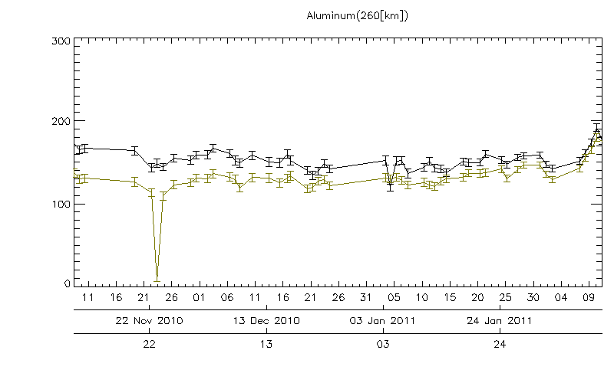
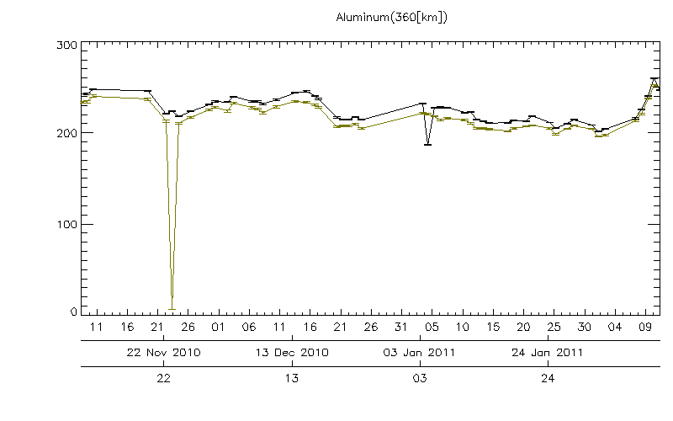
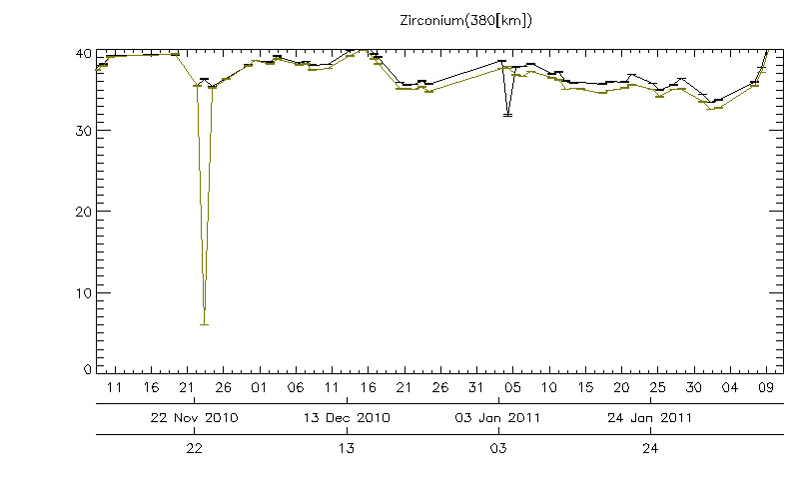
Points of interest
Some outliers that are not yet understood
all channels
but not necessary the same outliers in all channels
Outlier sometimes in entry phase, but not in exit phase
Difference between the occultation entry and occultation exit phase
Sometimes the difference is constant
Sometimes not
Zi_380km shows a trend, but can this be real/physical? If not, then none of the trend observed might be real.

Slide 9
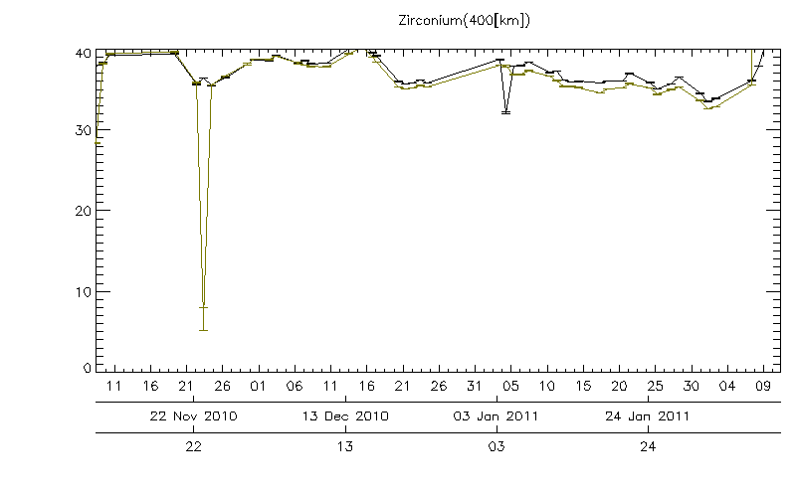
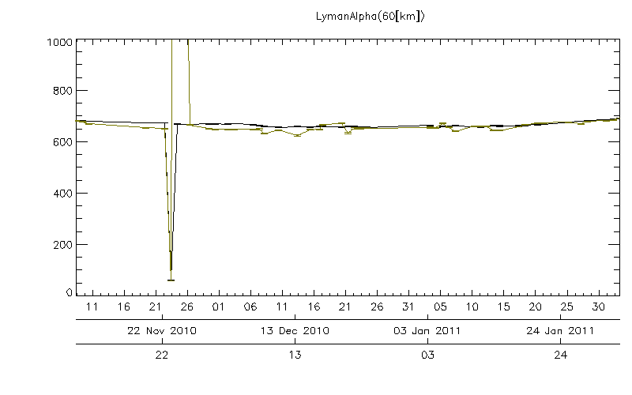
Points of interest (cont)
For some plots, the difference is negligible for several weeks and then starts to grow
For some plots, the difference changes sign
The difference is however very small, but
The error bar is also very small

Slide 10
Results and ideas from discussion from 5 May 2011 from occultation WG
Check for temperature dependence
Plot against latitude of tangential altitude
Plot against latitude of magnetic altitude

