Slide 1
SWAP and LYRA onboard PROBA2
RWC Belgium’s space segment
Notes:
PROBA2 is an ESA satellite for technology demonstration. As the secondary mission goal, RWC Belgium is now using it for space weather monitoring and research.

Slide 2
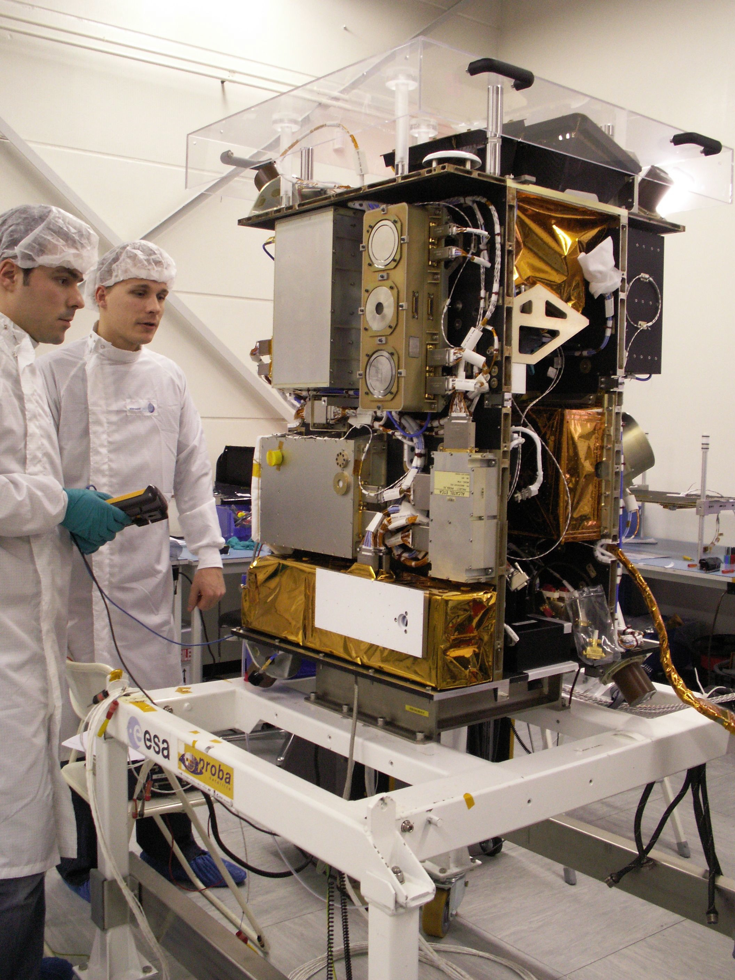

ESA technology demonstration satellite
Dual Segmented Langmuir Probe (DSLP)
Thermal lasma Measurement Unit (TMPU)
Lyman alpha radiometer (LYRA)
SUN WATCHER USING APS AND IMAGE PROCESSING (SWAP)
Notes:
The spacecraft carries 4 scientific instruments: 2 instruments (DSLP and TPMU, provided by the Czech Republic) measure the local in-situ plasma (not discussed in what follows). The two other instruments are remote sensing solar instruments: LYRA is radiometer, providing integrated flux timelines in 4 UV and EUV channels. SWAP is a coronal EUV imager. The spacecraft and SWAP are fabricated in Belgium. LYRA is a Belgian-Swiss collaboration.

Slide 3
Timeline
2009 Nov 2: Launch in sun-synchronous orbit at 725km height. Eclipse season from Dec-Jan.
2010 March: Nominal Operations
2011 Feb: 250 000th SWAP image
2011 March: release of calibrated LYRA data products
2012 Dec 31: End current mission funding
Later: Transition to ESA SSA is being explored

Slide 4
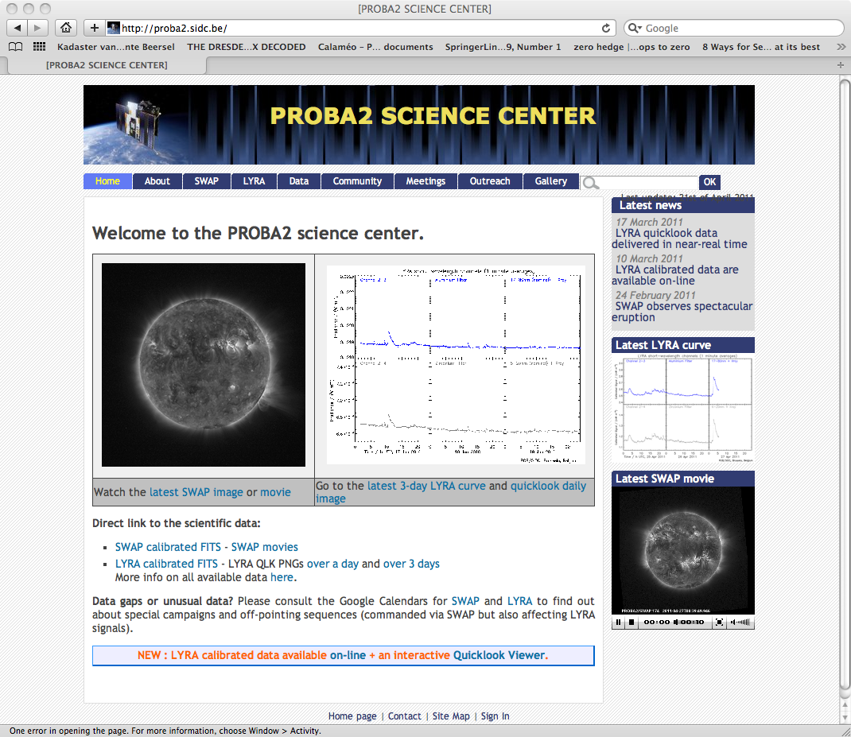
http://proba2.sidc.be
Real time Flare curves
Daily coronal movies
Calibrated FITS files

Slide 5
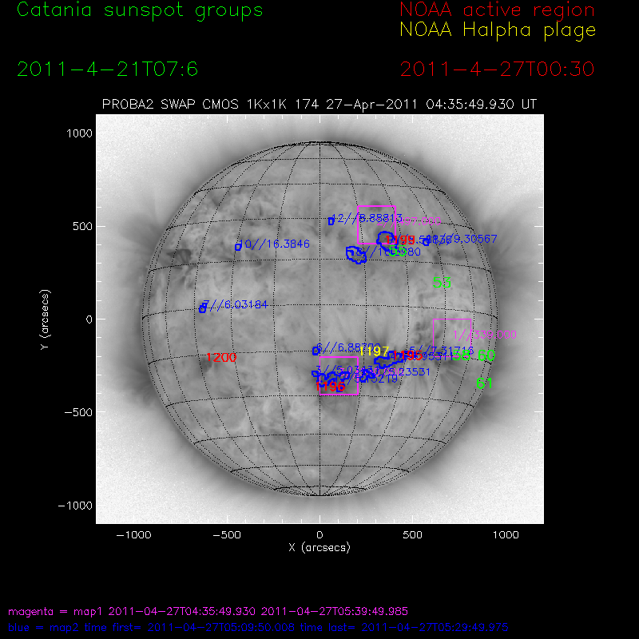
Upcoming derived products
Automated identification
of regions with enhanced
dynamics.
Draft version at
http://sidc.be/SOTERIA/FLARE/html/flaretool.html
Notes:
Blue contours show regions with dynamics significantly above the expected instrumental noise over the last half hour. Pink squares show the 3 macropixels (each 64x64 pixels) with the largest deviations in the last difference image.

Slide 6
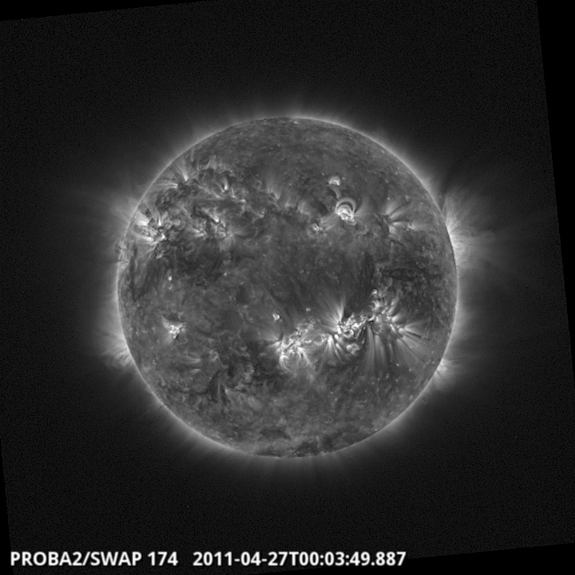
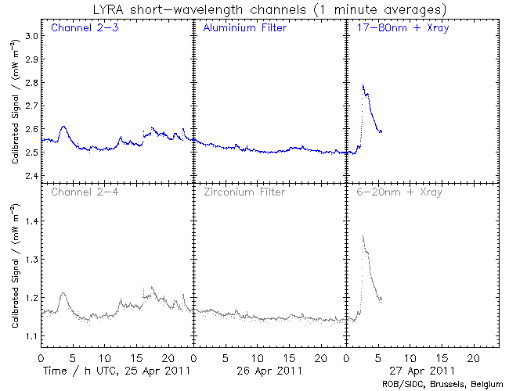
Contact us
Open call for PROBA2 Guest Investigator Grants
PROBA2 Splinter meeting in Kiel end of July
LYRA: marie.dominique@sidc.be
SWAP: david.berghmans@sidc.be
Notes:
Typical question: what is the latency on the data arrival? Answer: we have up to 10 ground contacts per day, so maximum latency on ground contact is like 3 hours, but a typically value is like 1 hour. The quicklook data products and calibrated FITS files appear on the website within 1 hour of arrival on the ground.

