Slide 1
First Results on Solar Irradiance Variability from PROBA2/LYRA/SWAP
R. Kariyappa (guest investigator),
S. T. Kumar, M. Dominique,
D. Berghmans, L. Dame, C.L. Pradeep
Notes:
(1) Indian Institute of Astrophysics, Bangalore 560 034, India
(2) Department of Physics, Auden Technology and
Management Academy, Bangalore, India
(3) Royal Observatory of Belgium, Brussels, Belgium
(4) LATMOS, 11 boulevard d’Alembert, 78280 Guyancourt, France

Slide 2
Objectives
Analyze the source of variability of Lyra channels 3 and 4
comparison of Lyra curves to SWAP 17.4 nm and SDO/AIA 30.4nm images and integrated flux
Flares:
comparison between Lyra channels
estimate the amount of energy radiated
Dynamics & heating of the solar corona at the sites of bright points
Determination of coronal rotation from bright points as tracers from SWAP daily full-disk synoptic observations
Comparison of SWAP and SDO/AIA 19.3nm bright points
Notes:
I have examined the light curve of a single isolated bright point (swap bright point.pdf)
observed at the center of the solar disk in a quiet region after correcting for solar rotation.
It is clearly evident from the light curve that the bright point show an intensity oscillations.
We need to concentrate on a large number of bright points and derive their light curves and
apply a wavelet analysis on the time series to determine the period of intensity oscillations
and phase information in comparison with the light curves of the same location observed
with SDO/AIA 193 °A .
(i) Spatial correspondence between the bright points observed at different heights
(SWAP/174 °A & SDO/AIA/193 °A );
(ii) Determine the phase information of the wave propagation & study the physical nature
of the waves, which are responsible for the heating of the corona;
(iii) Finally, give an observational evidence for heating of the corona at the sites of bright
points ;
how the coronal rotation rate related with the
solar magnetic activity cycle.

Slide 3
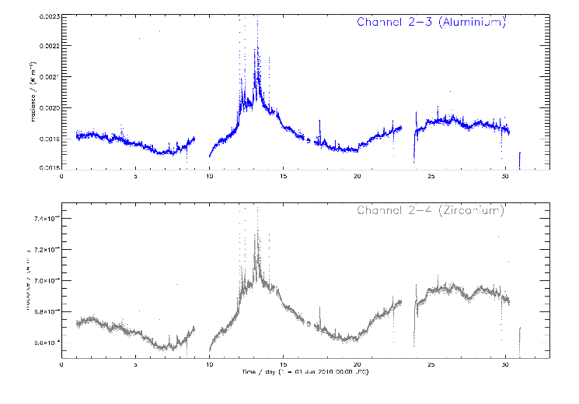
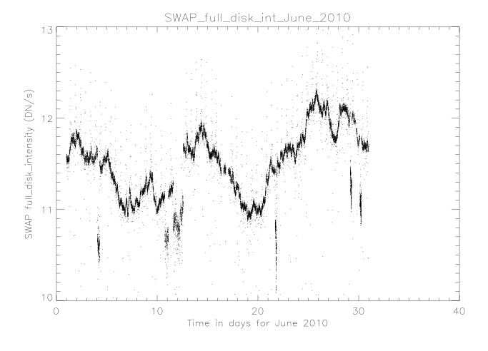
Solar variability in Ly Al channel
Day to day variations:
comparison with SWAP integrated curves
June 2010
Notes:
June 10, 2010 from 00.00 hours to 12.00
hours.
CaII K filtergram, Kitt Peak Obs., USA, 393nm

Slide 4
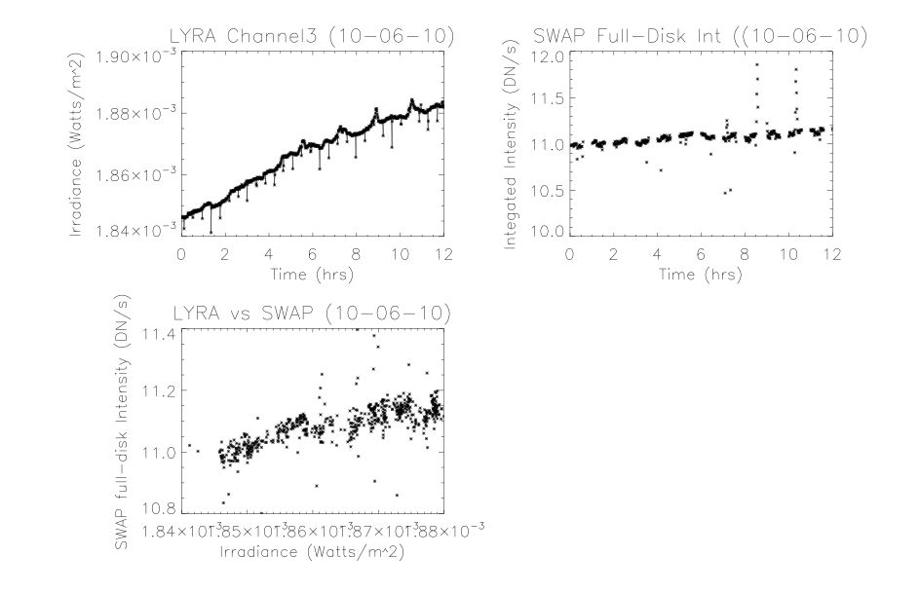
Solar variability in Ly Al channel
Short term variations:
June 10, 2010 from 00.00 hours to 12.00
Notes:
June 10, 2010 from 00.00 hours to 12.00
hours.
CaII K filtergram, Kitt Peak Obs., USA, 393nm

Slide 5
Conclusions
Good correlation between the LYRA irradiance and SWAP integrated series;
the variations in LYRA irradiance are due to the features observed in SWAP
Next step: Separating the contribution of the different solar magnetic features by observing full-disk spatially resolved images from SWAP and SDO/AIA (30.4 nm ) (in progress).

Slide 6
Solar variability in He II
compare LYRA Al curves to SWAP 17.4nm (Fe IX, …) and SDO/AIA 30.4nm (He II) images to identify the source of solar variability in this channel
estimate the contribution of individual features (plages, network, internetwork regions and back-ground emission)

Slide 7
