Slide 1
LYRA Status
PROBA2 workshop
February 2011
M. Dominique + LYRA team

Slide 2
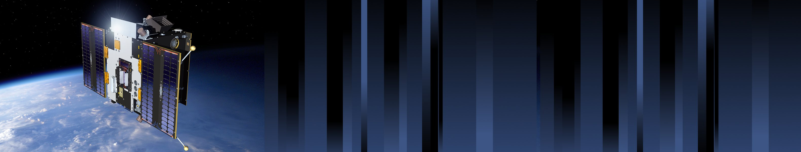
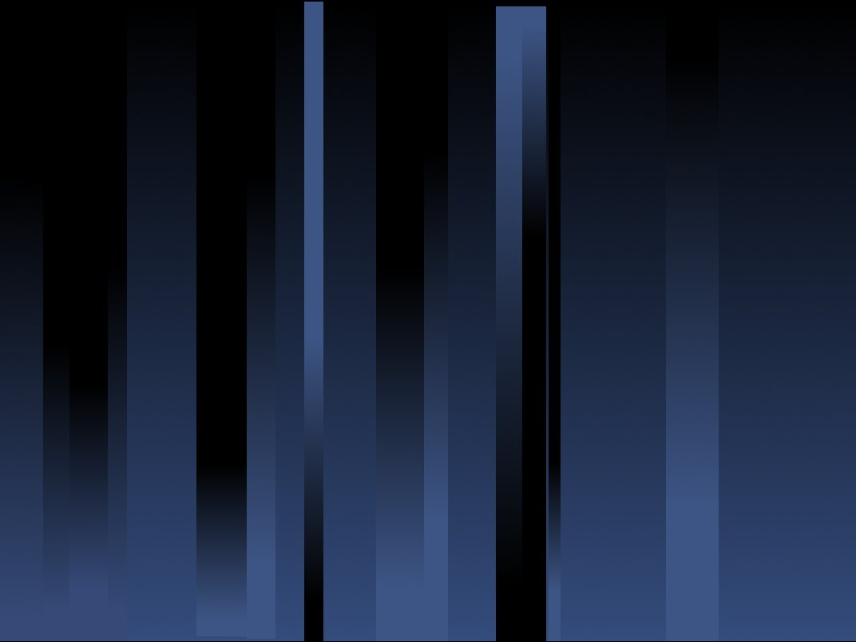
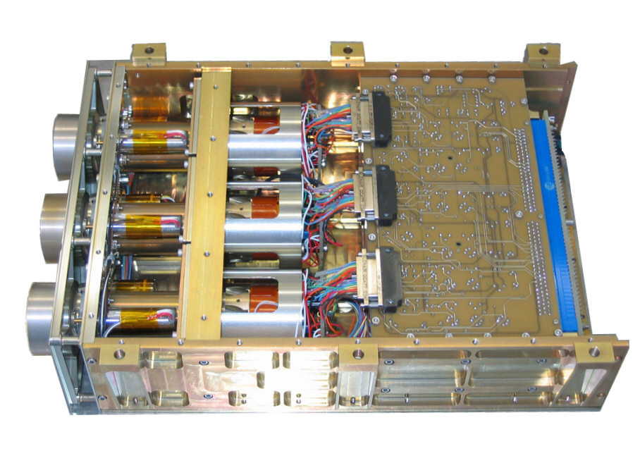
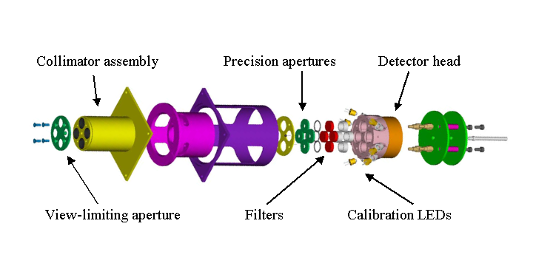
LYRA highlights
 | Ly | Hz | Al | Zr
 | 120-123 nm | 190-222 nm | 17-80 nm + <5nm | 6-20 nm + <2nm
Unit1 | MSM - diamond | PIN- diamond | MSM- diamond | P-N Silicon
Unit2 | MSM- diamond | PIN- diamond | MSM- diamond | MSM- diamond
Unit3 | P-N Silicon | PIN- diamond | P-N Silicon | P-N Silicon
Notes:
λ = 465 nm and 390 nm

Slide 3
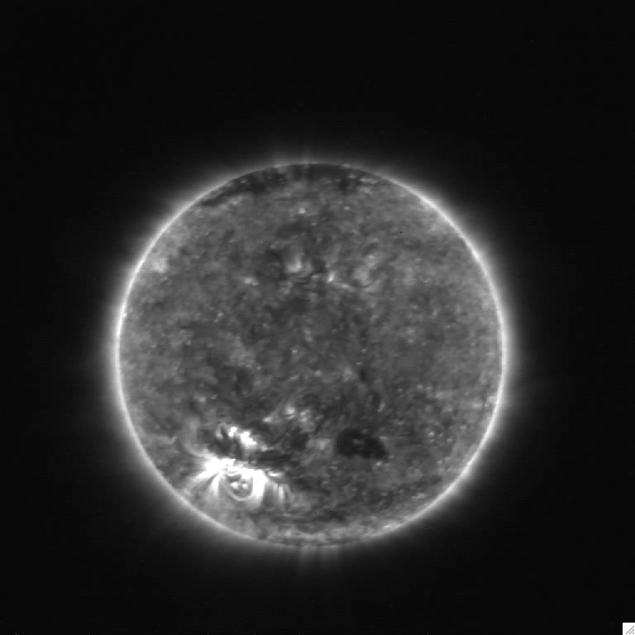
One year of activity
Notes:
3 eclipses: 15/01/2010, 11/07/2010, 04/01/2011

Slide 4
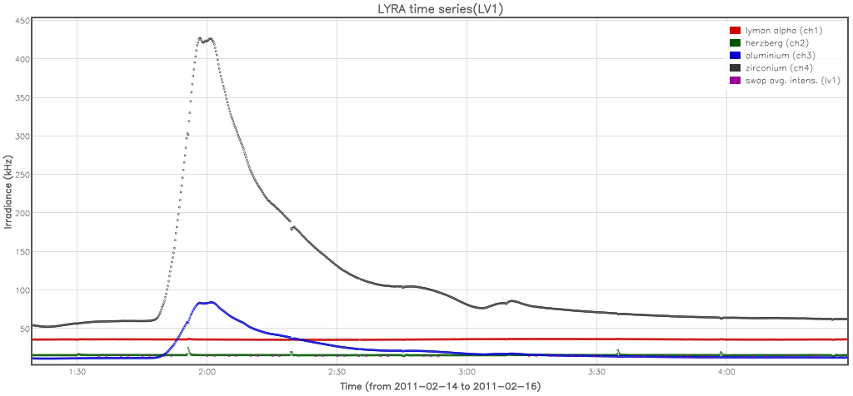
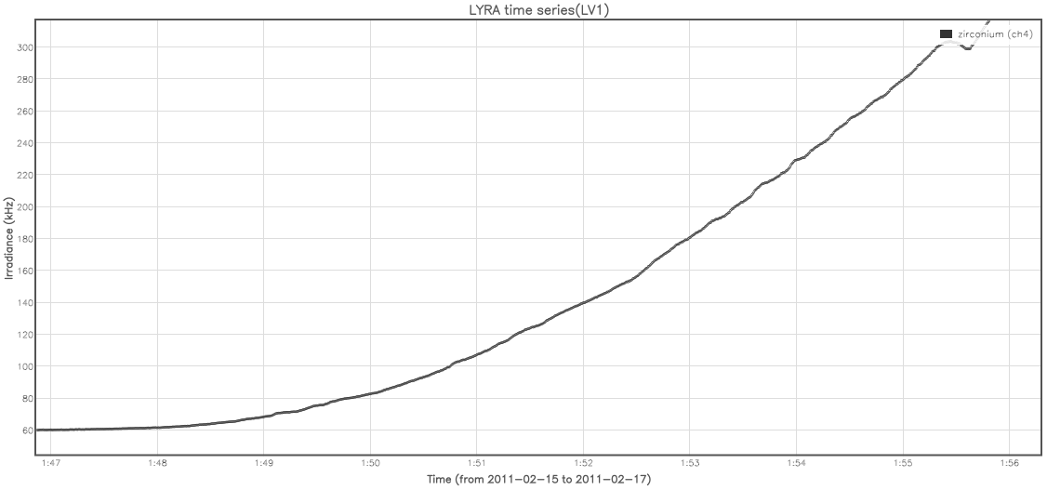
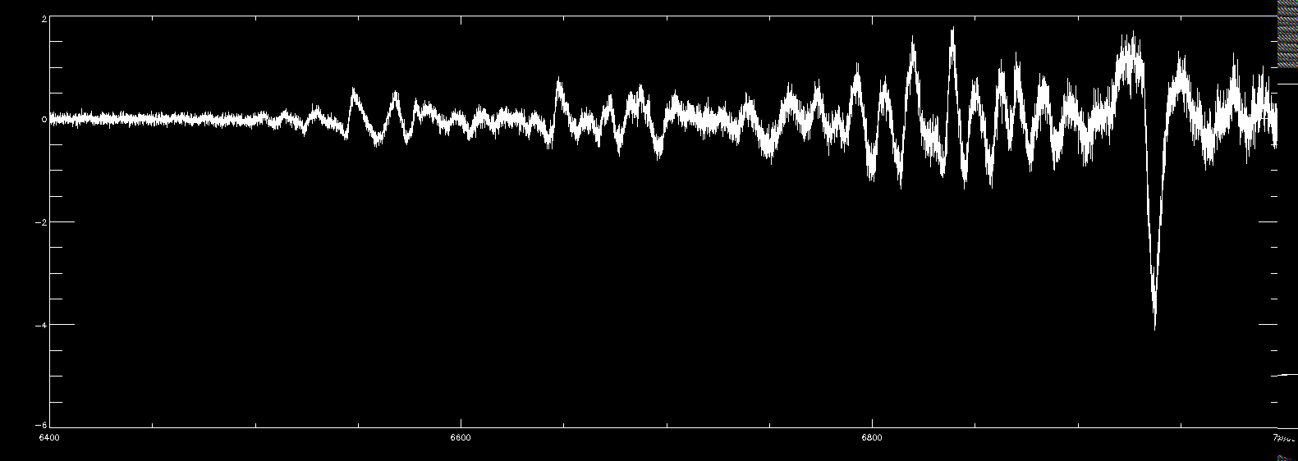
One year of activity

Slide 5
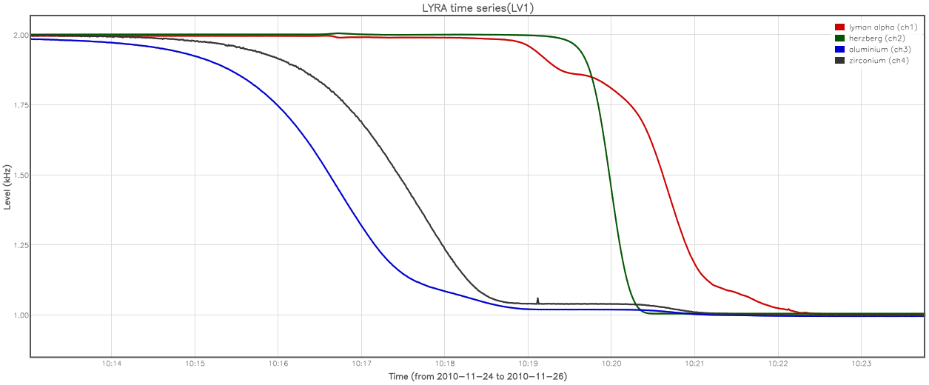
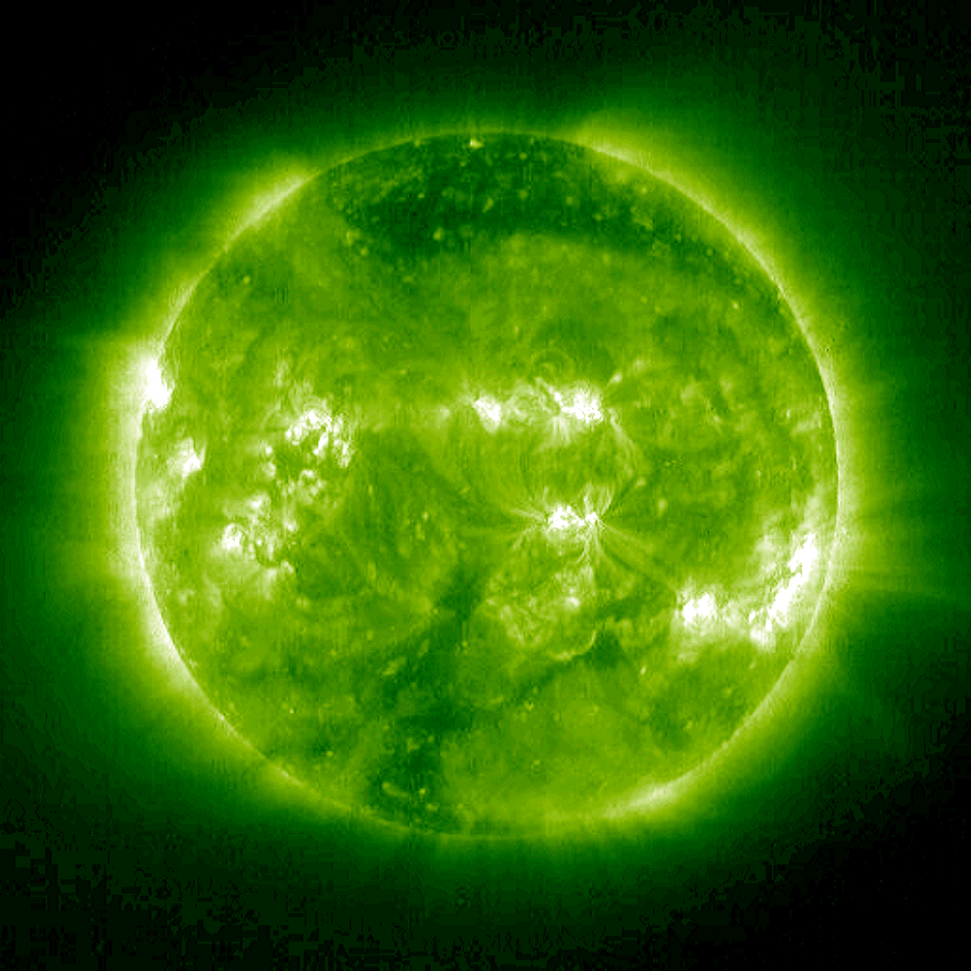
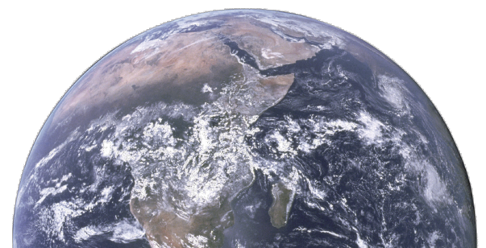
One year of activity

Slide 6
GI program
Kariyappa (Indian Inst. of Astrophysics, Bangalore):
  Analyze the variability in Lyra channels 3 and 4 from SWAP and AIA 304A images
  Determine the energy output of flares
  analyze the dynamics and heating of corona, looking for bright points in SWAP and AIA 193A images
G. Cessateur (LPC2E, Orléans)
  Analysis of the occultation process
  Reconstruction of solar UV irradiance
M. Snow (LASP,Colorado)
  Analysis of unit2 detectors degradation
  Cross–calibration with Sorce/Solstice

Slide 7
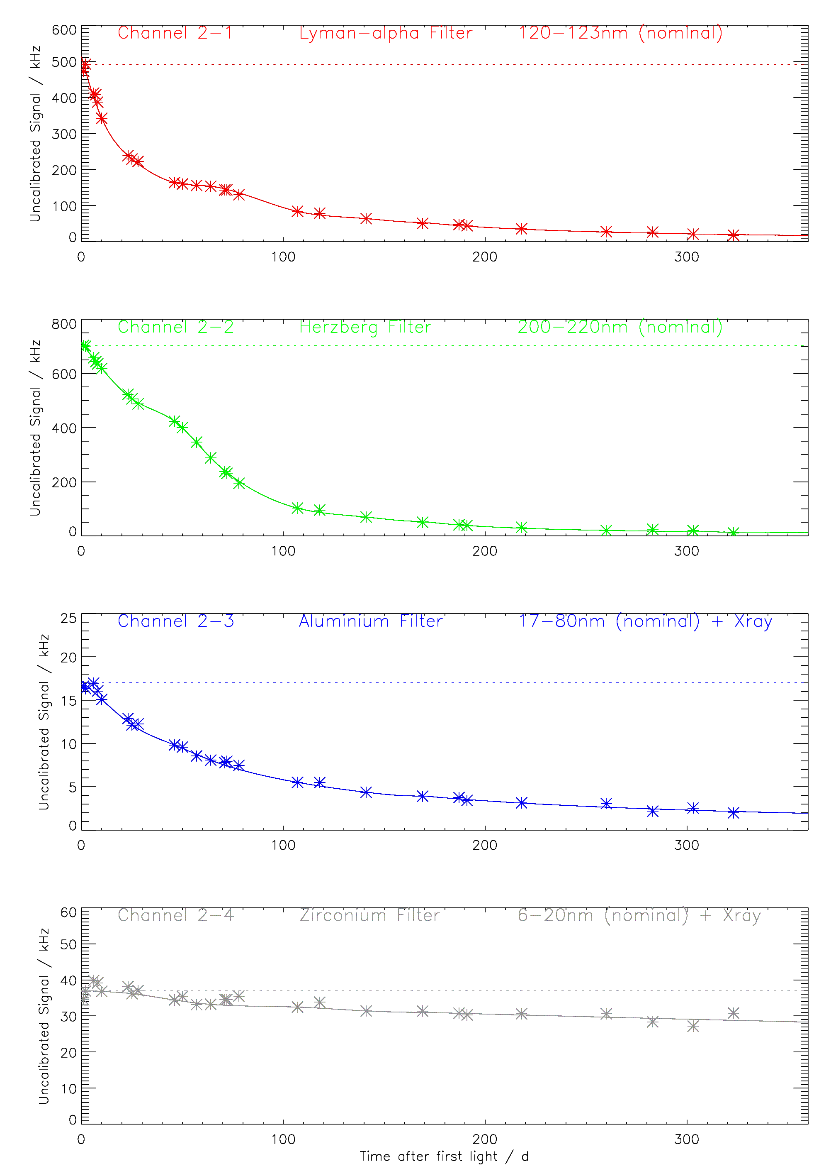
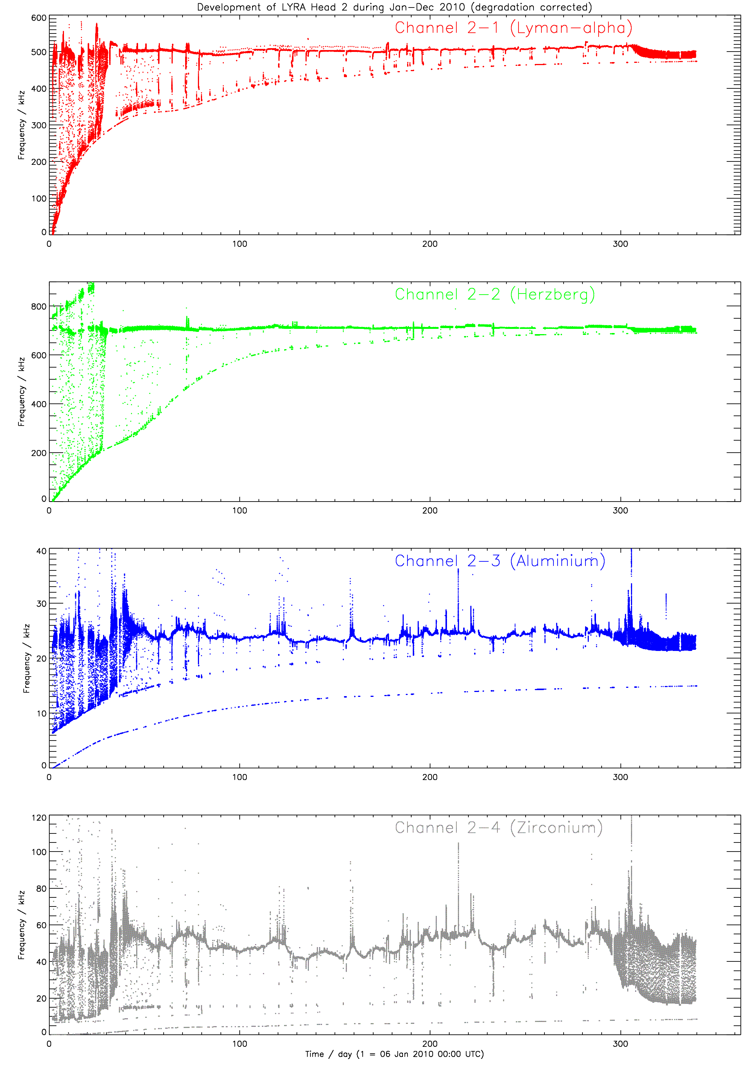
Degradation of unit 2
> 95%
> 95%
~ 90%
~ 25%
Notes:
Now I made some calculations. These Lyman-alpha precursors had a strength above the usual level of the day ("delta irradiance") of approx 1 kHz or less. Channel 2-1 lost approx 96% of its initial strength relative to First Light day (492 kHz), and about 90% of its strength since begin-February (~ 224 kHz) when we observed the few precursors. Now we are around ~ 27 kHz. Consequently, the delta irradiance of a flare precursor would now also be 10% of its strength as measured in February, thus below 0.1 kHz.
The (thermal, electronic?) noise observed in an arbitrary interval in February (08 Feb 2010, 13:45 UTC) was varying between 11242 and 11230 counts, i.e. 224.84 to 224.60 kHz, or 0.24 kHz. A delta signal of 1 kHz was significantly higher that that, therefore we were able to see it, e.g. here:
http://solwww.oma.be/users/dammasch/flare7650.eps
The noise observed in an arbitrary interval in December (01 Dec 2010, 05:30 UTC) was varying between 1255 and 1262 counts, or 25.10 to 25.24 kHz, or 0.14 kHz. An expected delta signal of 0.1 kHz from a flare precursor would not be discernible in this kind of noise any longer.
In other words, even if there are still flare precursors in Lyman alpha, we will not be able to see them any more, because they are hidden by the detector noise.

Slide 8
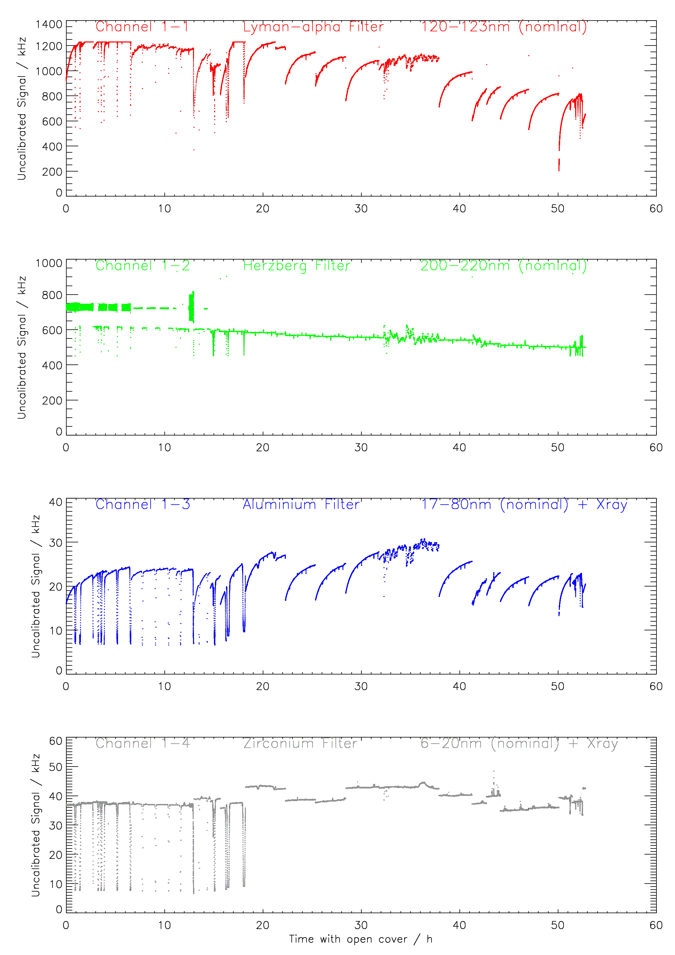
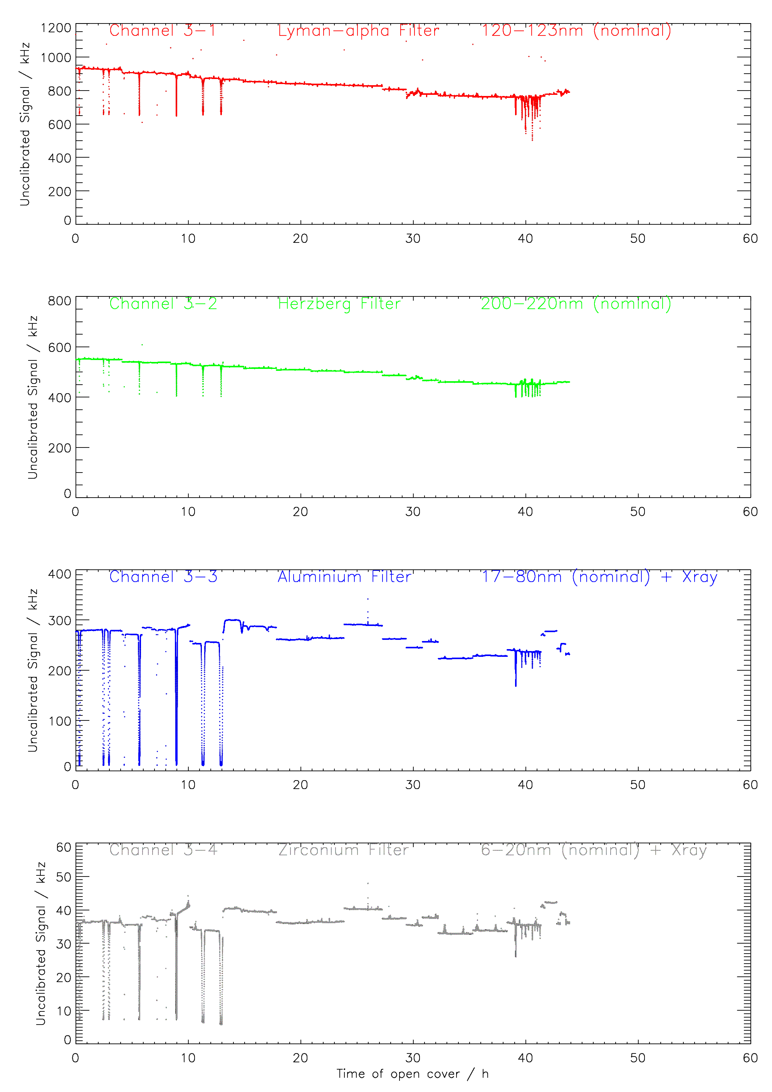
Degradation of units 1 and 3
30%
10%
15%
20%
10%
/
/
/
Notes:
Now I made some calculations. These Lyman-alpha precursors had a strength above the usual level of the day ("delta irradiance") of approx 1 kHz or less. Channel 2-1 lost approx 96% of its initial strength relative to First Light day (492 kHz), and about 90% of its strength since begin-February (~ 224 kHz) when we observed the few precursors. Now we are around ~ 27 kHz. Consequently, the delta irradiance of a flare precursor would now also be 10% of its strength as measured in February, thus below 0.1 kHz.
The (thermal, electronic?) noise observed in an arbitrary interval in February (08 Feb 2010, 13:45 UTC) was varying between 11242 and 11230 counts, i.e. 224.84 to 224.60 kHz, or 0.24 kHz. A delta signal of 1 kHz was significantly higher that that, therefore we were able to see it, e.g. here:
http://solwww.oma.be/users/dammasch/flare7650.eps
The noise observed in an arbitrary interval in December (01 Dec 2010, 05:30 UTC) was varying between 1255 and 1262 counts, or 25.10 to 25.24 kHz, or 0.14 kHz. An expected delta signal of 0.1 kHz from a flare precursor would not be discernible in this kind of noise any longer.
In other words, even if there are still flare precursors in Lyman alpha, we will not be able to see them any more, because they are hidden by the detector noise.

Slide 9
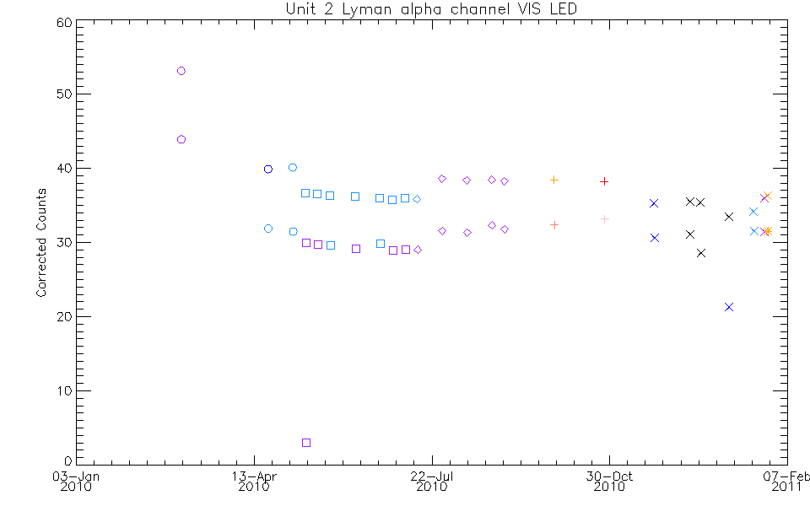
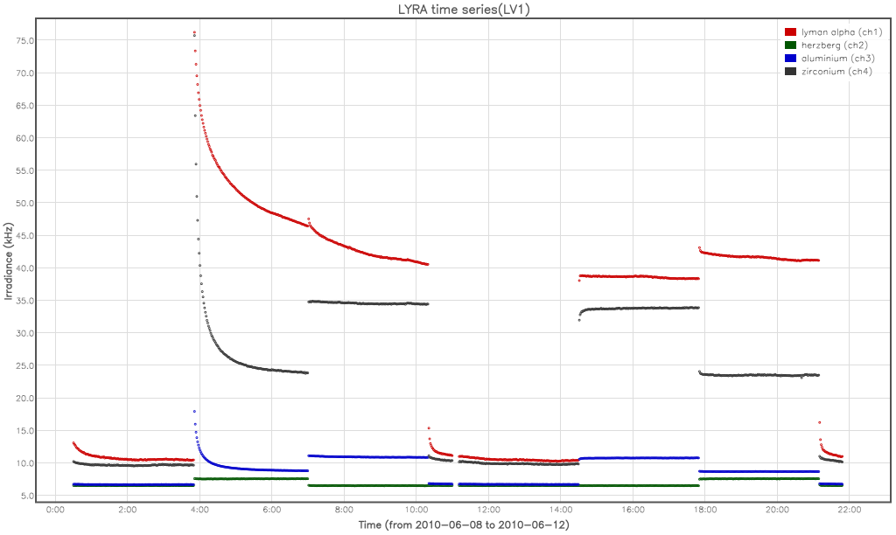
LED signal time series
Very little change of detector output when illuminated by LED over the mission.
Bimodal appearance is due to systematic difference between first and second measurements during each observing sequence.
Low detector degradation,
if any

Slide 10
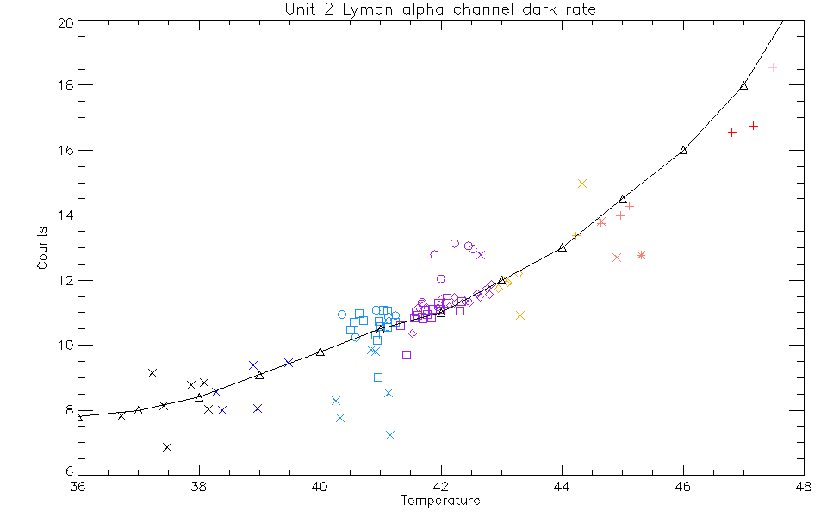
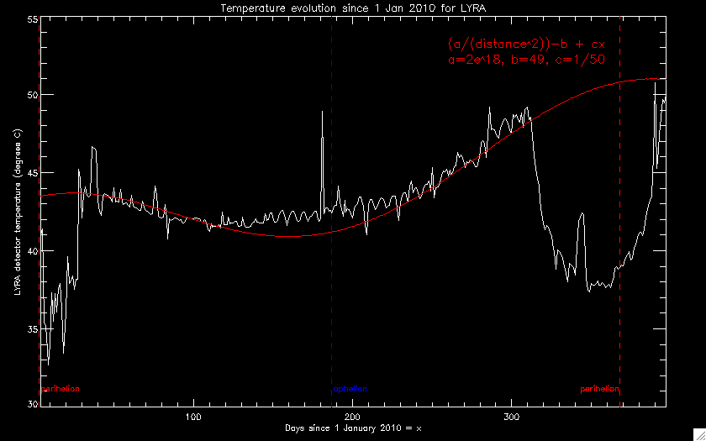
Temperature evolution
Dark current in Lyman alpha
Temperature evolution
I. Dammasch + M. Snow
A. De Groof
Notes:
Augmentation de 6,3-6,7°

Slide 11
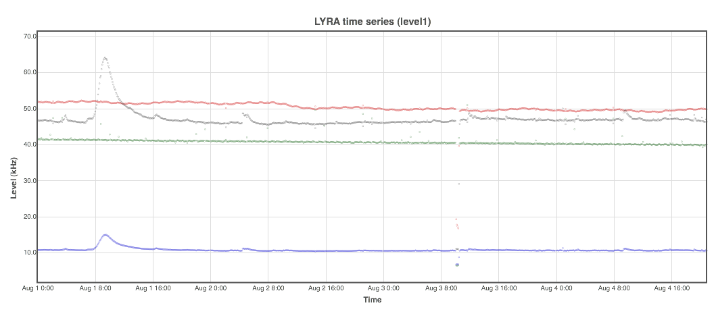
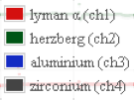
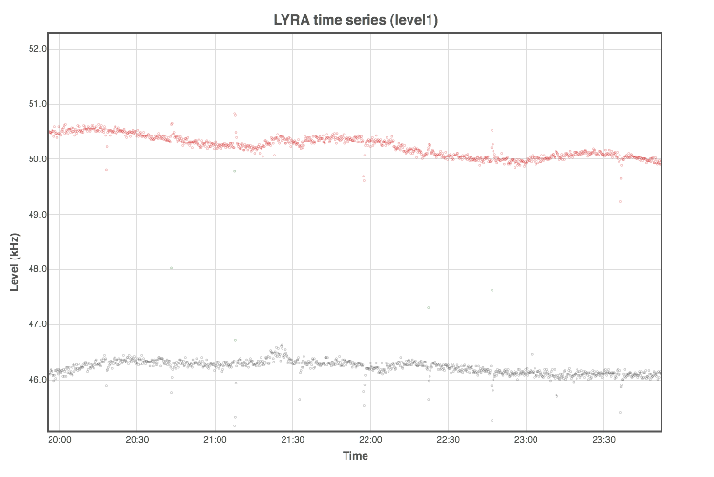
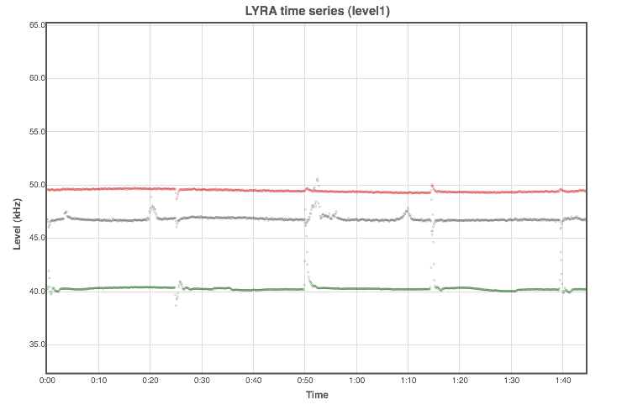
Impact of the particle environment

Slide 12
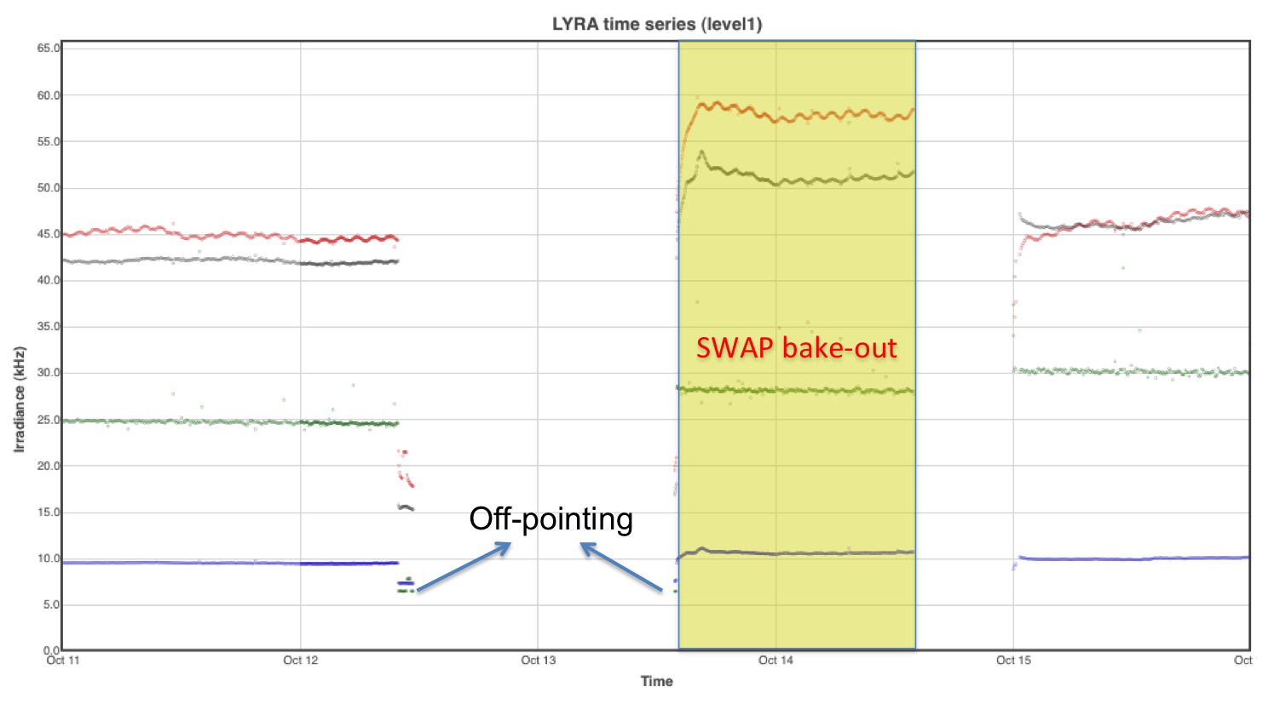
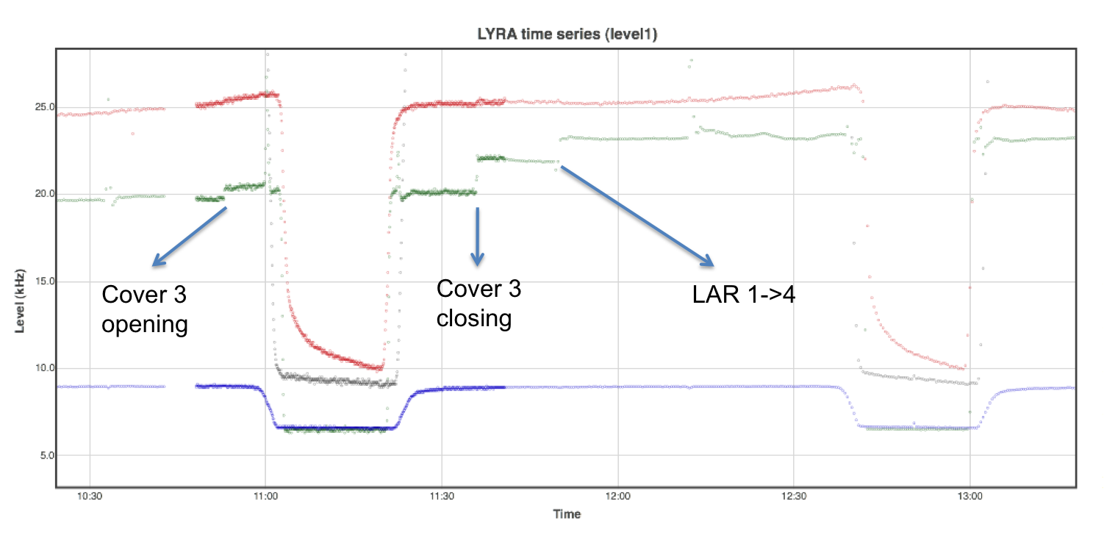
Jumps
jumps in unit 2 herzberg channel (and zirconium in a couple of occasions)
from the beginning of the mission
amplitude of a few kHz
complicates the calibration
hides solar variability
usually associated to spacecraft maneuvres or cover movement

Slide 13
State of the data processing pipeline
Telemetry packets
Current state
Not distributed
LY-TMR:
Raw data (in counts)
fits
After each
contact
LY-EDG
fits
fits
http://proba2.sidc.be/
Lv1: Engineering data (in Hz)
Reprocessed data available
LY-BSDG
fits
After each
contact
Lv2: Calibrated data
(in W/m²)
Other tools
Higher level
data products
Plots + flare list
irregularly
Notes:
What is corrected in the data, and what remains
13

Slide 14
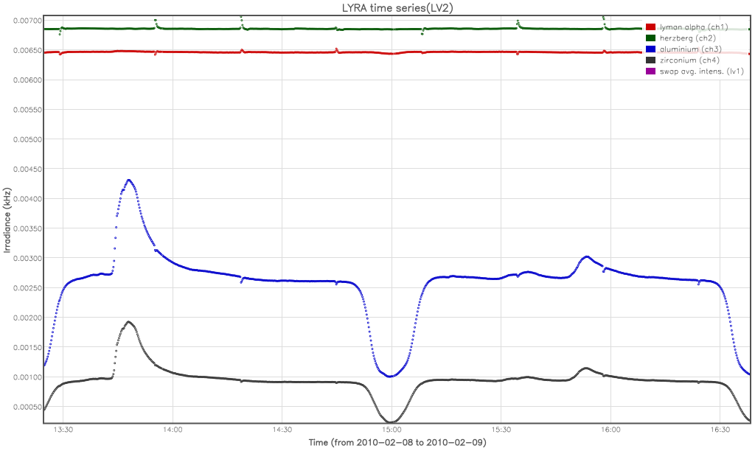
Calibrated data
Calibration process:
  Dark current removed
  Degradation substracted
  Conversion into physical units
  Still in the data
    Flat-field effects
Hz channel * 0.01 !

Slide 15
Timeline
Proposal
Mission Development
Launch
2002
2004
2006
2008
2010
2012
Engineering
data available
First light
paper
Launch
First Light
Guest Investigators
11/2009
01/2010
03/2010
05/2010
07/2010
09/2010
11/2010
01/2011
03/2011
05/2011
07/2011
Commissioning
Notes:
Publication of first light paper
Mise en ligne des données processées
Détection de flare automatique

Slide 16












Collaborations

