Slide 1


SWAP onboard PROBA2, a new EUV imager for solar physics
D. Berghmans and the SWAP team
Royal Observatory of Belgium

Slide 2
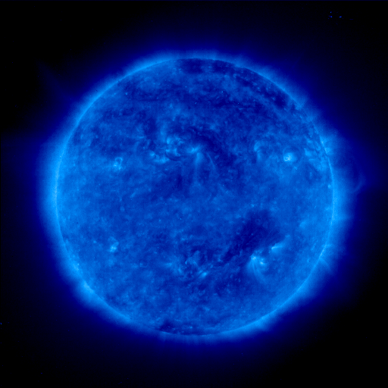
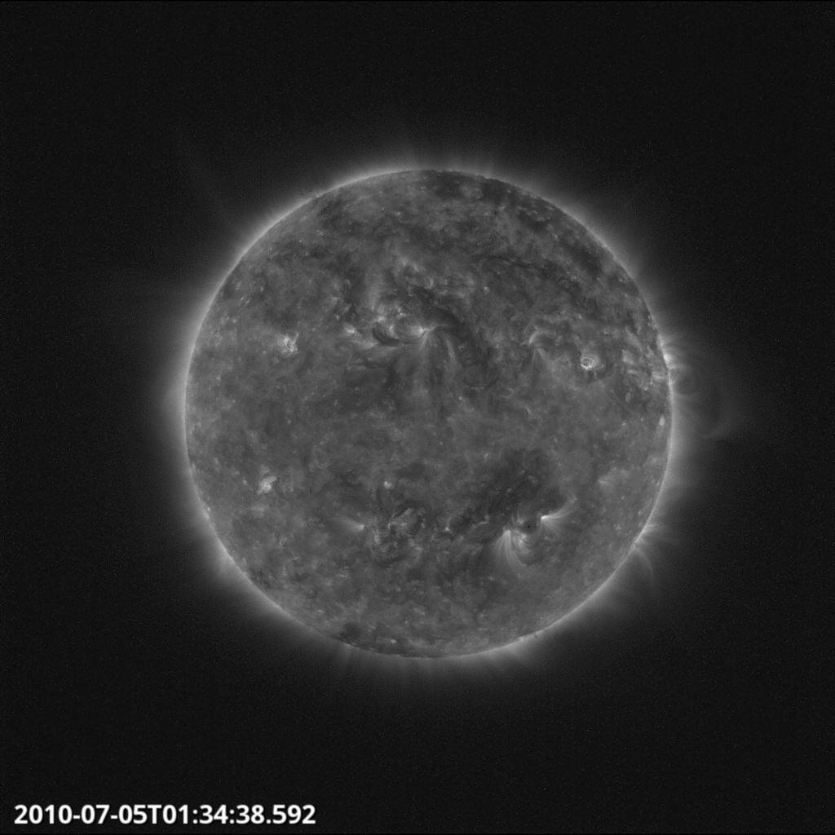
EIT
SWAP

Slide 3
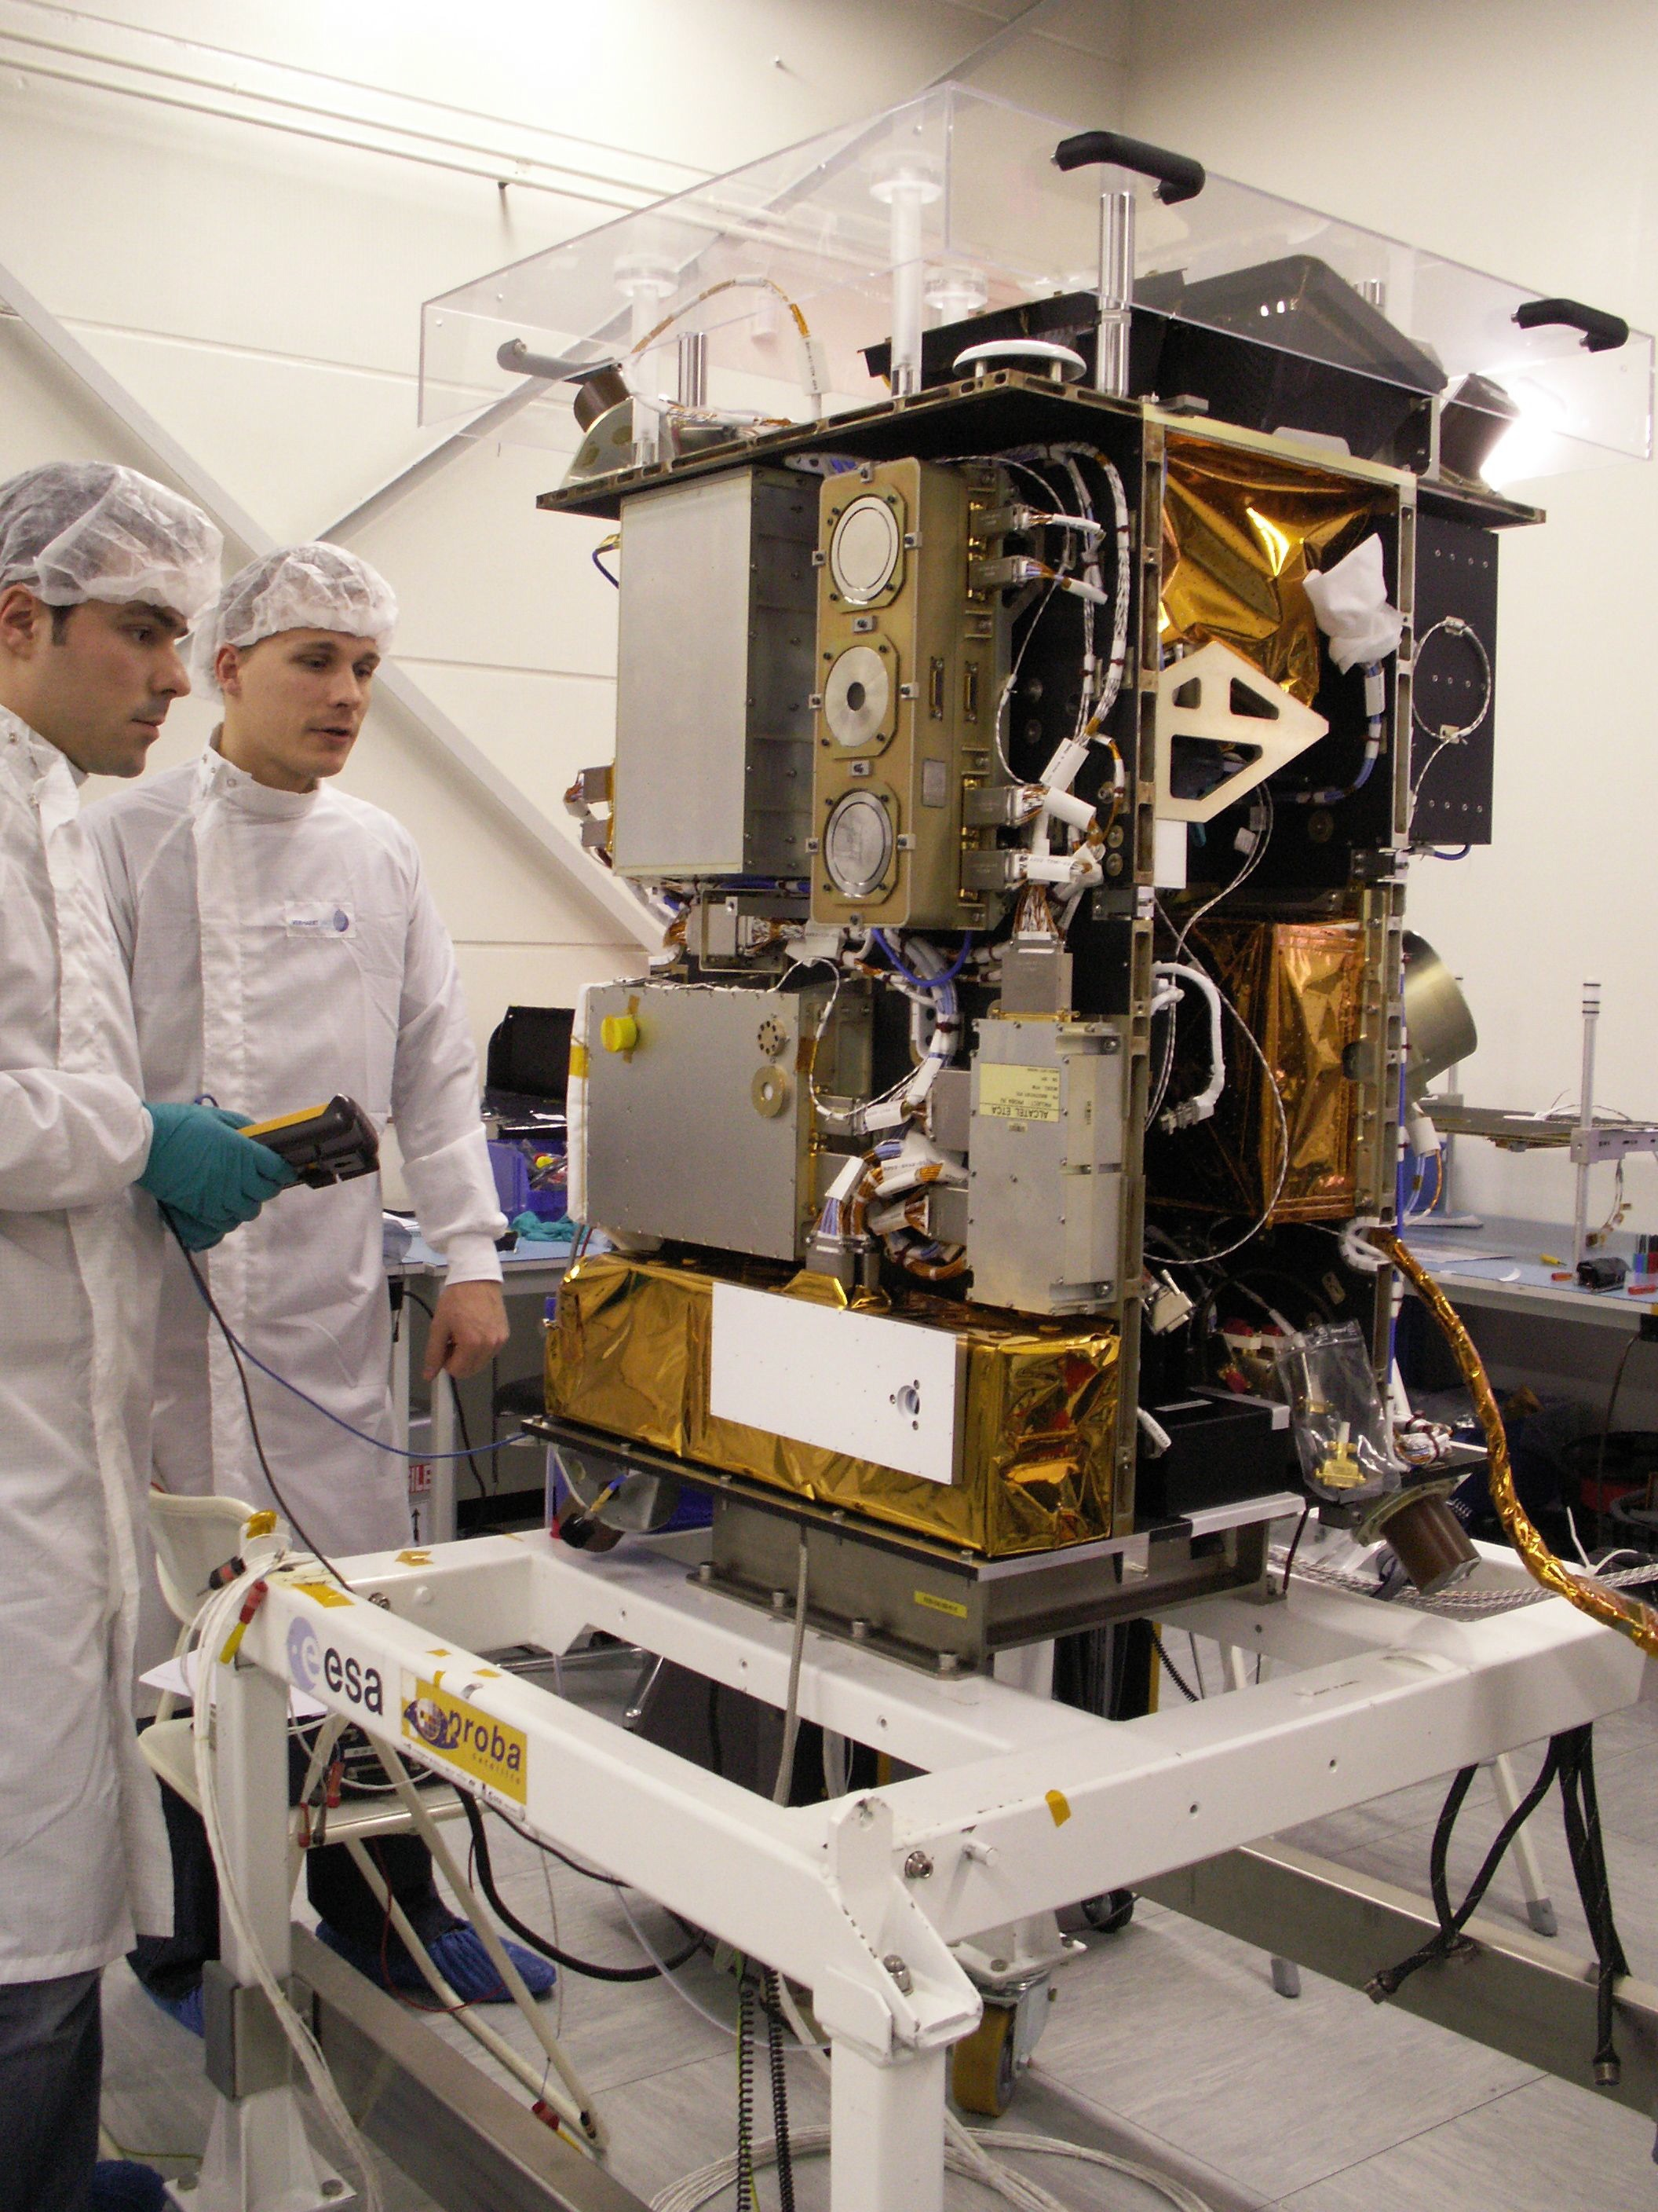
ESA technology demonstration satellite
Dual Segmented Langmuir Probe (DSLP)
Thermal Plasma Measurement Unit (TMPU)
Lyman alpha radiometer (LYRA)
SUN WATCHER USING APS AND IMAGE PROCESSING (SWAP)
Notes:
Second mission objective: space weather monitoring

Slide 4
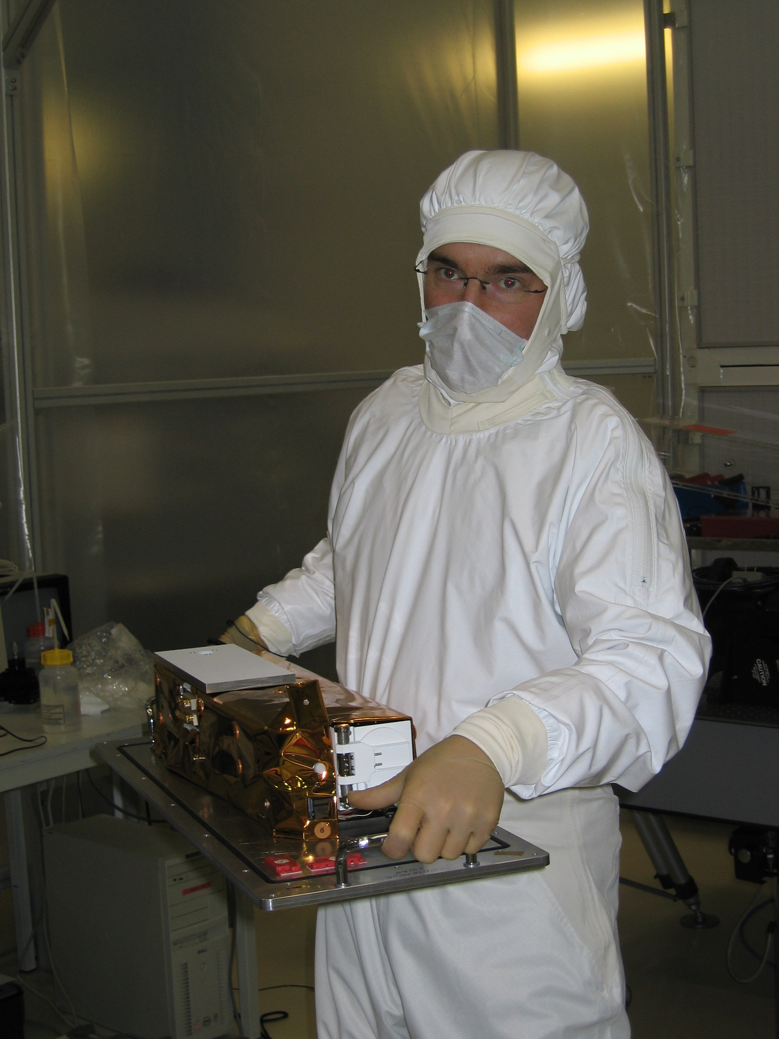
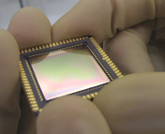
SWAP innovation
10 kg
60cm long
3 Watt
Notes:
CMOS detector, first in space for solar physics
Off-axis design
Lightweight INVAR optical bench
No-shutter
33 mm diameter entrace pupil, focal length 1173 mm

Slide 5
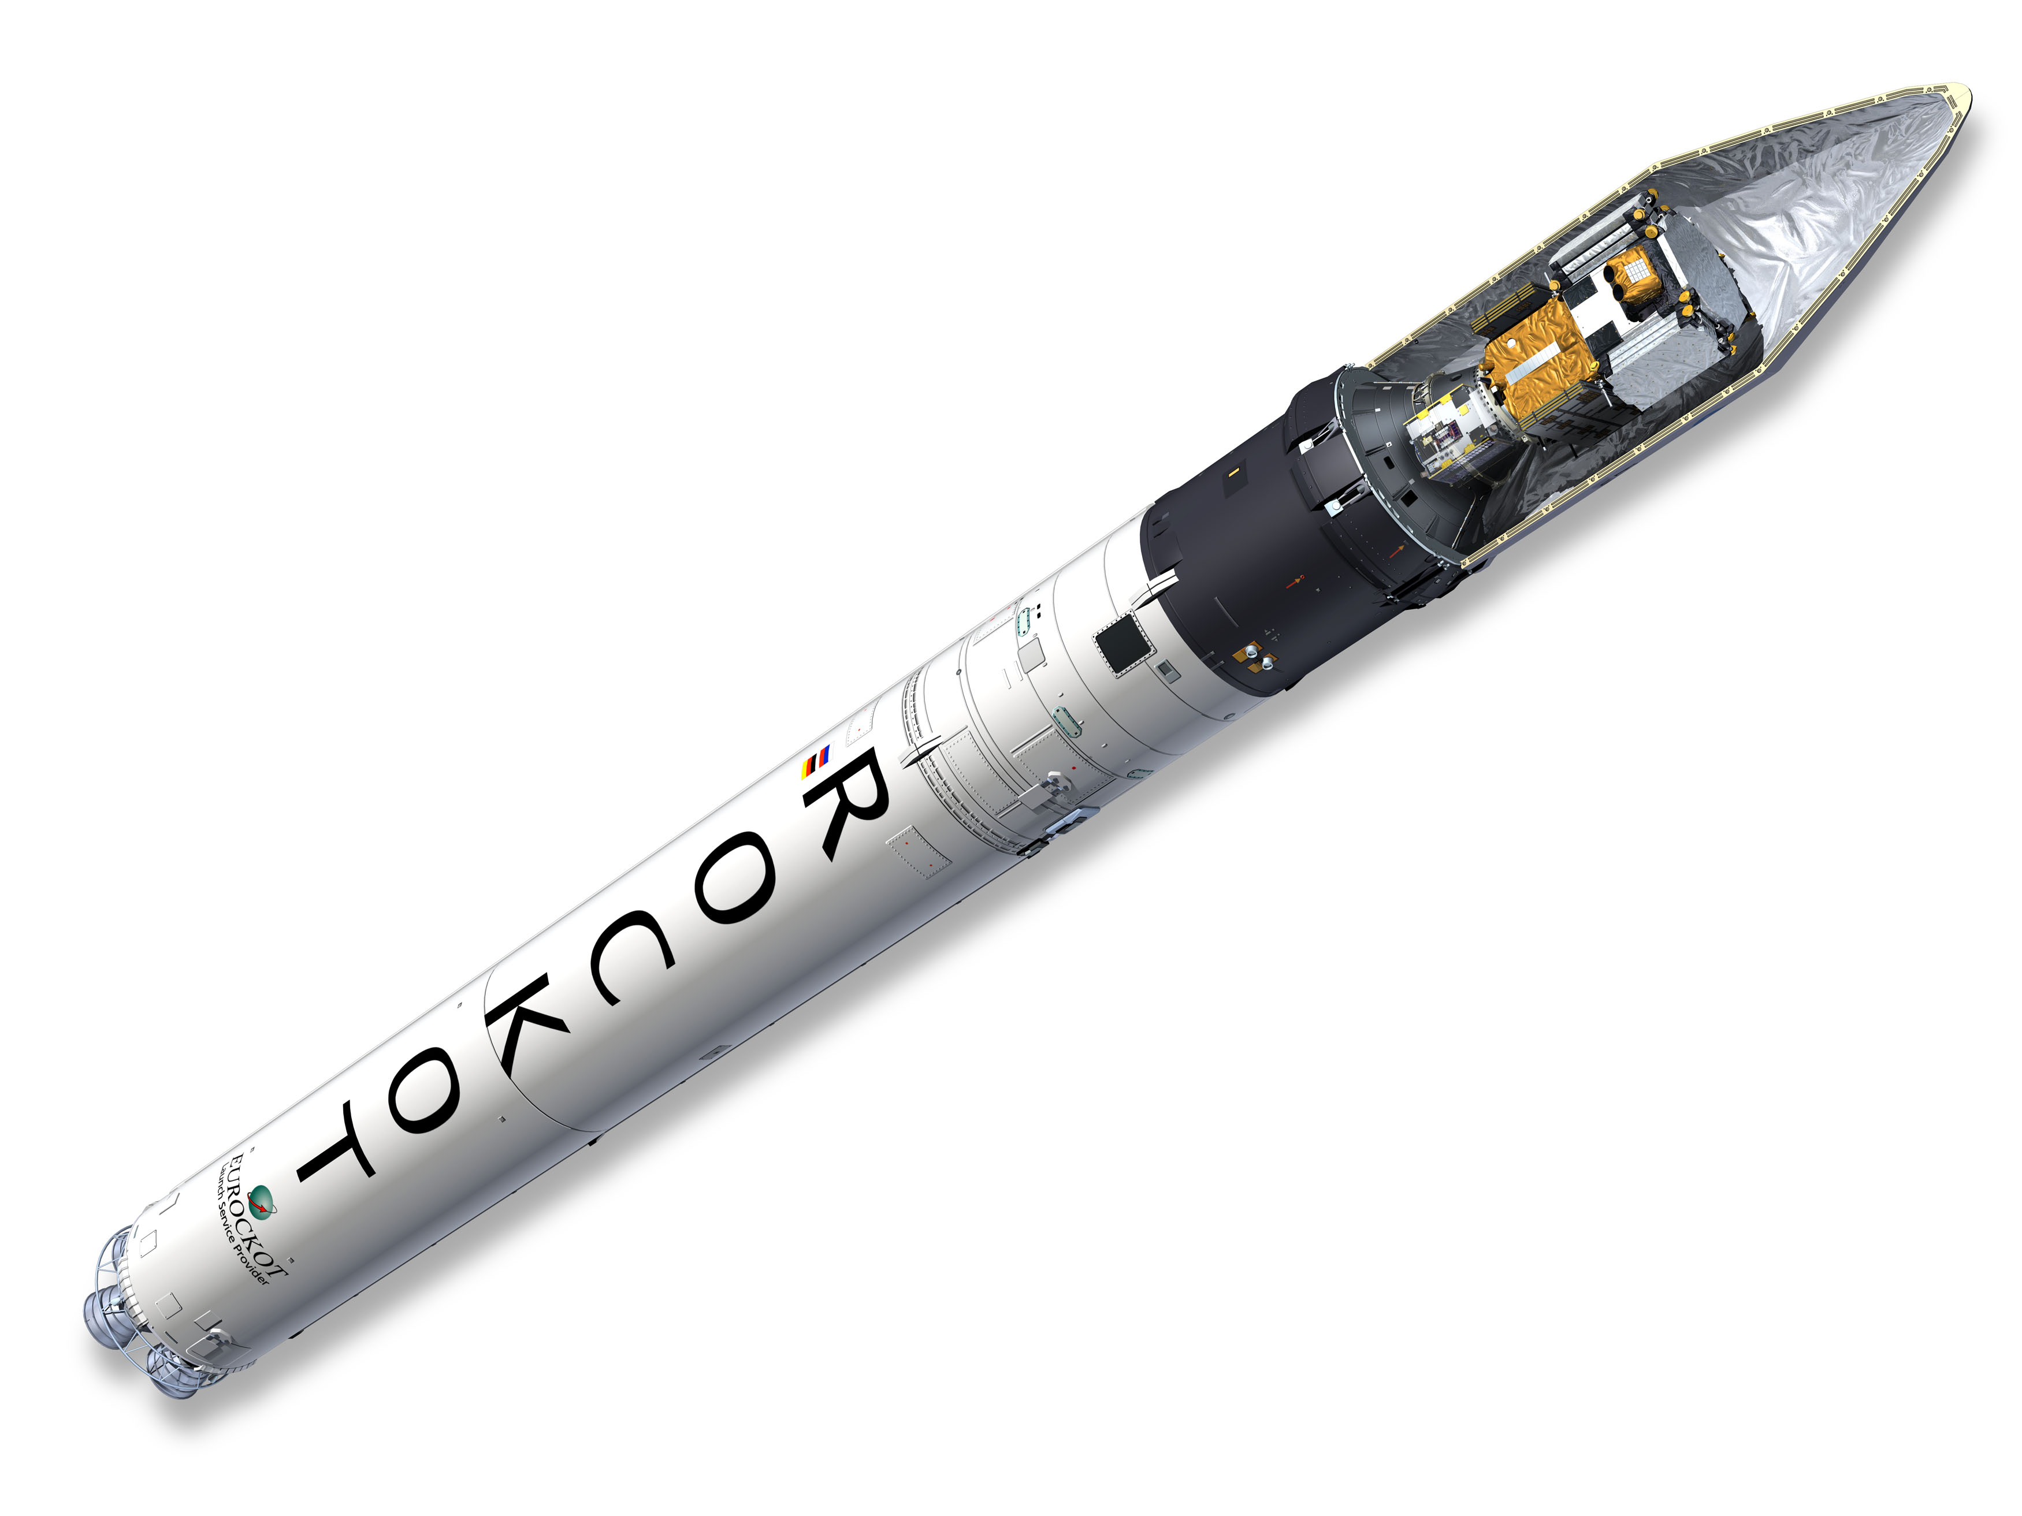
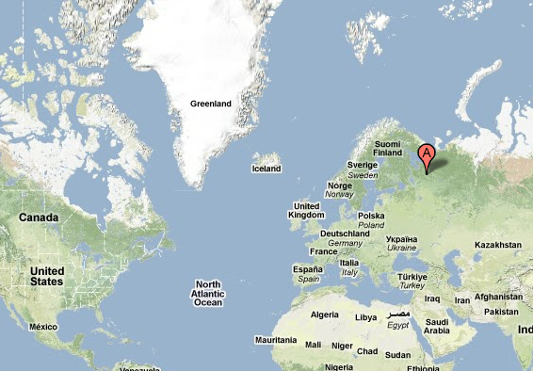
Eurockot Launch Nov 2010
SMOS
Plesetsk
PROBA2
Notes:
Low earth sun synchronous orbits, eclipse season Nov-Jan.

Slide 6
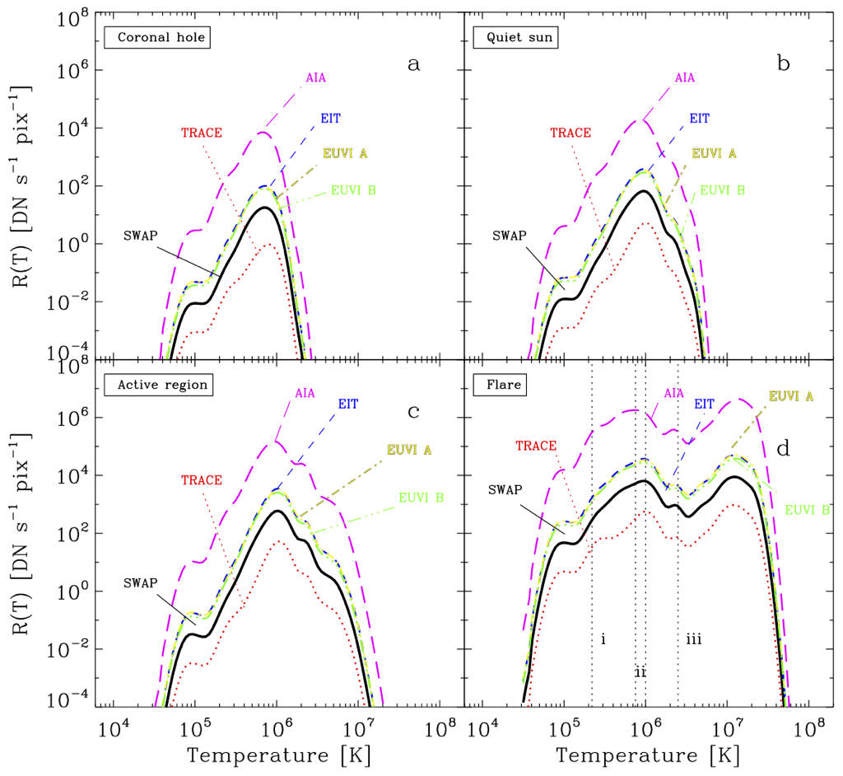
Band- pass
C. Raftery (TCD)

Slide 7
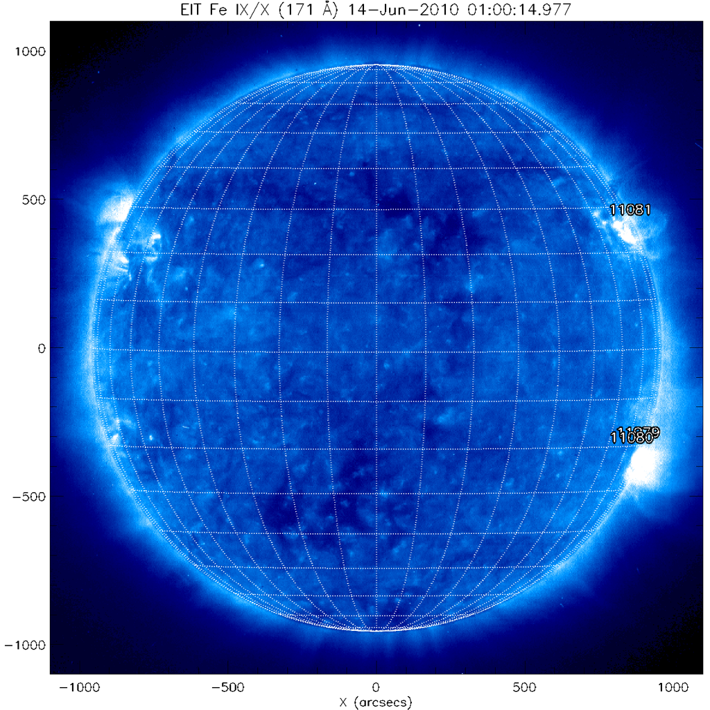
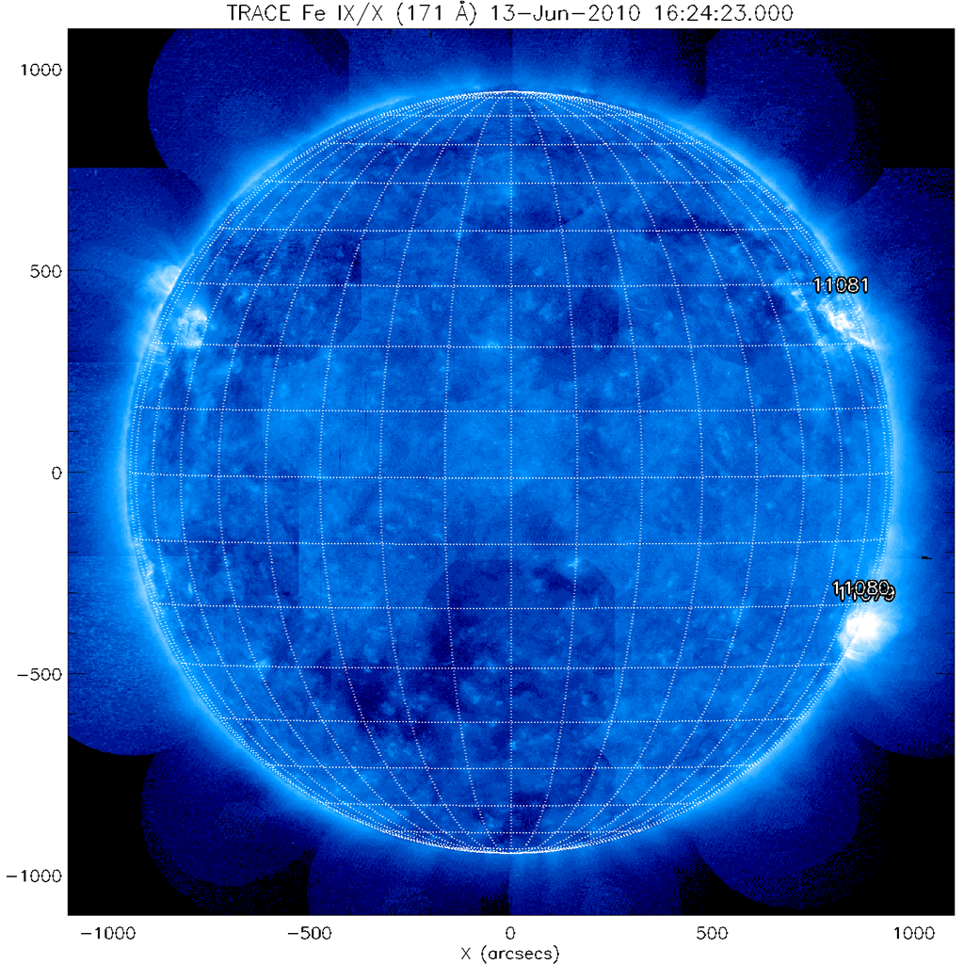
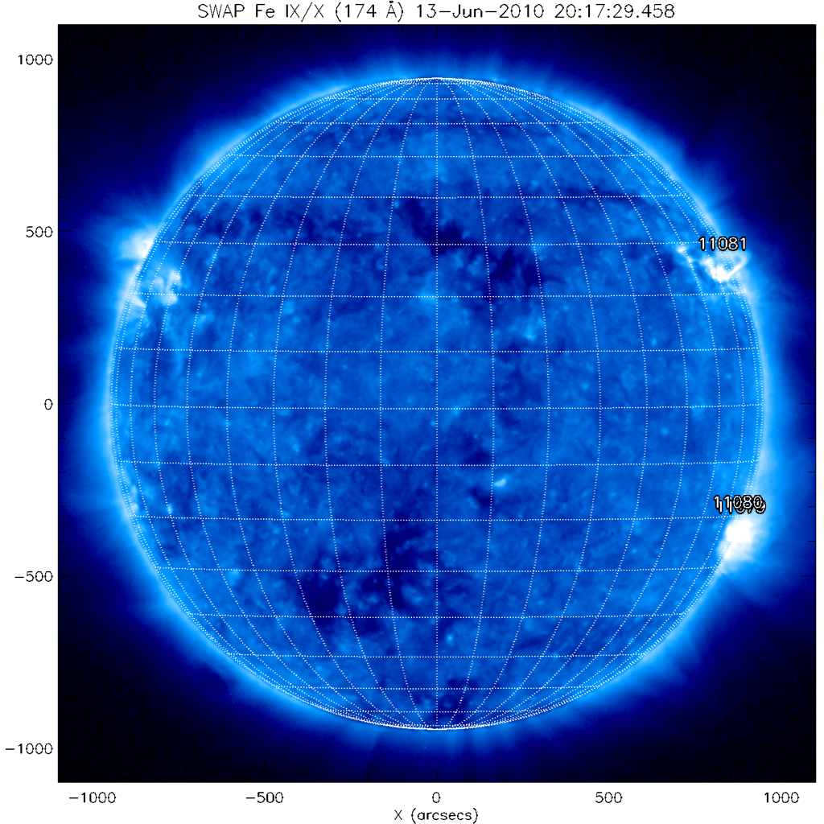
EIT
TRACE
SWAP
http://www.solarmonitor.org

Slide 8
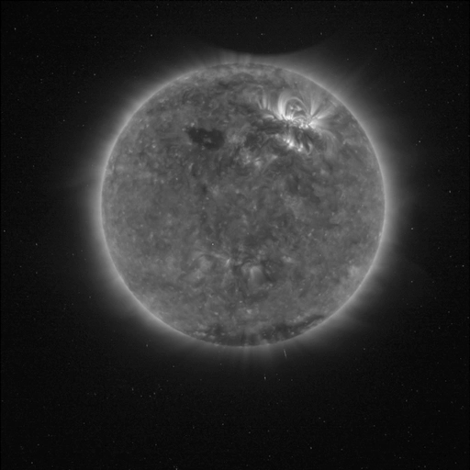
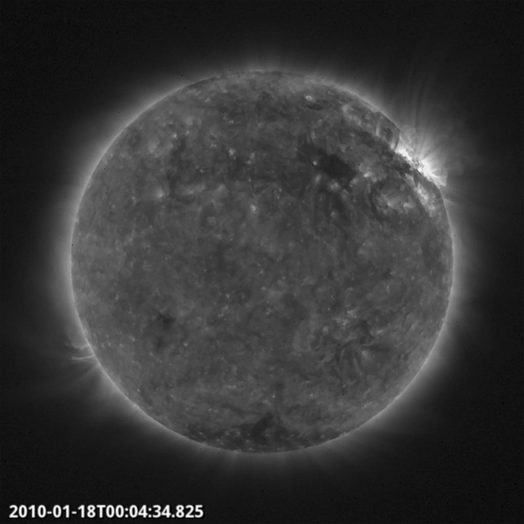
January 15 eclipse
First M flare of new cycle

Slide 9
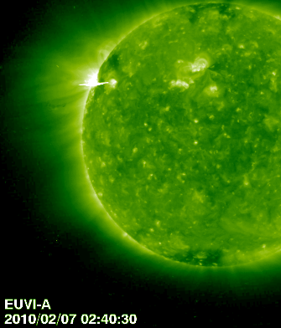
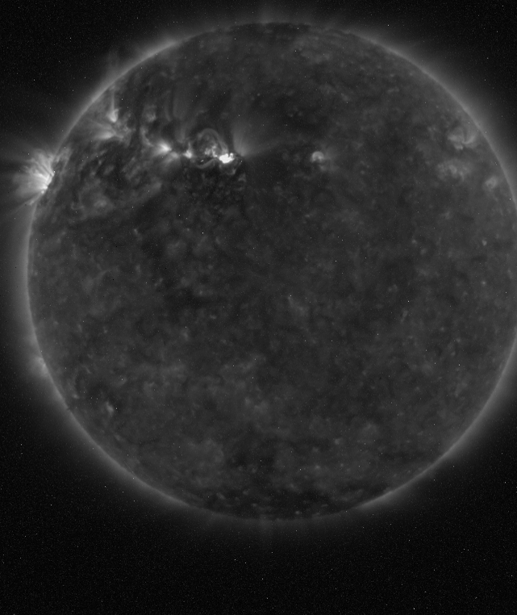

Slide 10
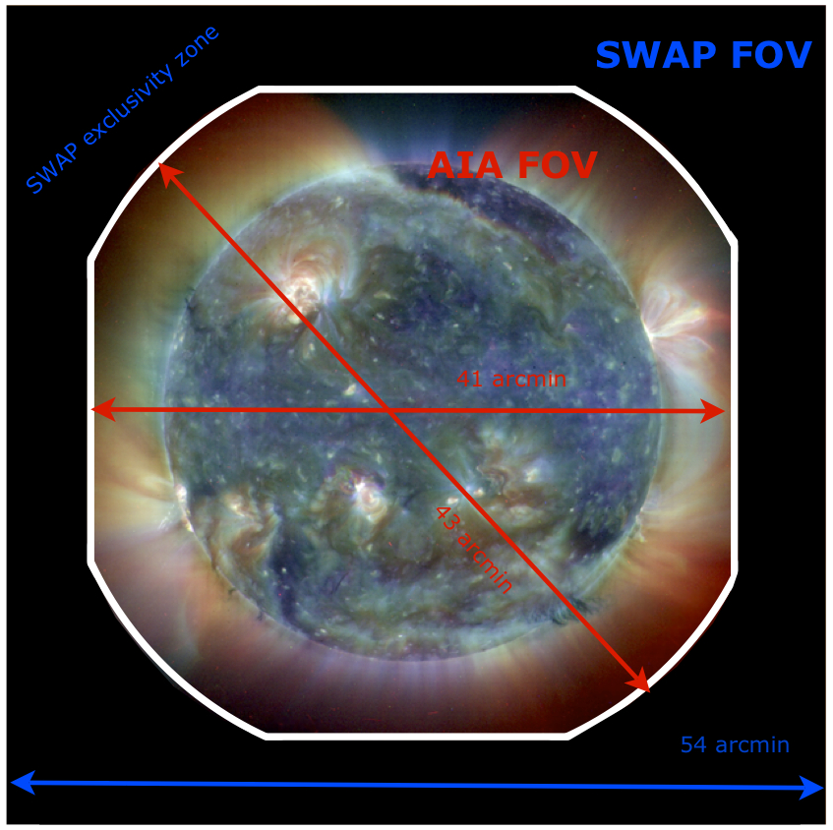

Slide 11
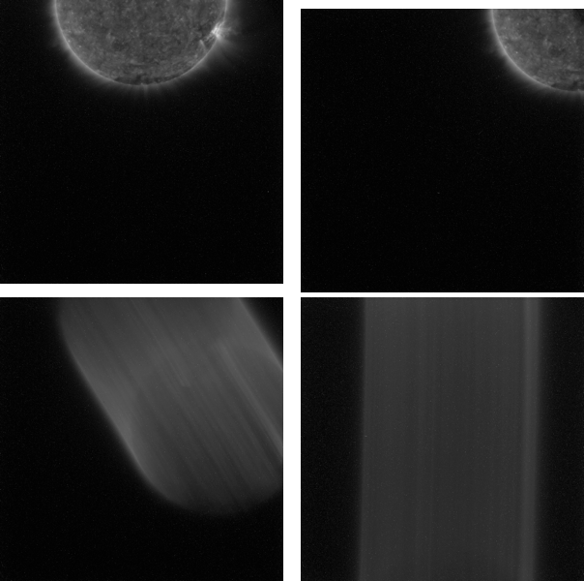
Off-Pointing

Slide 12
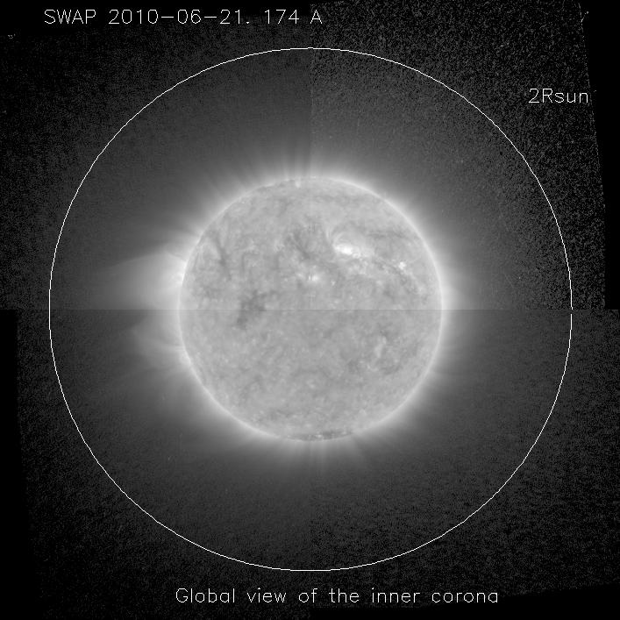
Work by Vladimir Slemzin (Lebedev)
Notes:
Eclipse of July 11

Slide 13
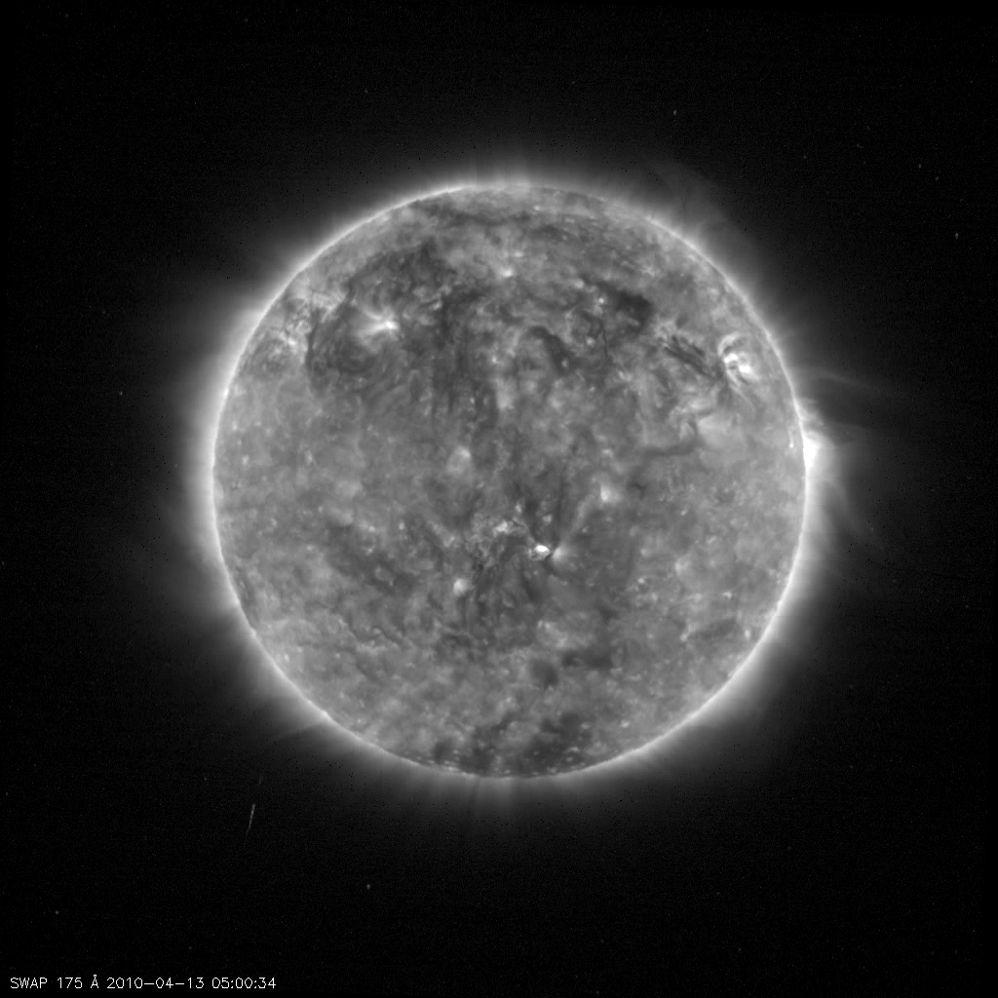
April 13

Slide 14
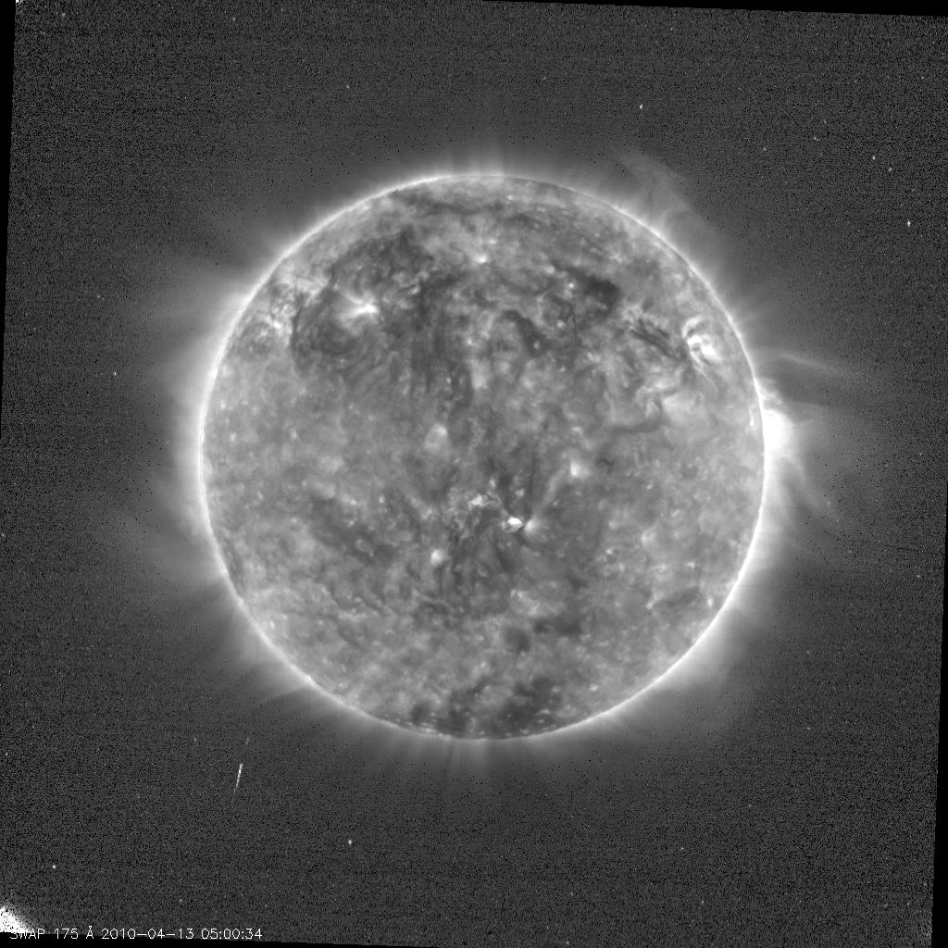
April 13

Slide 15
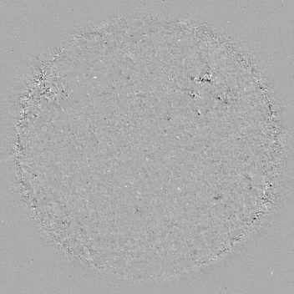
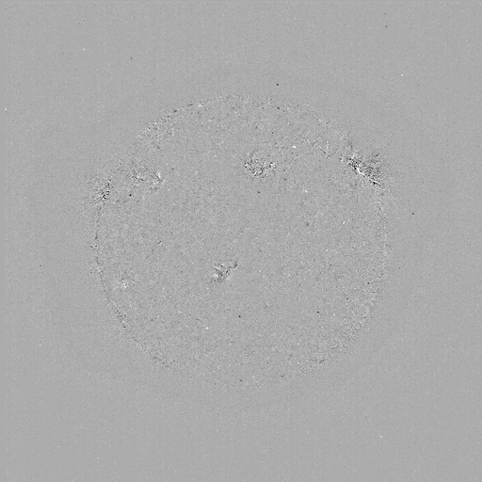
EIT waves
EUV jets
Notes:
February 2010

Slide 16
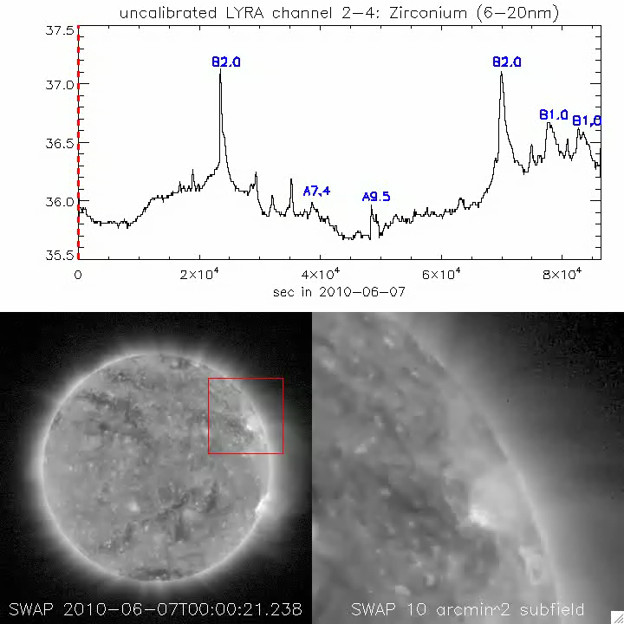

Slide 17
Operations
Commanded from ROB
Nominal: 2min cadence, sun pointing
Image cadence 5s – 2min, subfields
Off-pointing on request within a few hours
Data latency few hours

Slide 18
Data distribution
Open data policy
Daily movies, latest image, documentation
http://proba2.sidc.be
Level 0 data: raw, engineering FITS files
http://proba2.sidc.be/swap/data/eng/yyyy/mm/dd
Level 1 data: calibrated, science FITS files
http://proba2.sidc.be/swap/data/bsd/yyyy/mm/dd
swap_lyra@oma.be

Slide 19



Thanks
Centre Spatial de Liege
European Space Agency
Belgian Science Policy Office
swap_lyra@oma.be

